Slide 2
I will set no wicked thing before
mine eyes.
Psalm 101:3

Slide 3
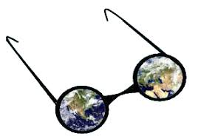
WORLDVIEW
We all have a lens through which we look and interpret life and our world.

Slide 4
Christ compels us to have a biblical worldview. We must view all of life through the lens of Scripture.
The bottom line is
what does God say.

Slide 5
Worldview answers basic questions:
Where did we come from and
why are we here?
What went wrong with the world?
How can we fix it?

Slide 6
A biblical worldview gives rise to a firm belief in moral absolutes,
human dignity, and the
possibility of redemption.

Slide 7
We want to be
biblically accurate
but culturally relevant.

Slide 8
Behaviors come from our VALUES and our values are based on what we BELIEVE.

Slide 9
BEHAVIOR
What and how do they eat?
How do they greet each other?
How do genders interact with each other?
How do they dress?

Slide 10
VALUES
Pre-set decisions that help those who live within a culture to know what “should” or “ought” to be done to “fit” in or conform to a pattern of life.

Slide 11
BELIEFS
What is true?
As Christ-followers, we hold the Scriptures to be true.
Thus, we must be systematic students of the Word.

Slide 12
Our beliefs are based on our worldview or what is real.
This returns to the
basic questions.

Slide 13
How does the Kwast framework help you understand the context of the culture in which you live?

