Slide 1
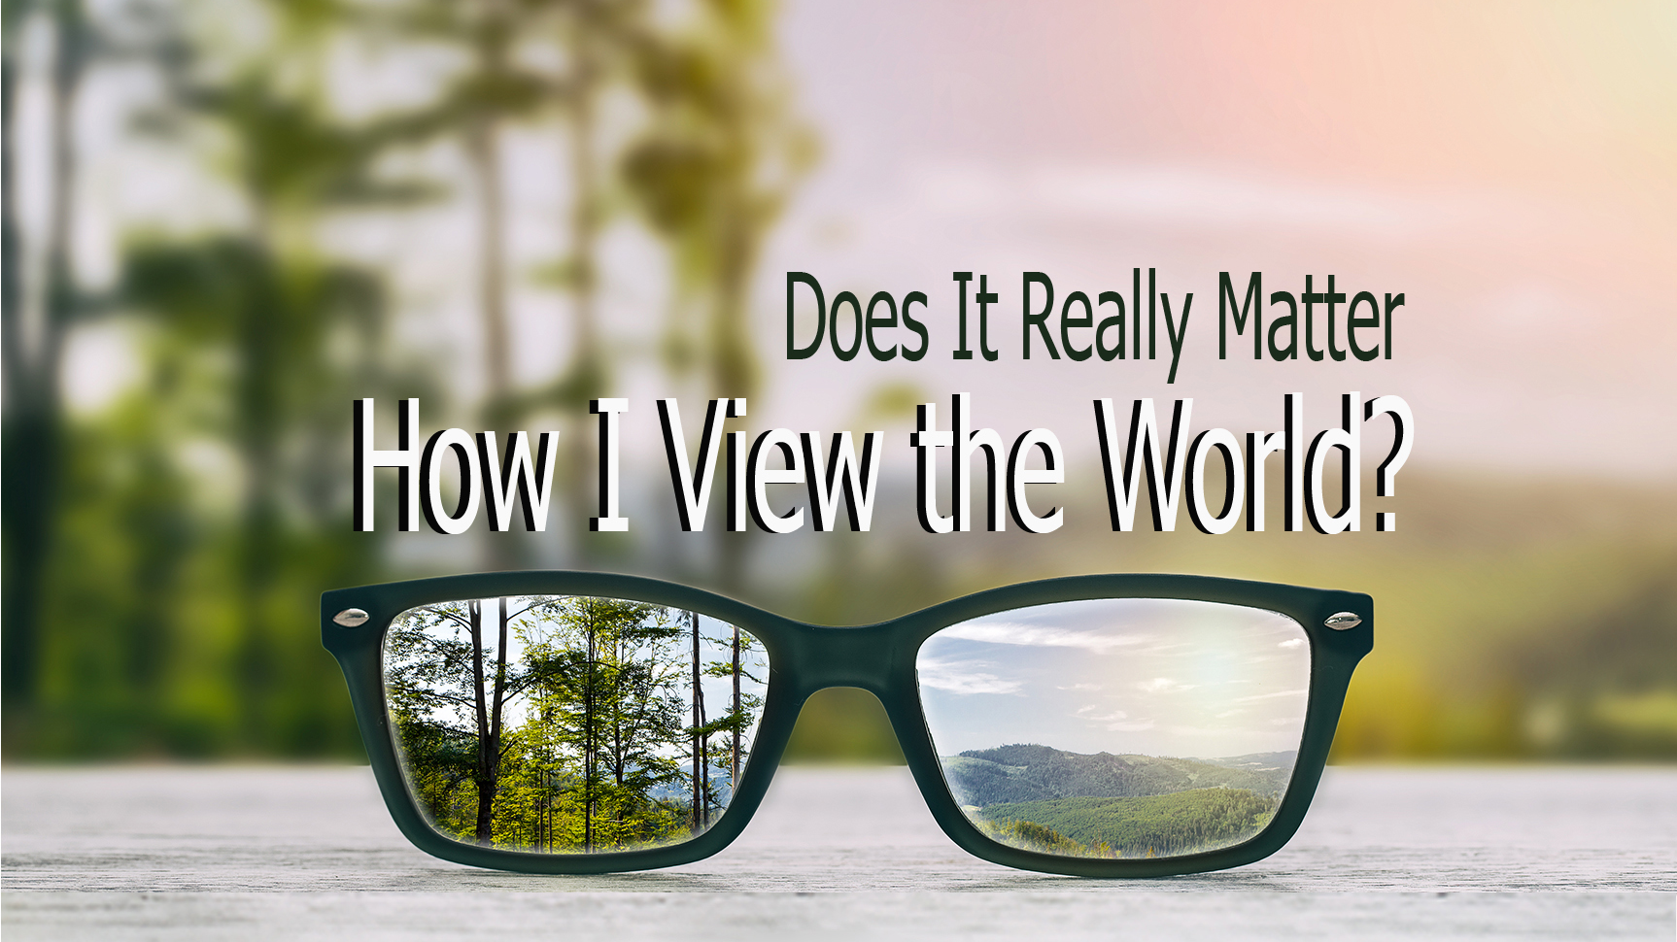

Slide 2
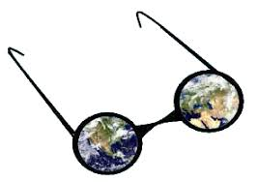
WORLDVIEW
We all have a lens through which we look and interpret life and our world.

Slide 3
Behaviors come from our VALUES and our values are based on what we BELIEVE.

Slide 4
Date:
Time:
Location:

