Slide 1
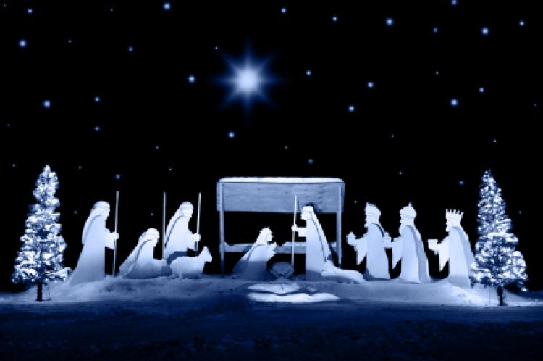
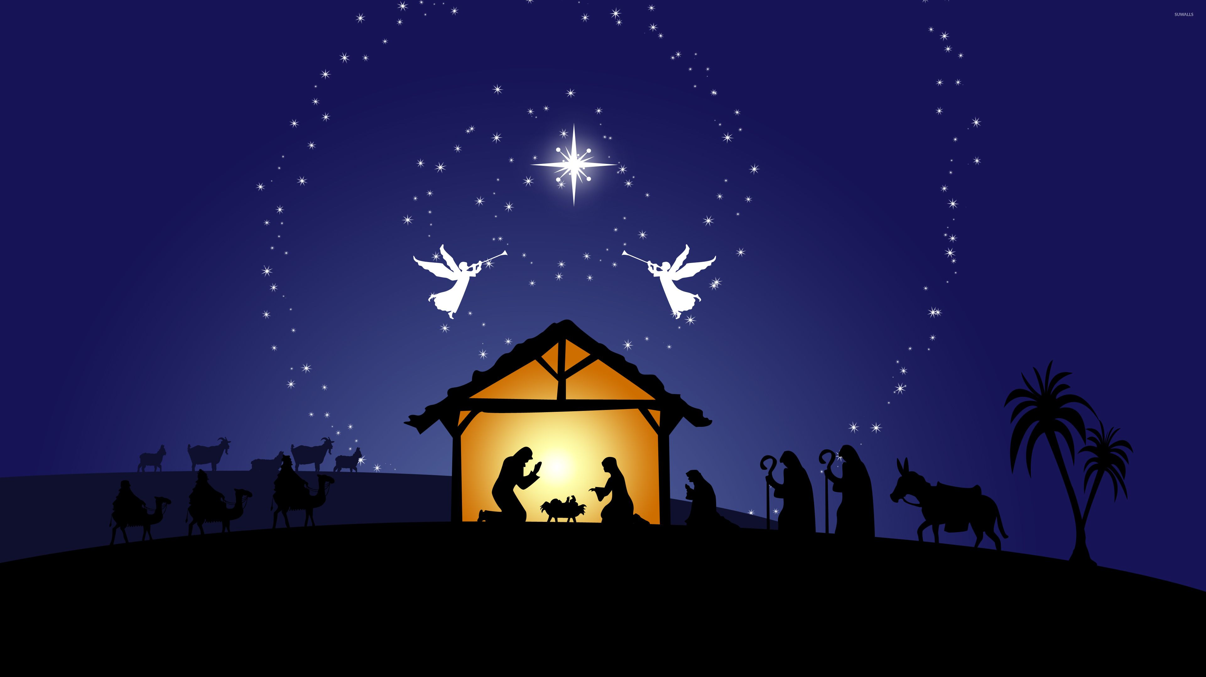

Slide 2
This month features Christmas celebrations in various locations.
These testimonies reveal God at work in unusual ways. The pictures are worth a thousand words.

Slide 3


www.wnac.org/treasure

Slide 4
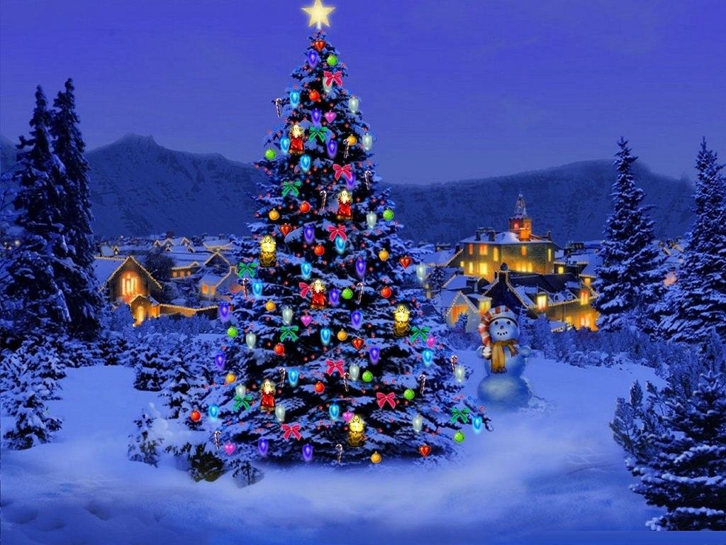
What do you want for Christmas?

Slide 5
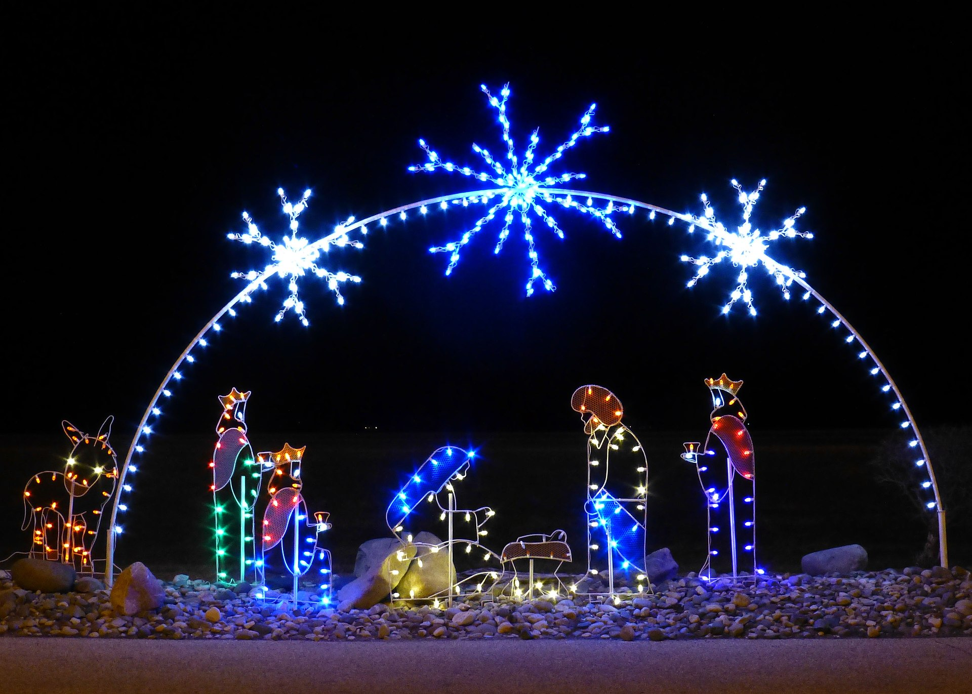
Date
Time
Location

