Slide 1
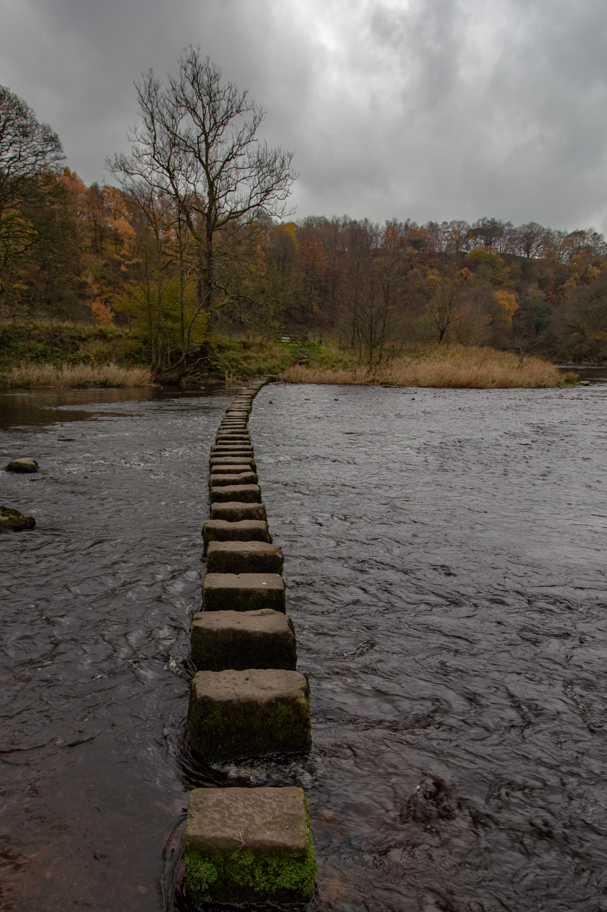
Faithfulness in
Kingdom Work

Slide 2
Yes, I may have been “blind” through some of His leading. Some of His guidance was through rough places that I did not know or understand.
Yet, I can say with confidence the Lord did not forsake me.
Psalm 145:13b

Slide 3
Date:
Time:
Location:

