Slide 1
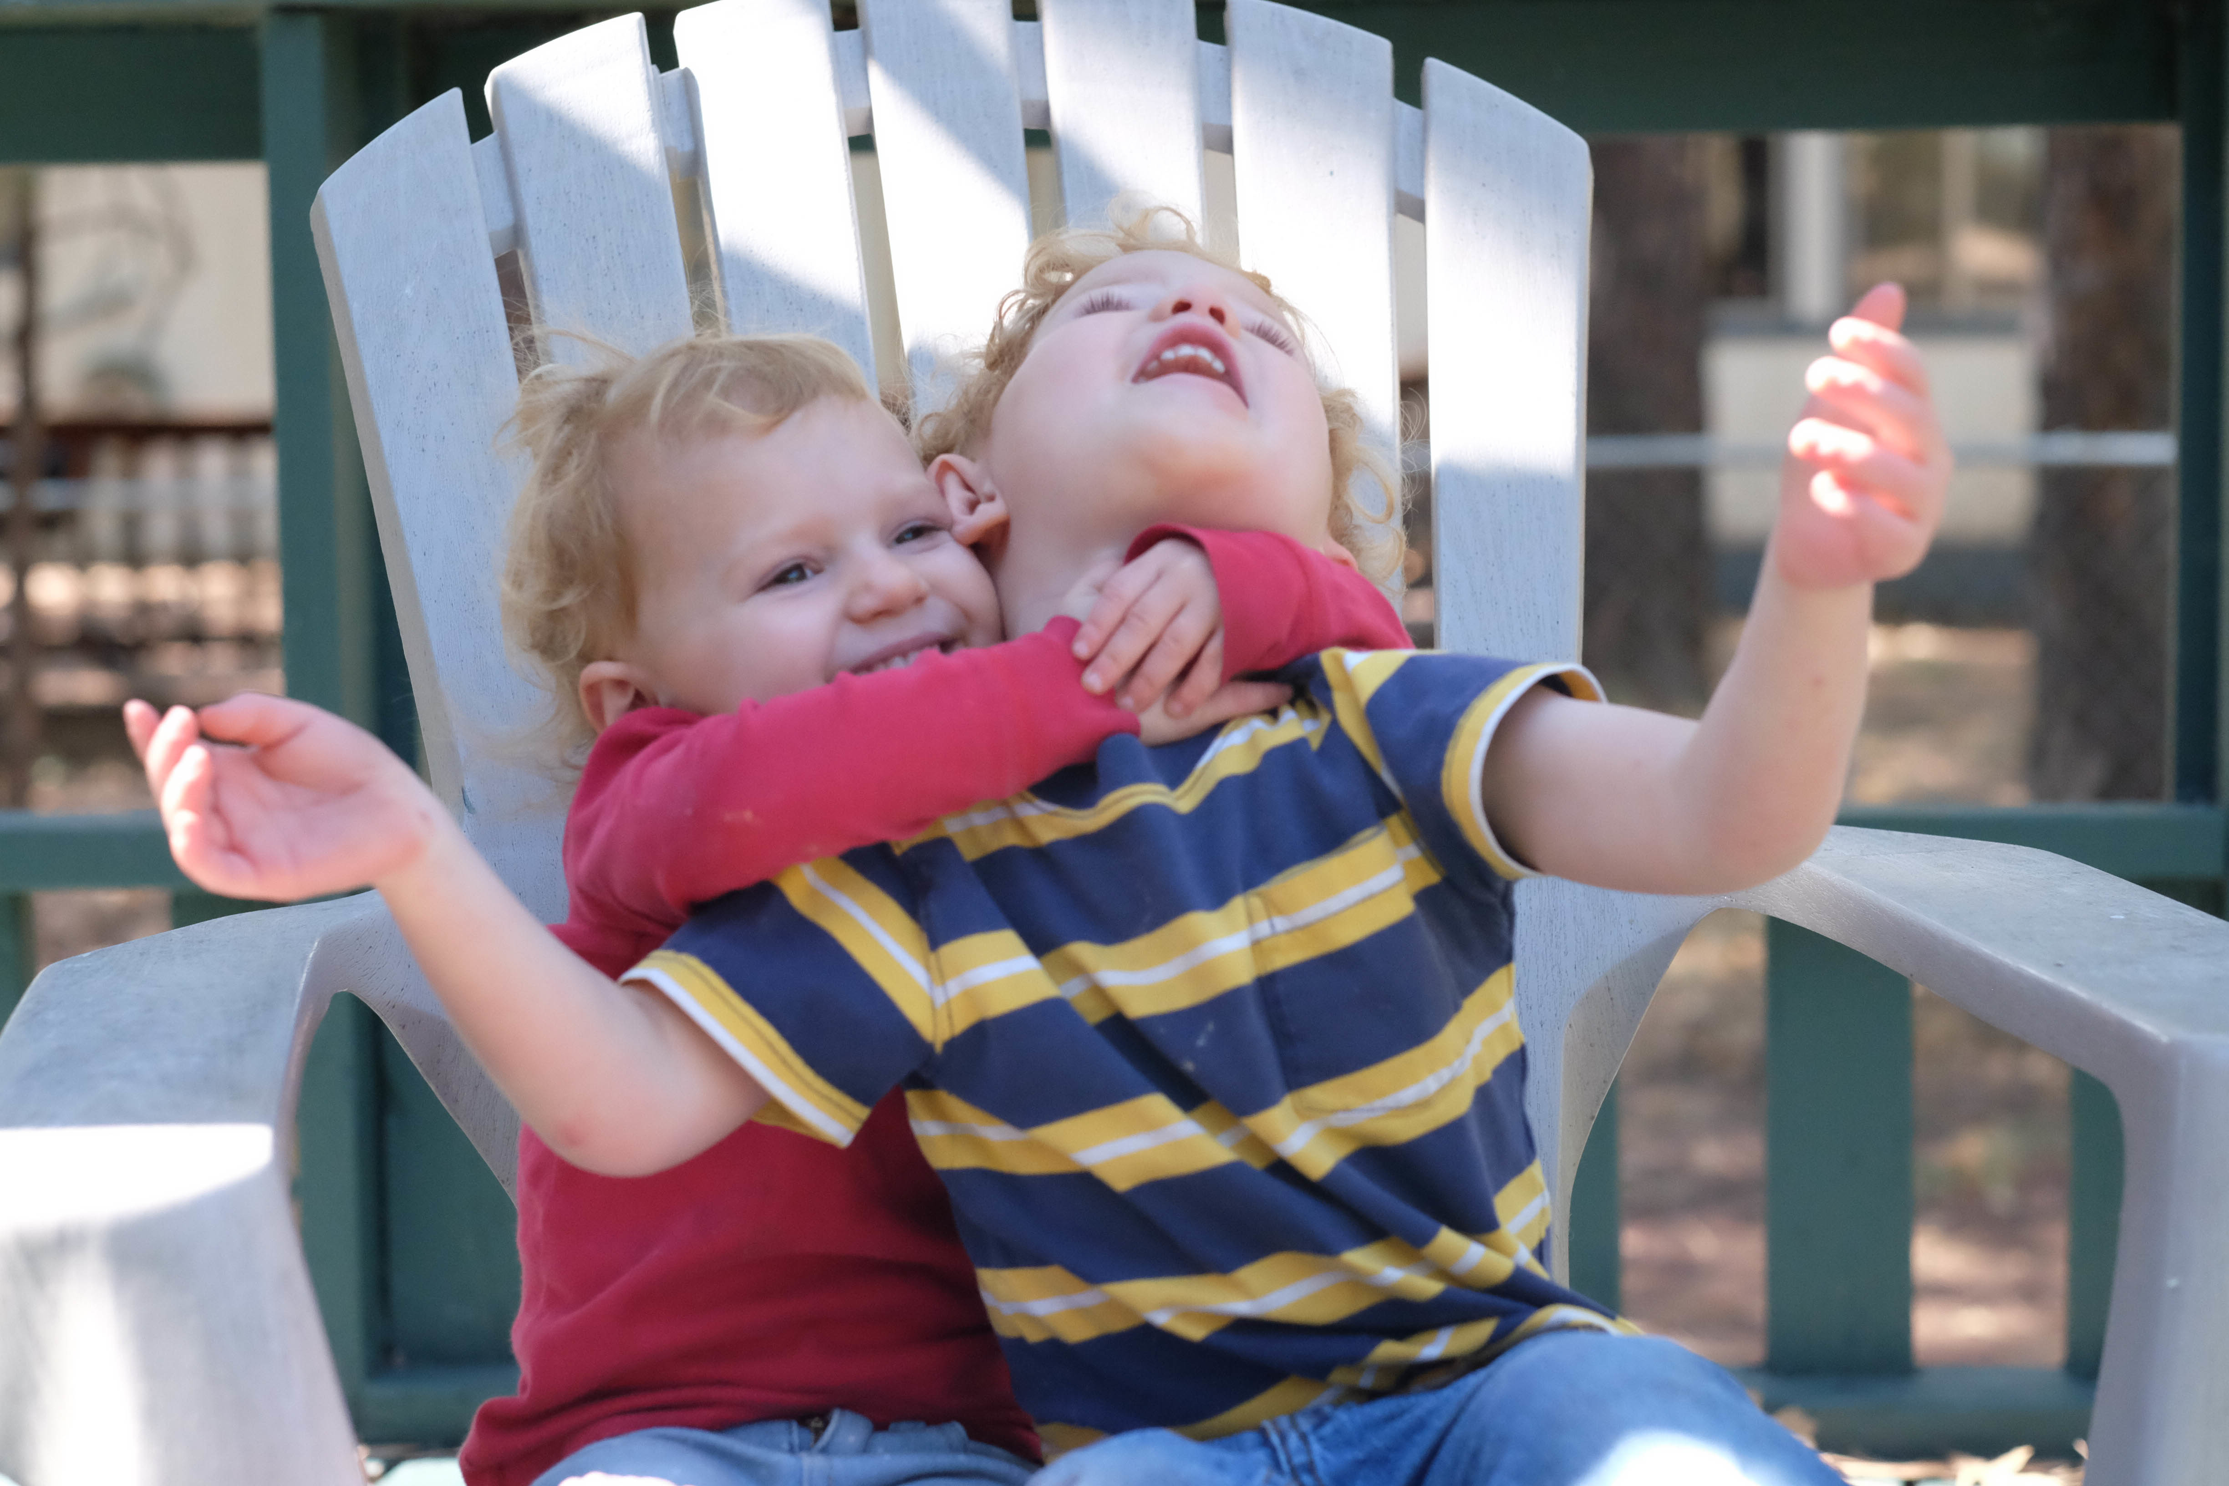
Crying Uncle

Slide 2
Crying uncle means we’re ready to quit.
We’ve reached our limits.
We are done.
On that declaration hinges an unspoken
hope for release.

Slide 3
How did Paul silence the uncle?
2 Corinthians provides an overview of his struggles and his pathway to victory.

Slide 4
Do you maintain a close relationship
with your Father?
Do you have supportive
Christian brothers and sisters?
How long have you lived as a member of
God’s family?

Slide 5
Where’s Your Uncle?
On a scale of 1 to 10:
1. Rate your resiliency.
2. Rate your spiritual family connectedness:
a. with God
b. with Christian brothers and sisters

Slide 6
Would you rate your personality best as….
strong-willed?
compliant?
complaining?

Slide 7
Encountering the Uncles
Uncle of Past….2 Corinthians 11:30-33
Uncle of Perception…2 Corinthians 10:12-16
Uncle of Pain…2 Corinthians 11:23-27

Slide 8
Uncle of Preoccupation
2 Corinthians 2:12-13 and 11:28
5. Identify Your Uncle
With which one do you most identify?
Or does your uncle have a different name?

Slide 10
Eight Insights for the Uncles
Wholesome Renewal
2 Corinthians 4:16 and 6:14-7:6
Focused Hope
2 Corinthians 1:10; 4:17; 5:5-6, 11,14

Slide 11
“Peace is not the absence of trouble;
it’s the presence of Christ.”
Judah Smith
“How’s Your Soul”
YouVersion.com

Slide 12
Effective Grace
2 Corinthians 1:12; 4:15; 6:1-3; 8:9; 12:9
Intentional Measures
2 Corinthians 1:11-14; 2:17; 10:10-12; 8:18-23

Slide 13
While other worldviews lead us to sit in the midst of life’s joy, foreseeing coming sorrows,
Christianity empowers its people to sit in the midst of this world’s sorrows,
tasting the coming joy.
Tim Keller
“Walking with God Through Pain and Suffering”

Slide 14
Balanced Perspective
2 Corinthians 12:15-16 and 7:8-13
Open Hearts
2 Corinthians 6:11-12 and 7:2

Slide 15
The measure of a life, after all,
is not its duration,
but its donation.
Corrie Ten Boom

Slide 16
Abundant Generosity
2 Corinthians 9:6-7 and 11-13
Restorative Plans
2 Corinthians 2:5-11; 5:19-20; 13:11

Slide 17
Choose a path, like Paul, that draws you closer to the Father rather than an uncle.

