Slide 1
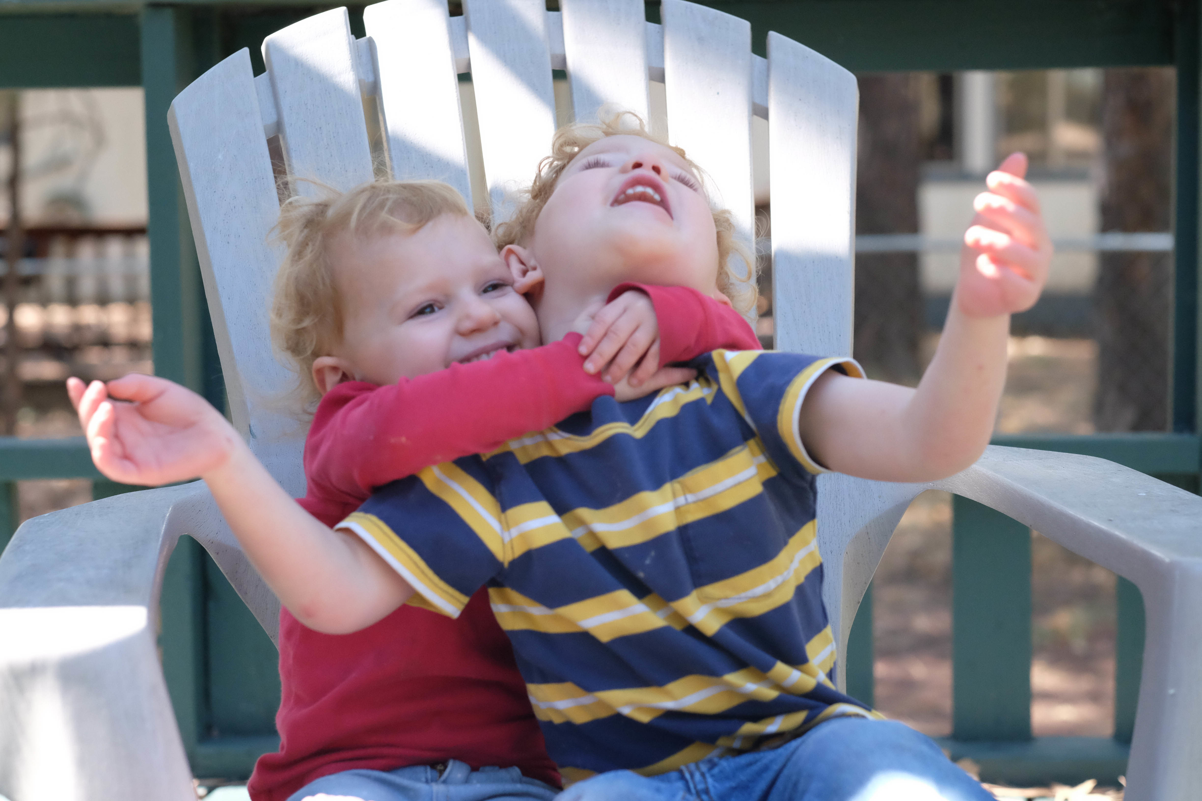
Crying Uncle

Slide 2
Crying uncle means we’re ready to quit.
We’ve reached our limits.
We are done.
On that declaration hinges an unspoken
hope for release.

Slide 3
How did Paul silence the uncle?
2 Corinthians provides an overview of his struggles and his pathway to victory.

Slide 4
Date:
Time:
Location:

