Slide 1


Slide 2
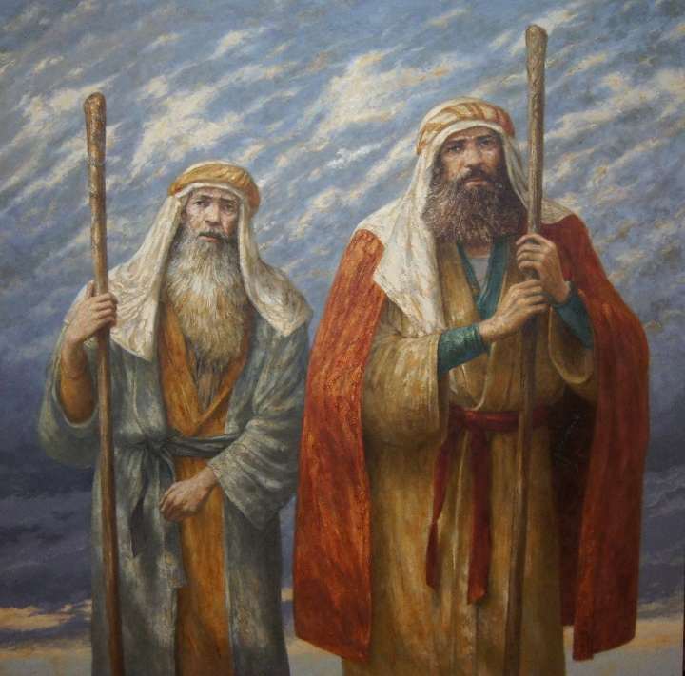
Exodus 4:10-16
Moses and Aaron
Partnership with friendship
Who has partnered with you when you felt inadequate?

Slide 3

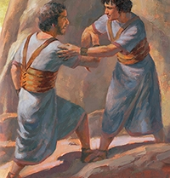
1 Samuel 18:3-4
David and Jonathan
Sacrificial friendship
Do you have such a friend?
Are you loving someone sacrificially?

Slide 4
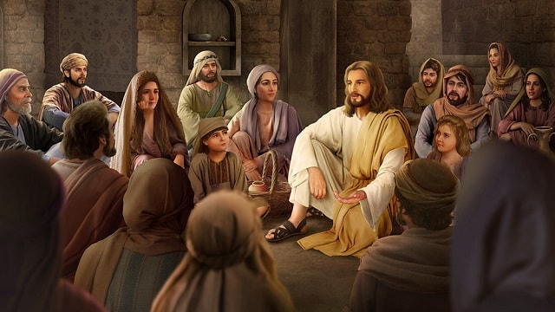
Romans 8:39
Jesus and Us
There is nowhere we can go that He won’t be with us. Not even the darkest places in our own minds. Even there, He is our Friend.

Slide 5
How to Have Faithful Friendships
1. Walk with friends through good and bad times.
2. Use the “like” button as often as possible. Be an encourager.
3. Take the time to build deep relationships, even if it’s a sacrifice.
4. When your “memories” pop up from years past, take some time to look through them.
5. Don’t let the “urgent” get in the way of the “important.”

Slide 6


