Slide 1
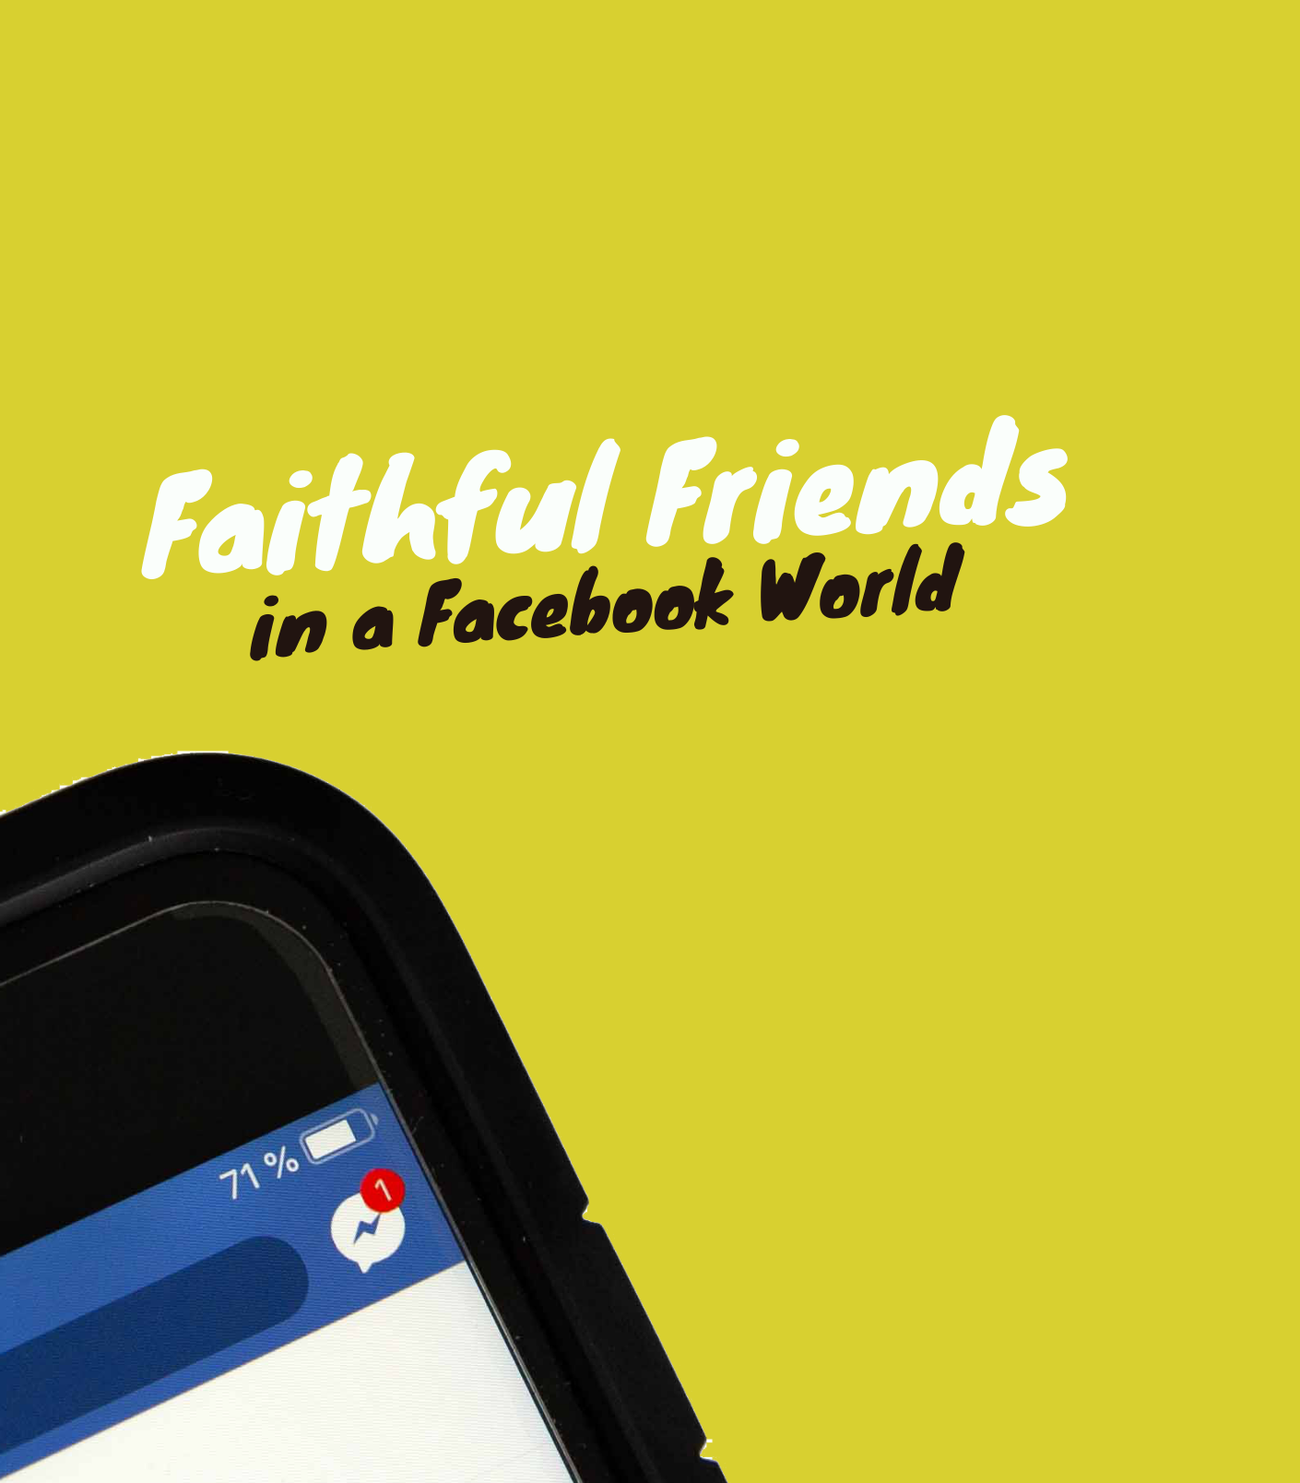

Slide 2
How to Have Faithful Friendships
1. Walk with friends through good and bad times.
2. Use the “like” button as often as possible. Be an encourager.
3. Take the time to build deep relationships, even if it’s a sacrifice.
4. When your “memories” pop up from years past, take some time to look through them.
5. Don’t let the “urgent” get in the way of the “important.”

Slide 3
Date:
Time:
Location:

