Slide 1
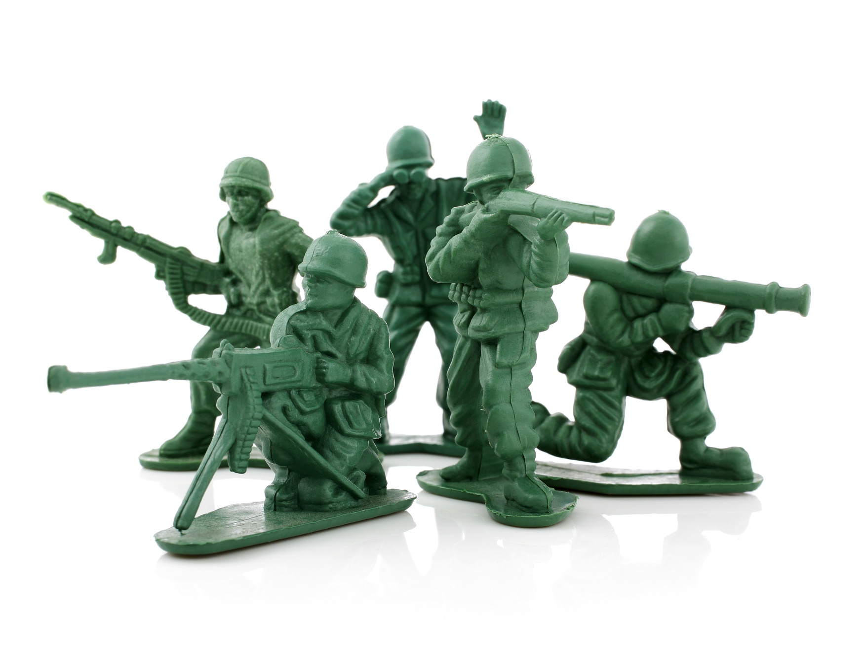
The Battle Plan for Discipleship

Slide 2
Did you know leadership and discipleship are two siblings from the same family?

Slide 3
What do little green soldiers teach us?
Even a child can get an “army” ready for battle.

Slide 4
Planning for discipleship is planning for X or backward planning for intentional discipleship.

Slide 5
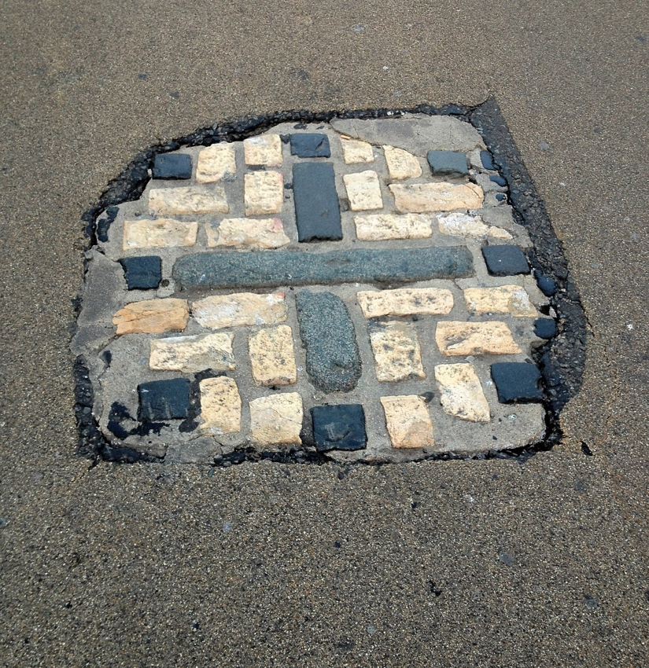
The Rescue Plan
We all have an X, the place where we are going to die.
No one knows where.

Slide 6
If you knew the X, what would you do between now and then?
What should the backward planning model look like?

Slide 7
Has the American church gone “deeper into the cave” by repetitively doing what we’ve always done?

Slide 8
Sadly, one hour a week is nothing when it comes to teaching our kids to passionately adopt and pursue the heart of
Jesus Christ.

Slide 9
God the Father has a rescue plan, and He shared it in Deuteronomy 6.
Discipleship in the home is very important.

Slide 10
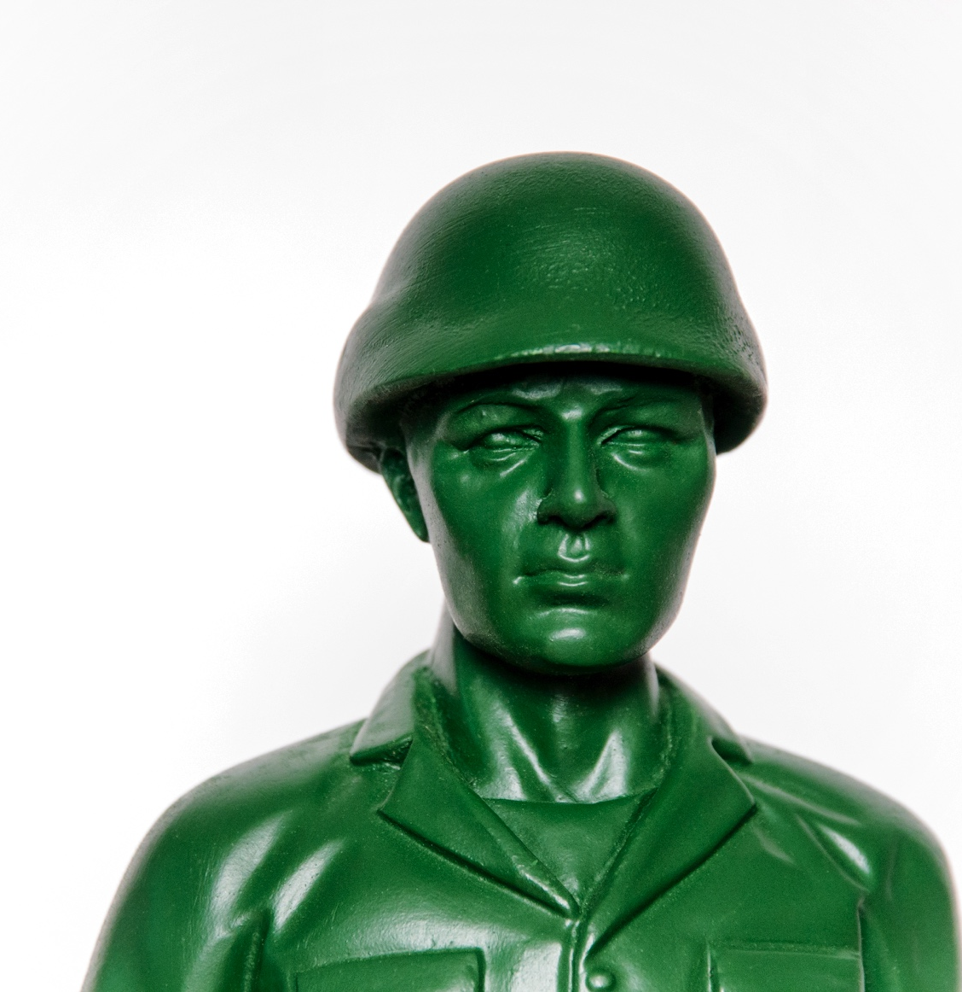
Characteristics of a Healthy Church
They don’t look for something new, but refine discipleship.

Slide 11
Scripture does not define discipleship as an event.... but as a way of life.
Discipleship is learning to be like Christ, resulting in disciple makers.

Slide 12

Biblical Foundation

Slide 13
Genesis 1:28
“Be fruitful and multiply” meant sharing His image with the next generation not just populating the earth.

Slide 14
Deuteronomy 6:4-6
Teach God’s commands
Share the love of Scripture
Pass down the love of God

Slide 15
Joshua 24:15
As for me and my house, we will serve the Lord.

Slide 16
Principles for Discipleship

Slide 17
#1: Each child is different.
#2: Training never stops.
#3: You should be training but also equipping others.

Slide 18
#4: Prepare the next generation to fight life’s battles and defend their faith.
#5: Prepare children for their X from the moment of birth.

Slide 19
Timothy didn’t become an incredible ministry leader without preparation.
Timothy had an X, and his family and Paul helped him prepare to face it.

Slide 20
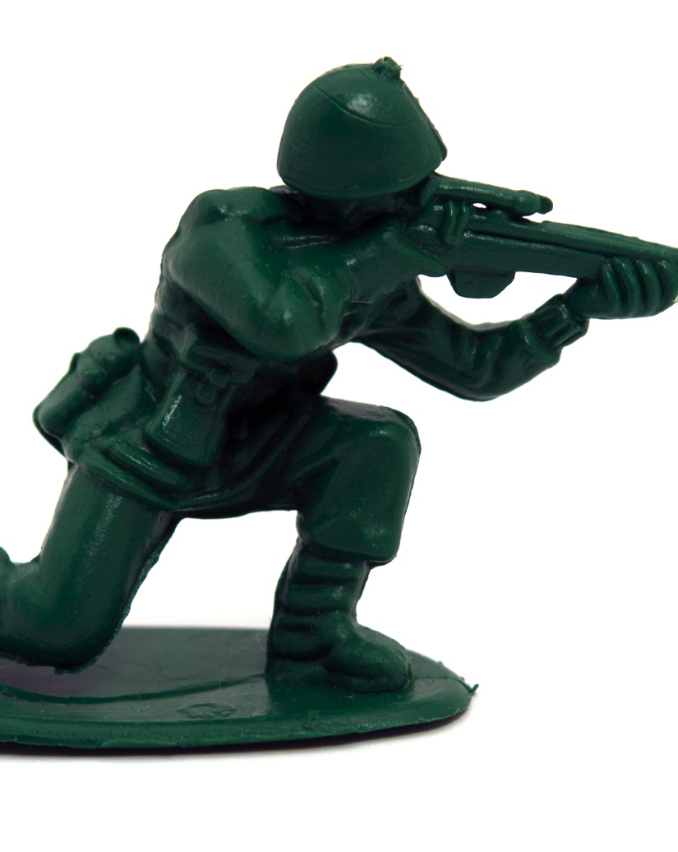
It is time to develop a battle plan for discipleship.

Slide 21


