Slide 1
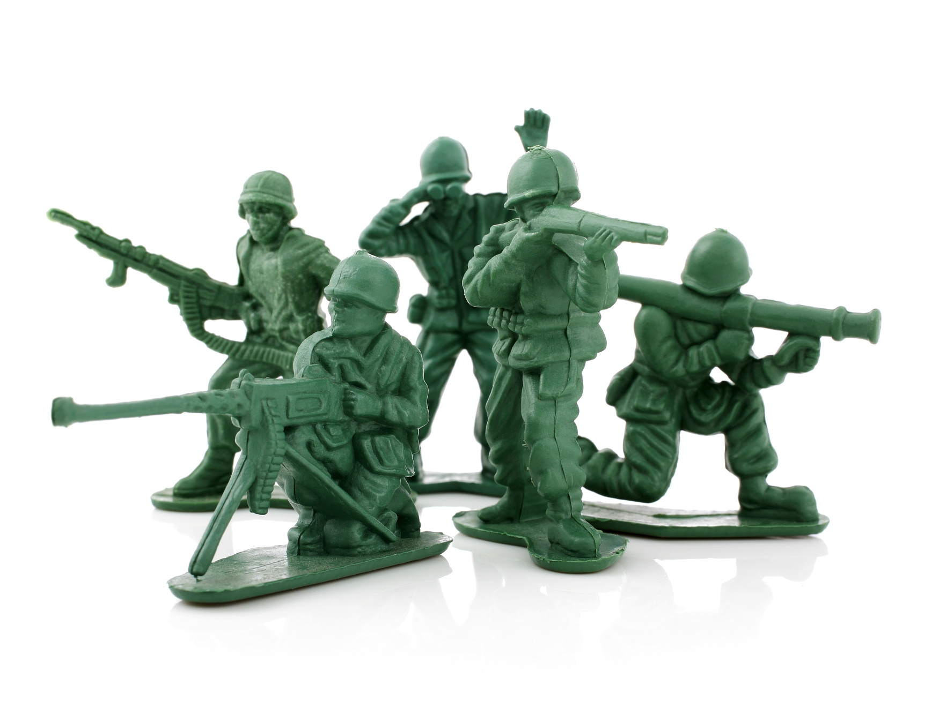
The Battle Plan for Discipleship

Slide 2
Did you know leadership and discipleship are two siblings from the same family?

Slide 3
Planning for discipleship is planning for X or backward planning for intentional discipleship.

Slide 4
Date:
Time:
Location:

Slide 5


