Slide 1
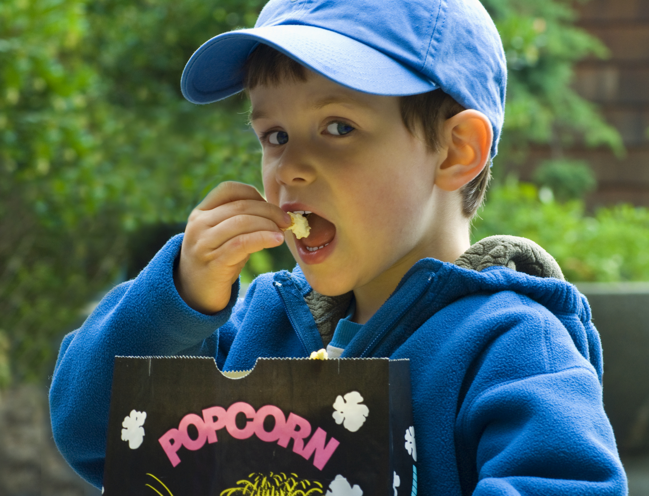
I Surrender My Children

Slide 2
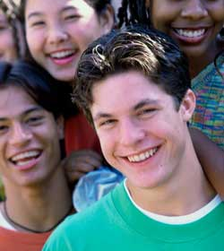
Proverbs 15:3
As our children grow, they will spend more time out of our sight. We will not always be there….but El Roi will.

Slide 3
El Roi
The omnipotent God is there and His eyes are not shut. He isn’t asleep unaware of all the circumstances. He sees.
(Kay Arthur, Lord I Want to Know You, pg. 29)

Slide 4
Date
Time
Place

Slide 5

In partnership
with….

