Slide 1
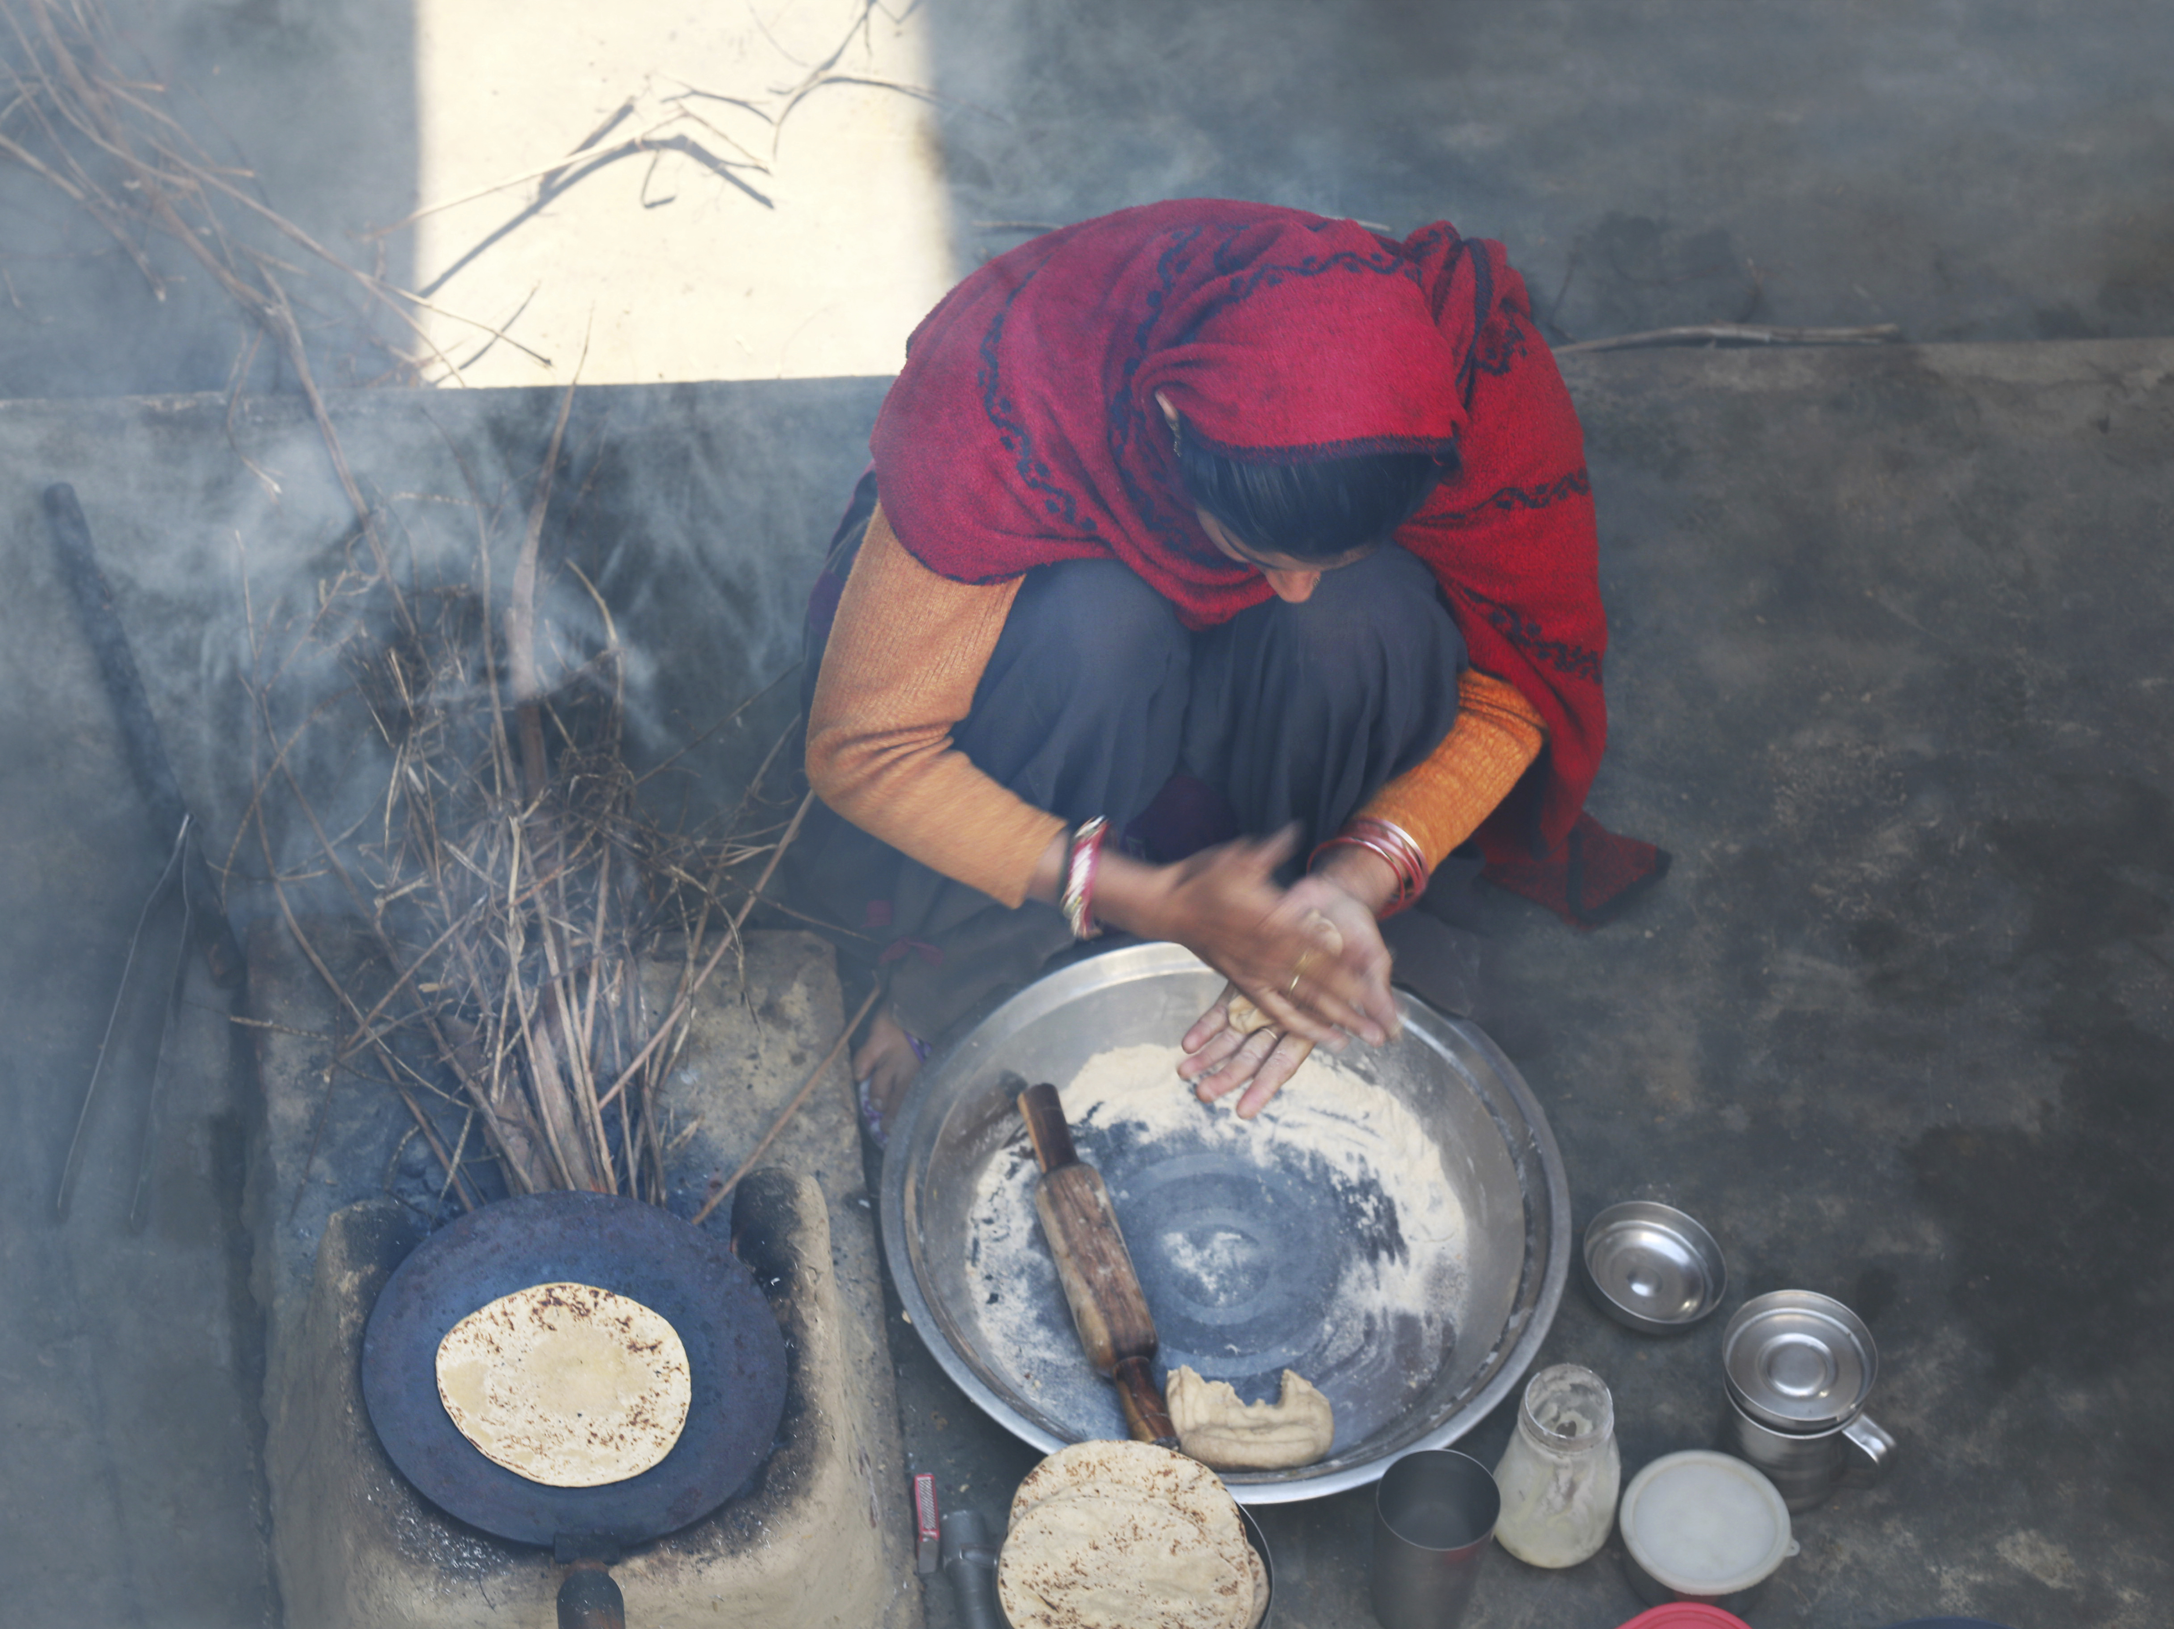
Lessons in Tithing

Slide 2
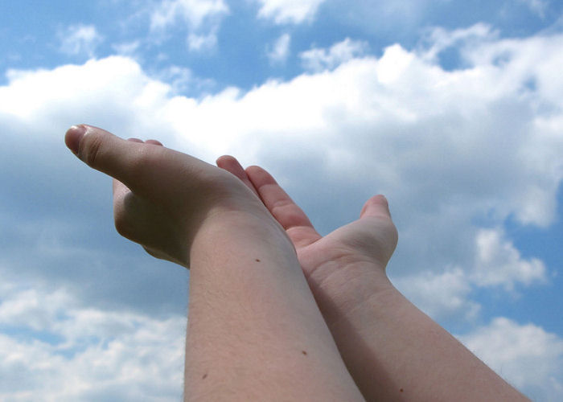
It isn’t natural for mankind to be content. Paul, with the Holy Spirit’s help, learned the secret of contentment.

Slide 3

Obedience in tithing may require sacrificial giving and acts of faith but a blessing is promised.

Slide 4
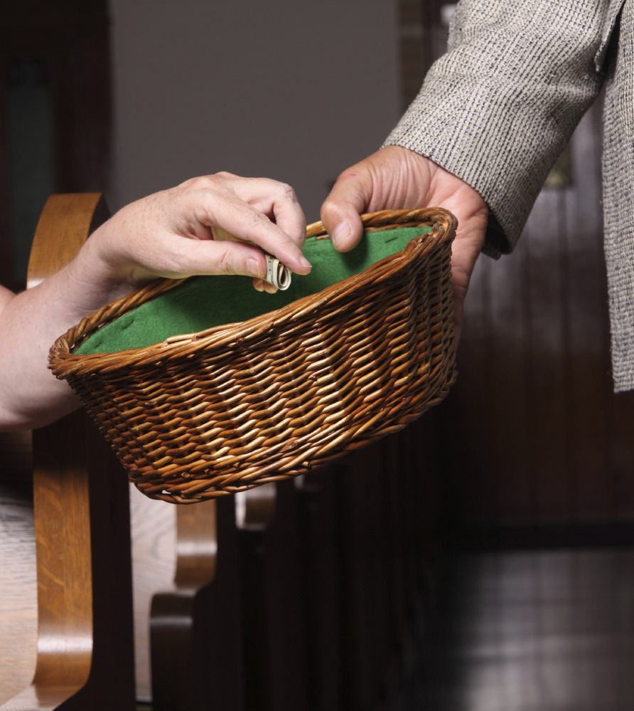
Date
Time
Place

Slide 5

In partnership
with….

