Slide 1
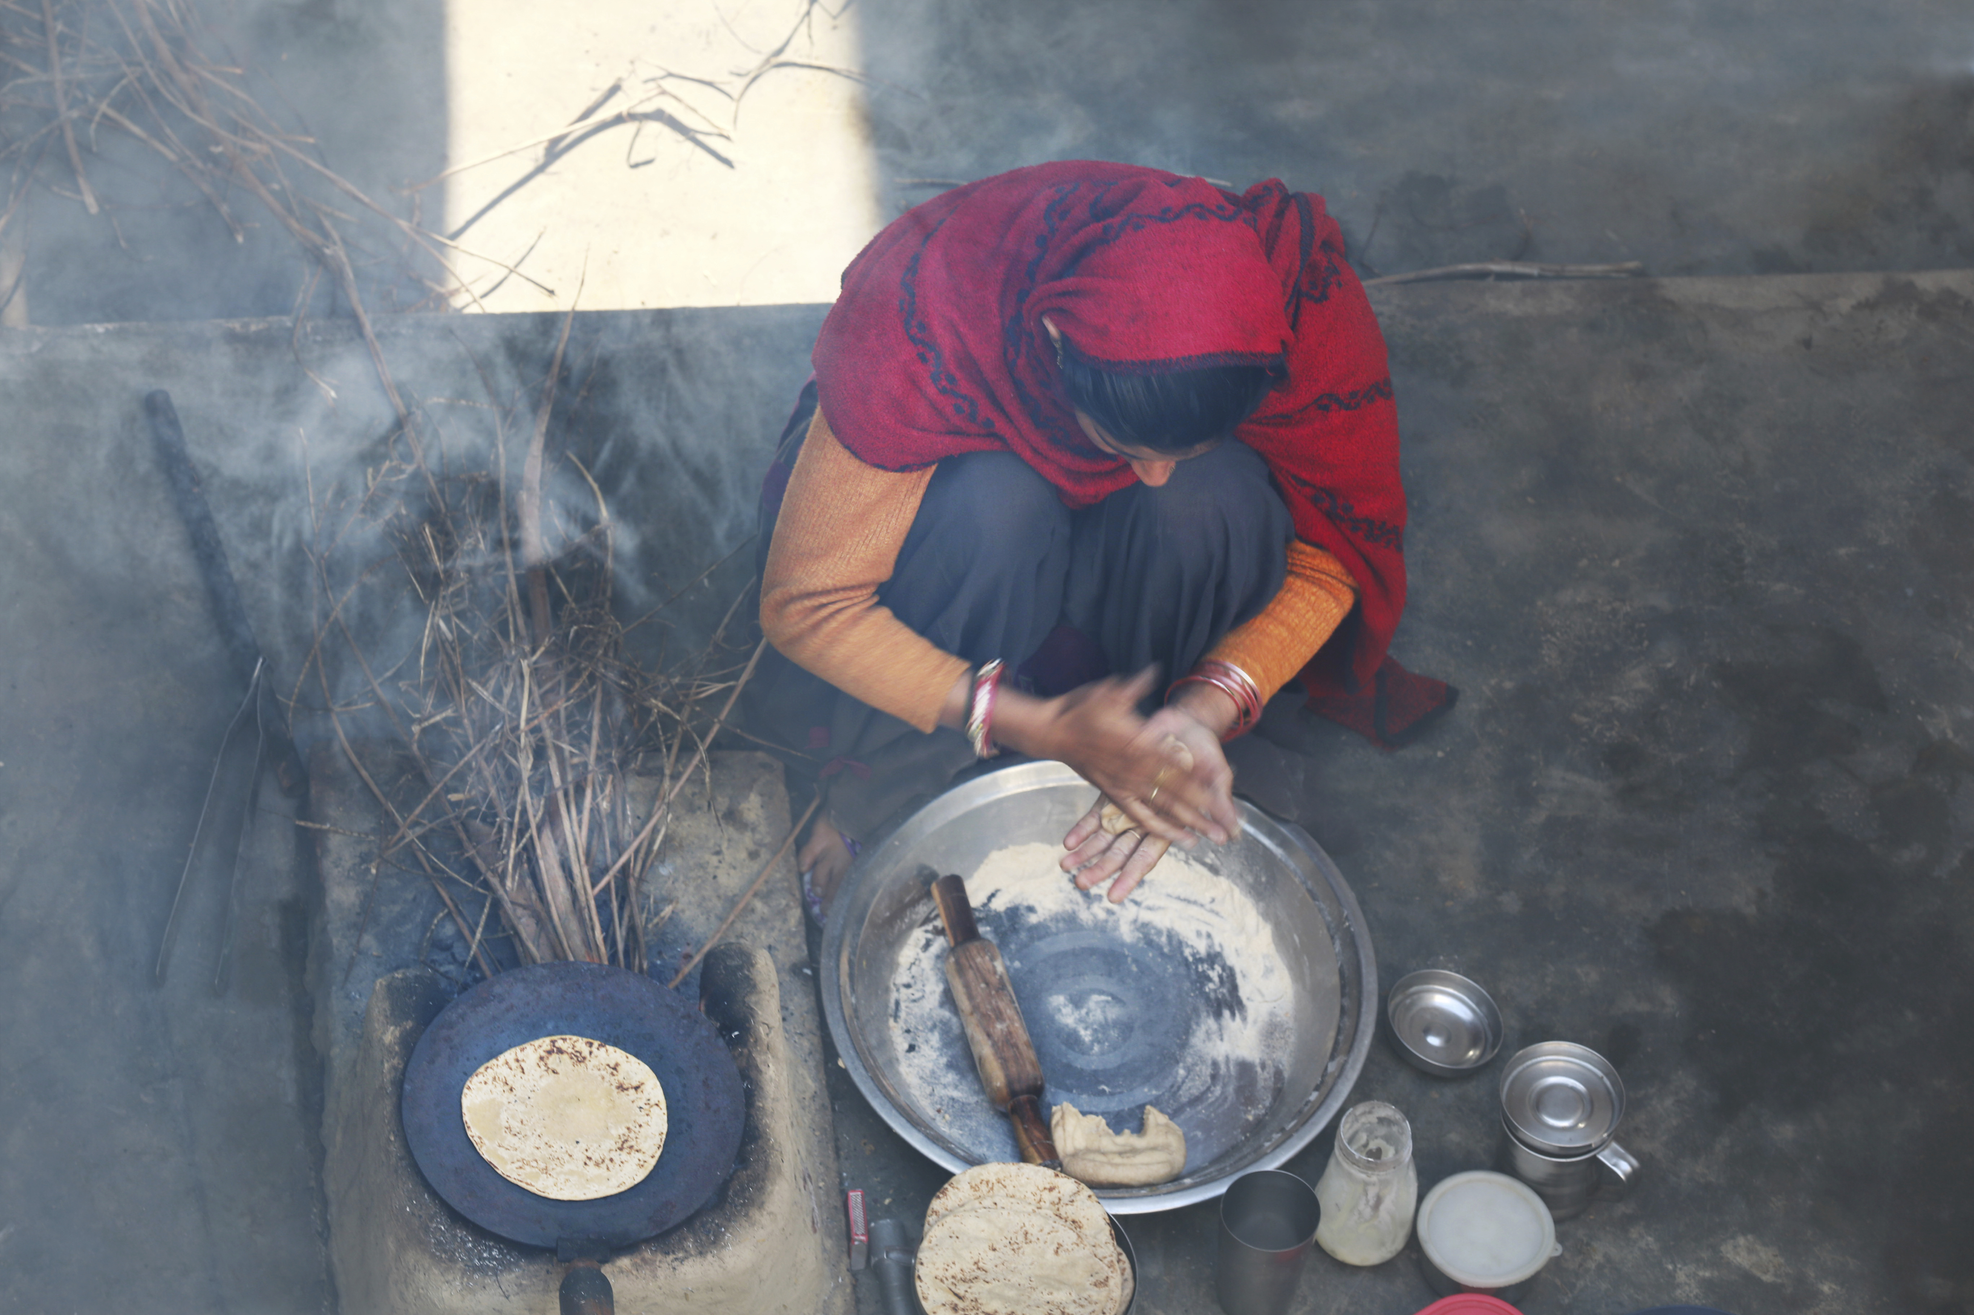
Lessons in Tithing

Slide 2
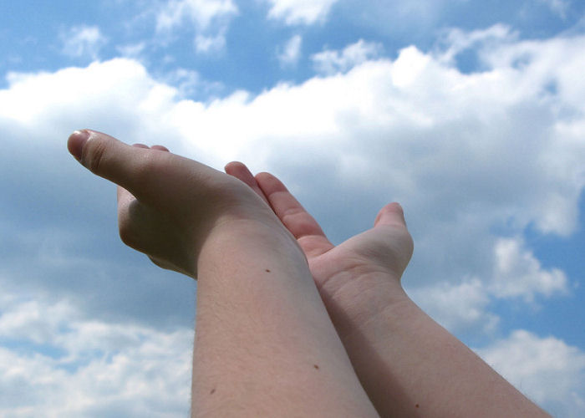
It isn’t natural for mankind to be content. Paul, with the Holy Spirit’s help, learned the secret of contentment.

Slide 3

Obedience in tithing may require sacrificial giving and acts of faith but a blessing is promised.

Slide 4
Philippians 4:12-19
Paul says he LEARNED…..
…to be brought low
…to abound
…to be full
…to be hungry
…to have plenty
…to suffer need

Slide 5
I Kings 17:8-16
This widow’s stomach could not have been as empty as her heart. Yet, she risked everything for this prophet.
What a remarkable faith!

Slide 6
Faith is the step between promise and assurance. Miracles seem so out of reach for our feeble faith. But every miracle, large or small, begins with an
act of obedience.

Slide 7
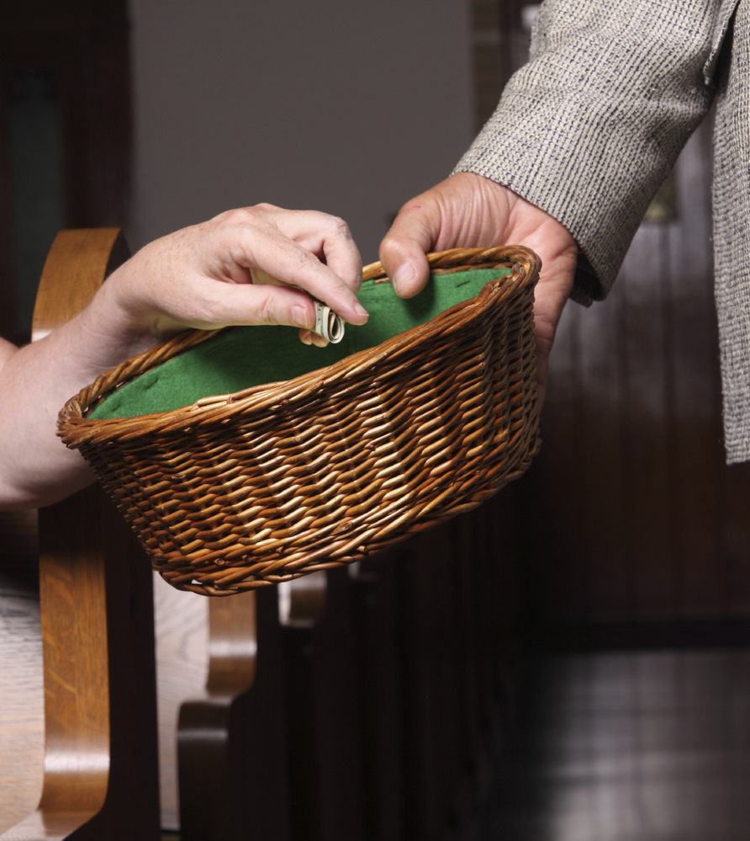
Malachi 3: 8, 10
Tithing is not optional. It is a direct command from the Lord.

Slide 8
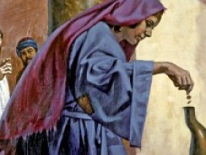
Blessing follows obedience.

Slide 9
You cannot out-give God.
(Luke 6:38)

