Slide 1

Good Grief

Slide 2

No rule book, no time frame. No judgment. Grief is as individual as a fingerprint.

Slide 3
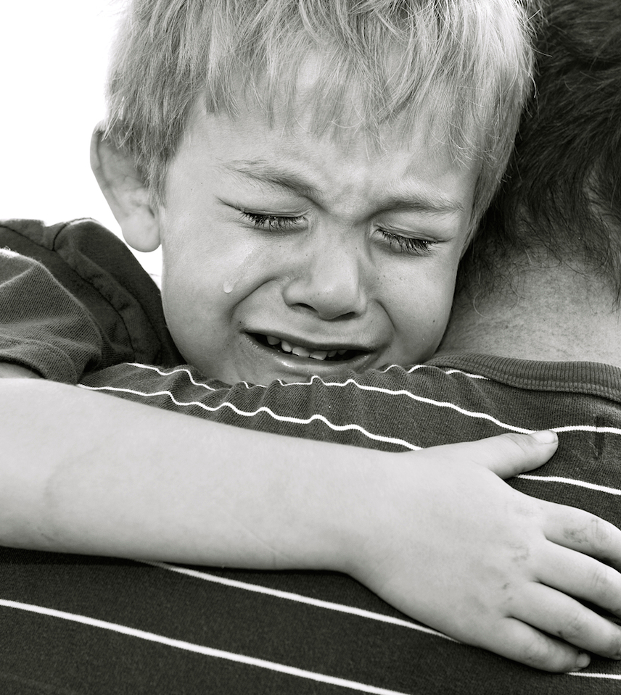
2 Corinthians 1:3-4
God is the God of all comfort.

Slide 4
Date
Time
Place

Slide 5

In partnership
with….

