Slide 1
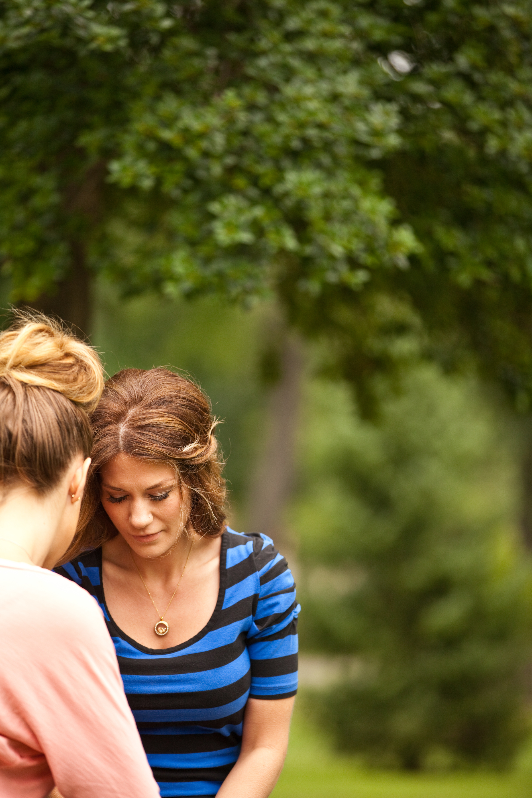
Good Grief

Slide 2
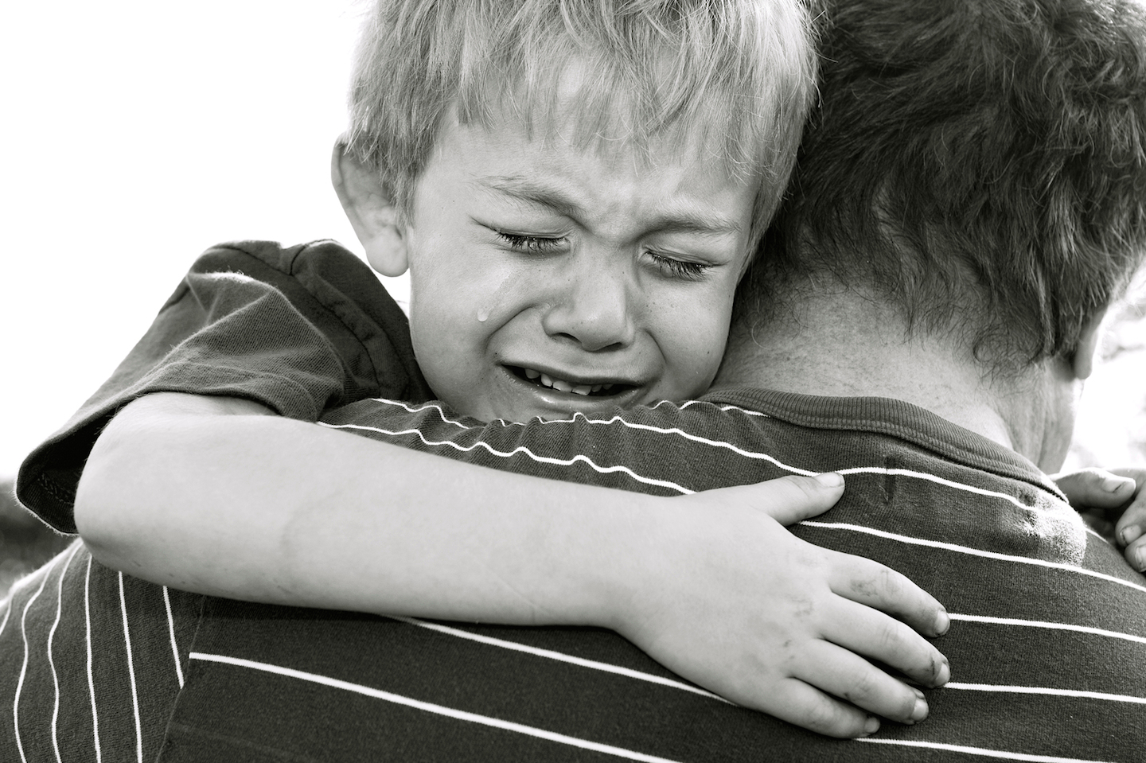
No rule book, no time frame. No judgment. Grief is as individual as a fingerprint.

Slide 3

Christians do not sorrow as those who have no hope, but we do sorrow.

Slide 4
Biblical Examples
Loss of a spouse: Genesis 23; Ruth 1
Loss of a child: 2 Samuel 12; 18:33-19:8; John 19:25-30
Loss of a friend: 2 Samuel 1; John 11
Loss of father and grandfather: 2 Samuel 4:4

Slide 5
Romans 12:2
Choose your focus.
Think on good memories.
Thank God for the time you did have with this special person.
Everyone grieves differently, but everyone grieves.

Slide 6
God uses people to help us with all we go through, including grief.

Slide 7
Psalm 147:3
God heals the brokenhearted.

Slide 8
2 Corinthians 1:3-4
God is the God of all comfort.

