Slide 1
I Surrender My
Comfort Zone

Slide 2
2 Corinthians 12:9
And he said unto me, My grace is sufficient for thee: for my strength is made perfect in weakness. Most gladly therefore will I rather glory in my infirmities, that the power of Christ may rest upon me.

Slide 3
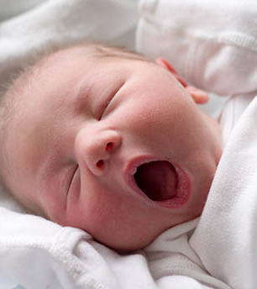
Hannah
Name means “grace”
Childless
Suffered disgrace
Provoked by Peninnah
Poured out her soul to God
Samuel: asked of God

Slide 4
How would you react?
Can you imagine the myriad of emotions Hannah experienced on the trip to Shiloh knowing she would be leaving little Samuel?
What do you think the trip home was like for Hannah?

Slide 5
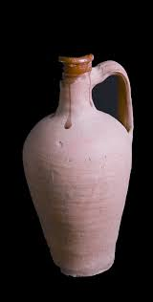
Widow with a Pot of Oil
Widow with two sons
Huge debt
Seeks help from the prophet

Slide 6
Think about it….
Does God care about your financial needs?
When God supplies your needs, does that include your wants? Is there a difference?
How should God’s supply of your needs affect your generosity?

Slide 7
Elisabeth
Married to a priest
Barren
Blameless, righteous, obedient
Reproach is removed …
“John” is born, the one who would prepare the way for the Messiah

Slide 8
Consider this….
Was Elisabeth in the multitude waiting for Zechariah to exit the Temple?
If not, can you imagine the “conversations” that occurred when Zechariah got home?
Do you think there was “discomfort” in the parenting stage as well as the reproach stage of Elisabeth’s life?

Slide 9
2 Corinthians 12:9-10
My grace is sufficient for thee: for my strength is made perfect in weakness …. for when I am weak, then am I strong.

