Slide 1

I
Surrender
My …

Slide 2
God is the source of our time,
and He has the highest claim
on its use.

Slide 3
Romans 12:1-2
Our reasonable service is submitting ourselves wholly to God as a living sacrifice….including the use of the time He has given us.

Slide 4
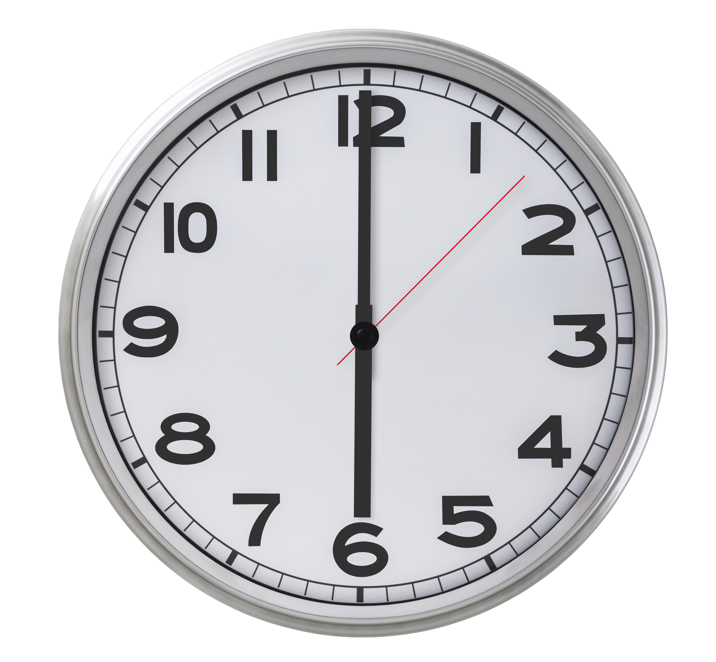
Everything we do requires time.
What distractions or demands might influence your usage of time?

Slide 5

We may think we are too busy to take time out to be with God,
but our busy-ness actually increases our need for Him.

Slide 6
If Jesus, the Son of God, needed to make special time to be with God and pray, how much more do we need time with God?

Slide 7
Not only is Jesus our role model in spending time with God, but also for spending time for God.

Slide 8
What part does the use of time play in your relationship with God?

Slide 9
We are accountable to
God for our decisions regarding time,
and will one day give an account to Him
for how we used the time He gave us.

Slide 10
Ephesians 5:16
How can you redeem time?

Slide 11
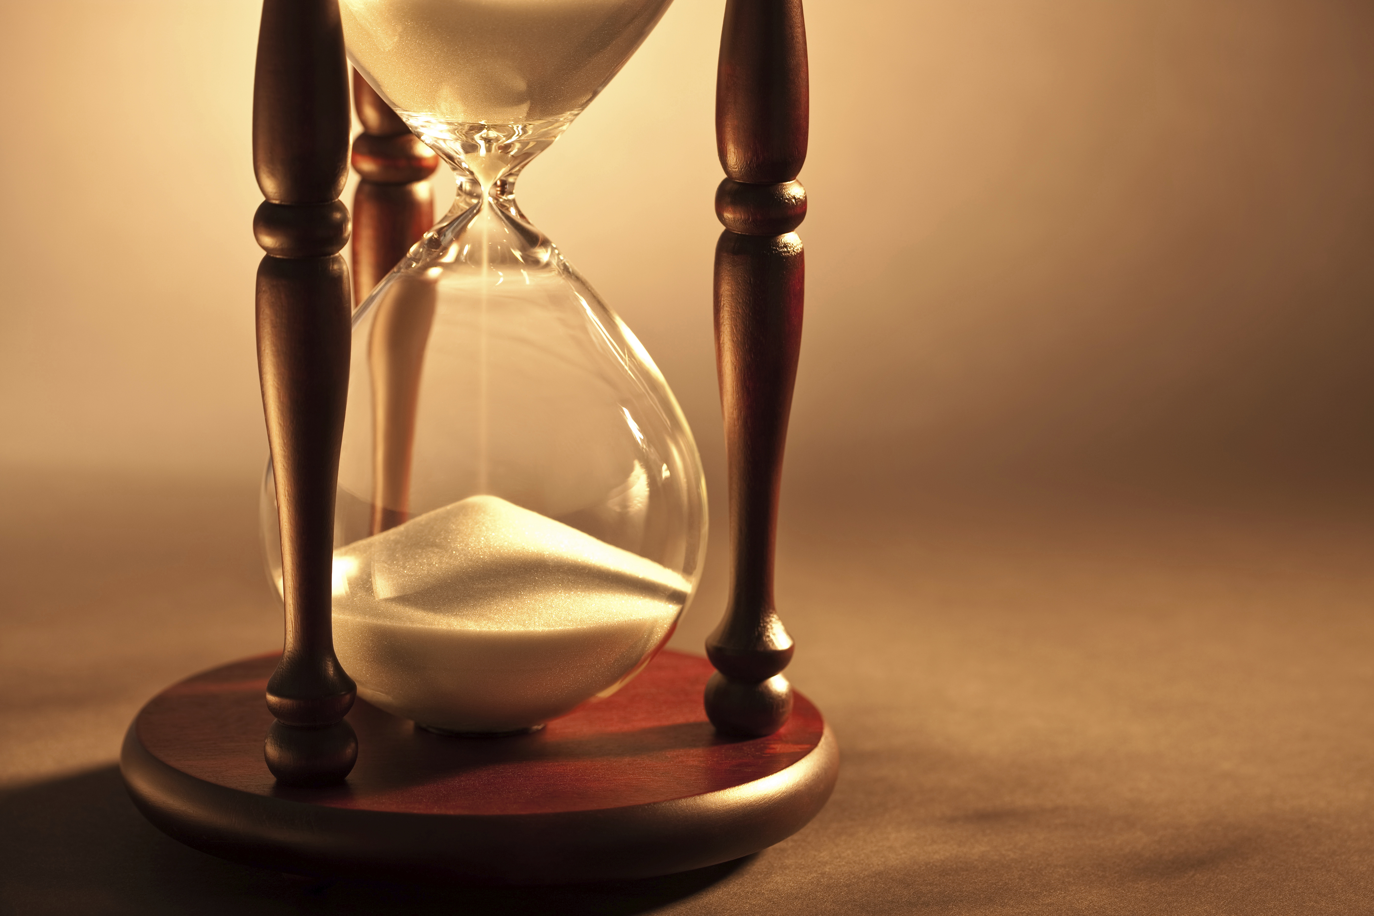
Date
Time
Place

Slide 12

In partnership
with….

