Slide 1
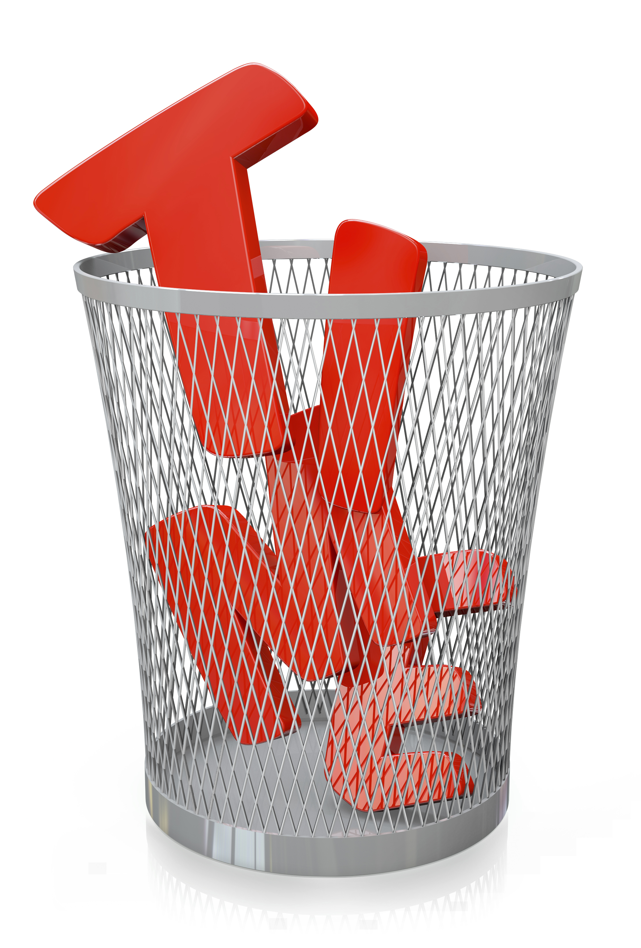
I
Surrender
My …

Slide 2
God is the source of our time,
and He has the highest claim
on its use.

Slide 3
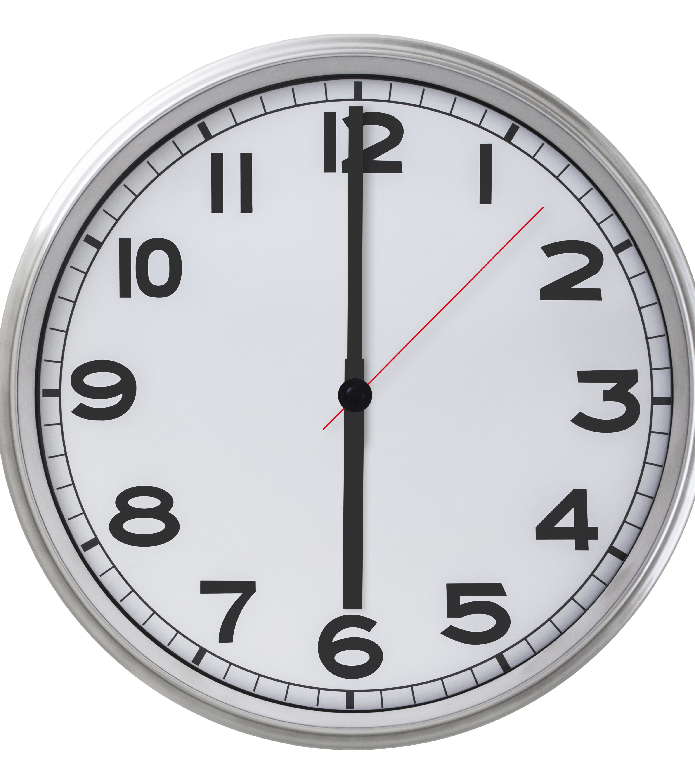
What distractions or demands might influence your time?

Slide 4
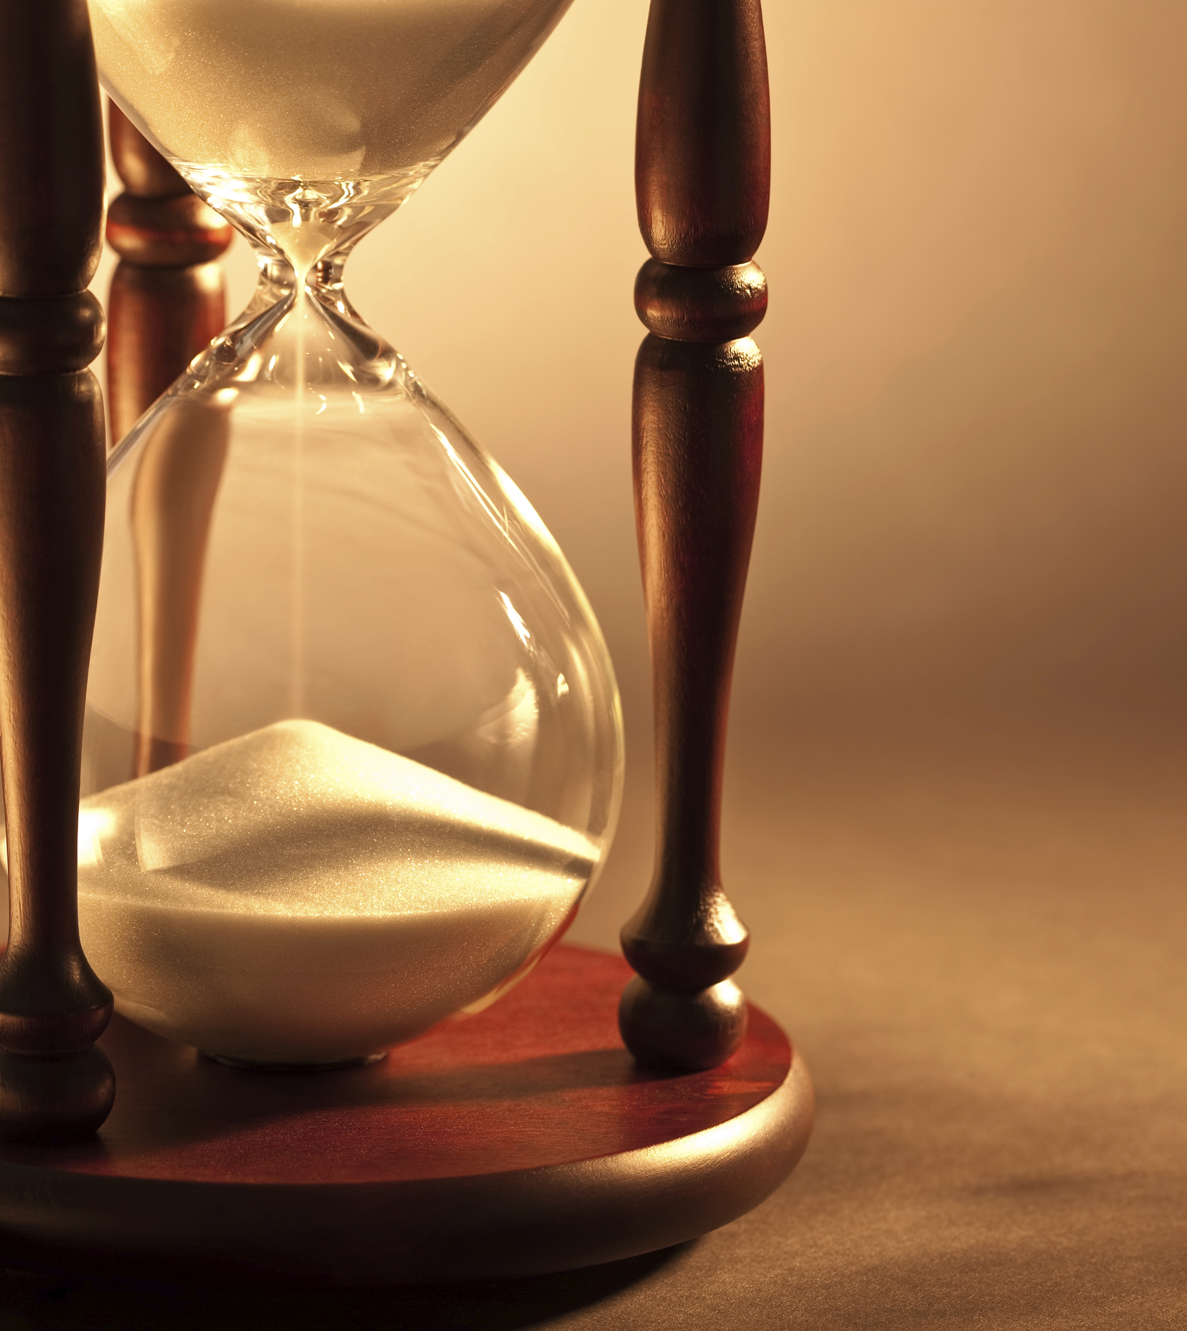
Date
Time
Place

Slide 5

In partnership
with….

