Slide 1
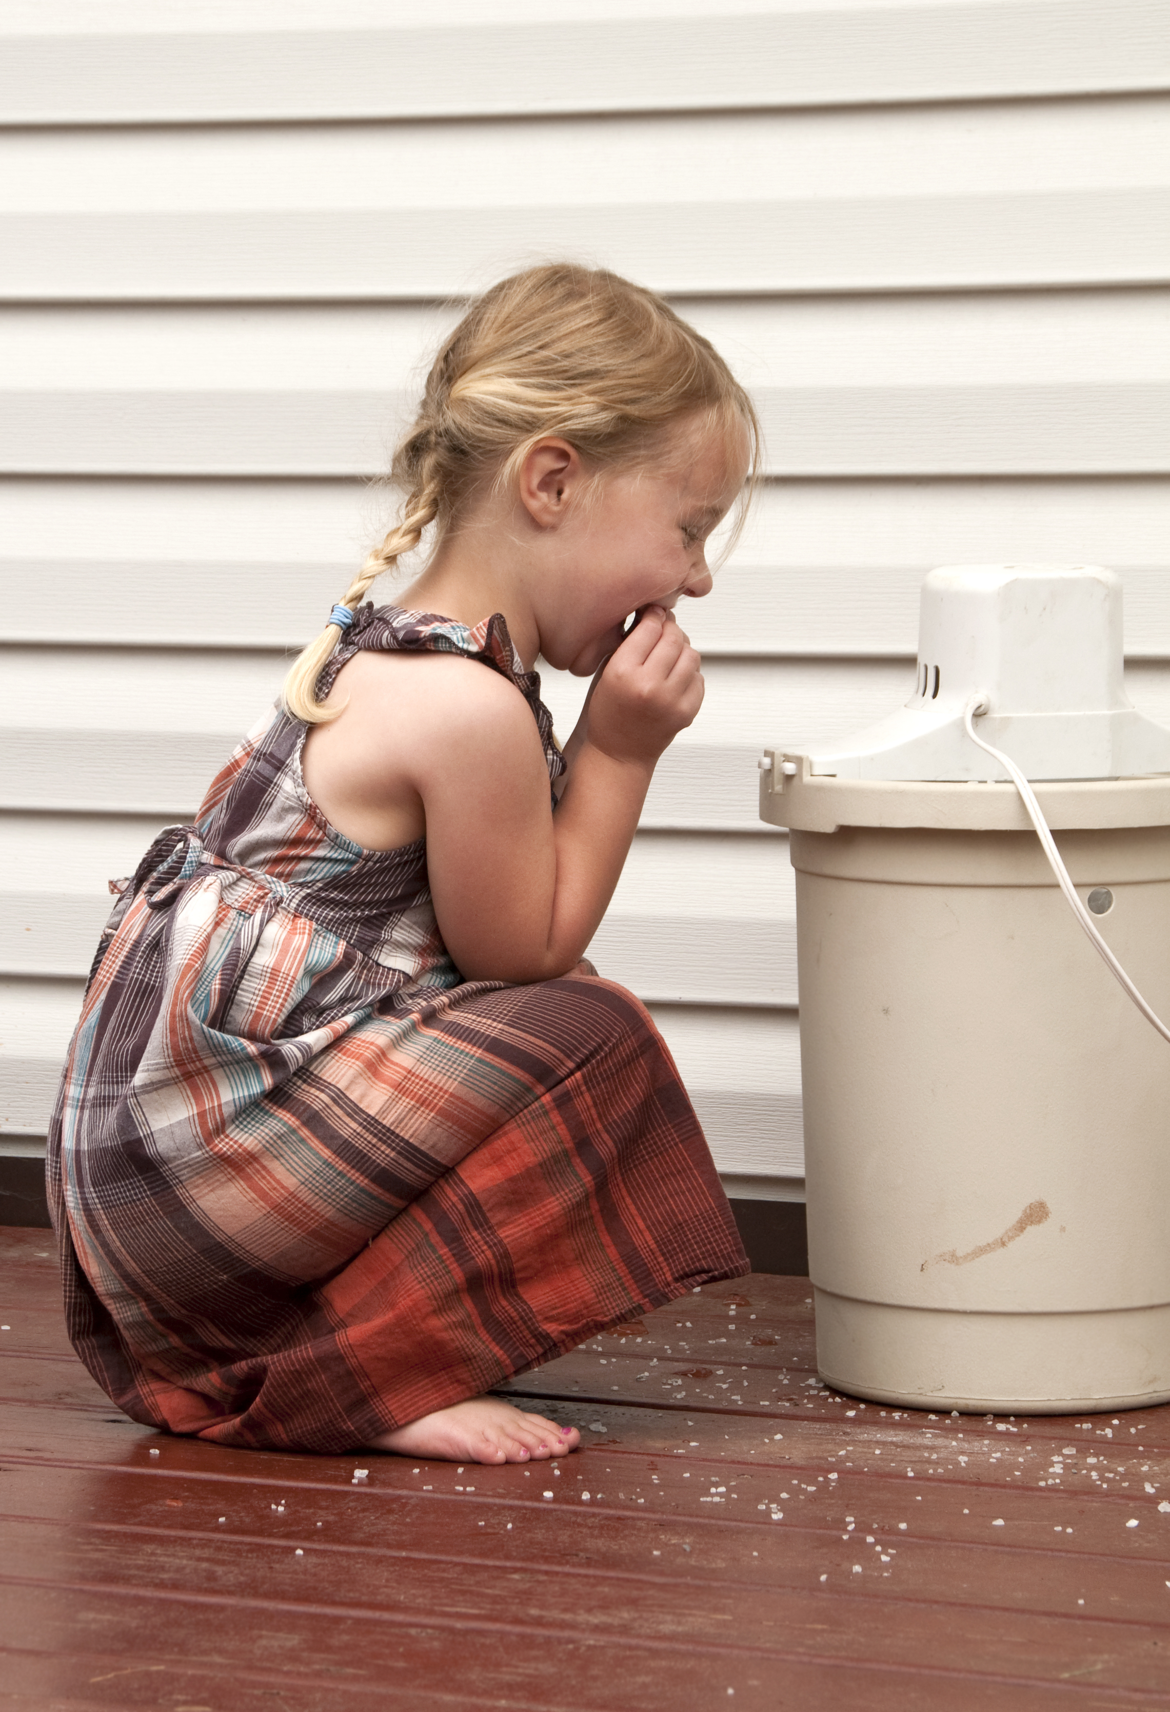
I Surrender My Expectations

Slide 2
Sometimes the purpose we create for ourselves skews the expectations Christ has for us.

Slide 3
He must increase, but I must decrease.
John 3:30

Slide 4
Date
Time
Place

Slide 5
In partnership
with….

