Slide 1

I
Surrender
My
Marriage

Slide 2

We search for fulfillment in our Christian marriages and do not realize we are searching in cultural principles instead of surrendering our marriages to God’s standards.

Slide 3

Stop making your obedience to God contingent on your spouse’s action.

Slide 4

I Peter 3:1-6
What instructions are wives given to “win” husbands and faithfully carry out their role as wives?

Slide 5

One of God’s purposes for marriage is to make us mature in love by requiring us to emulate Christ-like love when we don’t feel like it.

Slide 6
Marriage is my most important act of service and ministry--- forcing me to draw closer to Christ and plead that He make me more like Him.

Slide 7
Philippians 1:6
Being confident of this very thing, that He which hath begun a good work in you will perform it until the day of Jesus Christ.

Slide 8

Submission to our husbands shows we value our relationship with Christ even more.

Slide 9
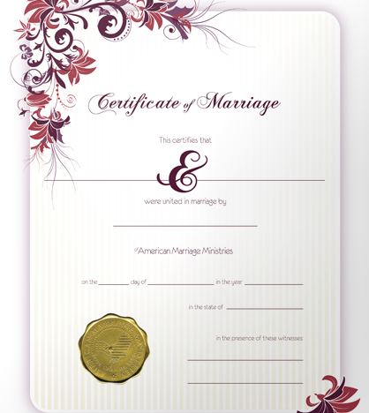
When we enter a marriage, we make a commitment to God and to our spouse to show acts of love, independent of our feeling.

Slide 10

1 Corinthians 13:1-3
Do our marriages even have hope without acts of love?

Slide 11
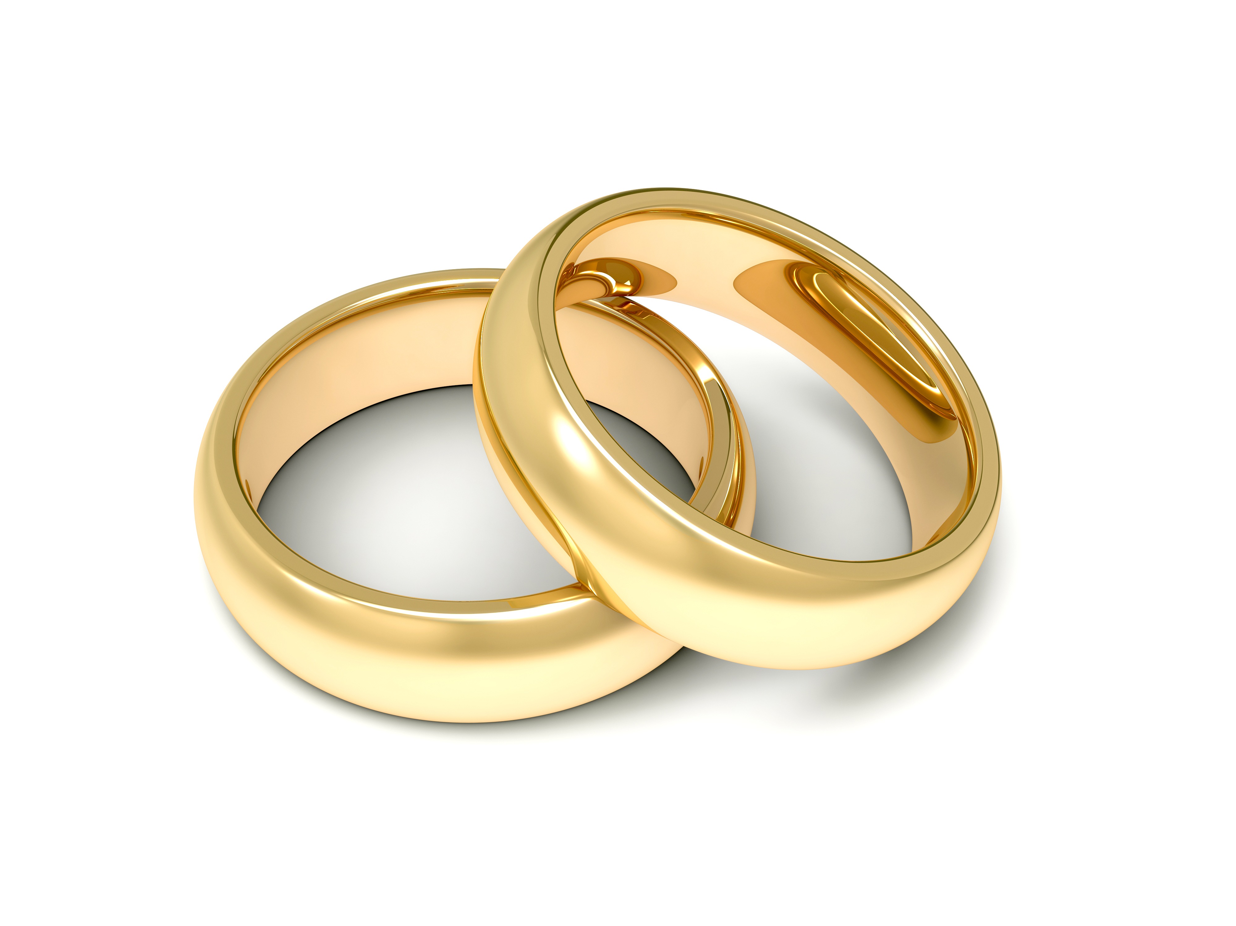
Ask God to reveal where you could show more love toward your husband that would bring glory to His name.

