Slide 1
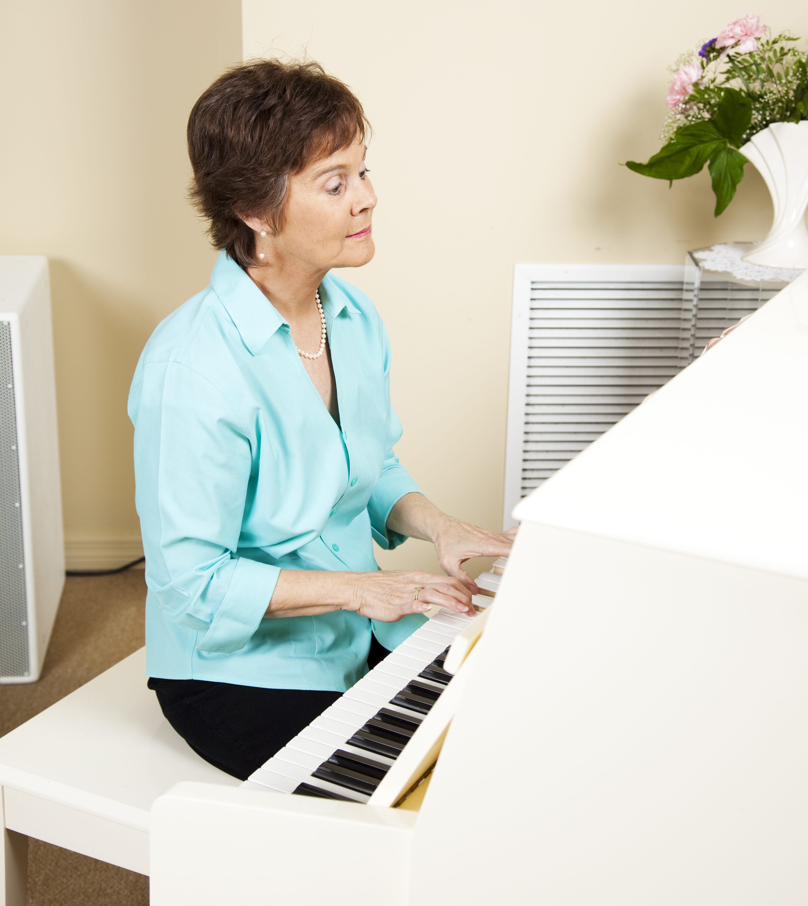
I
Surrender
My
Abilities

Slide 2
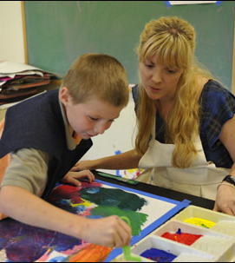
God gave you a very special gift!
No one can do a better job at being you than you.

Slide 3
1 Corinthians 12
Understand how your abilities relate to the church and therefore to the individuals within the body of Christ.

Slide 4
Spiritual gifts are not the same as
the fruit of the Spirit,
though they are easy to confuse.

Slide 5

Trust God to show you your spiritual gift(s) and allow Him to guide you in the best way to use that gift.

Slide 6
Availability and ability are not synonymous.

Slide 7
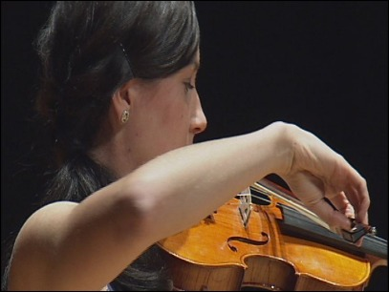
Are you serving because it is your gift, or because you are available?

Slide 8
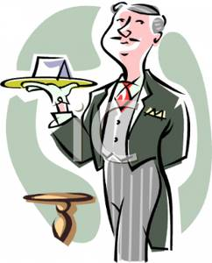
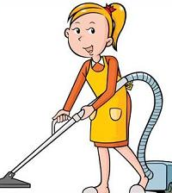
Know when to serve
…and when to be served.

Slide 9
God has designs on our future….and He has designed us for the future. He has given us something to do in the future that no one else can do.
(Ruth Senter)

Slide 10

Sometimes our own priorities and prideful natures stop us from encouraging others to use their abilities.

Slide 11
What happens when you are the only one at your church with the unique, God-imparted gift to do a certain job, but you are burned out?

Slide 12
Matthew 11:28
When our strength is at an end, what does God promise?

