Slide 1
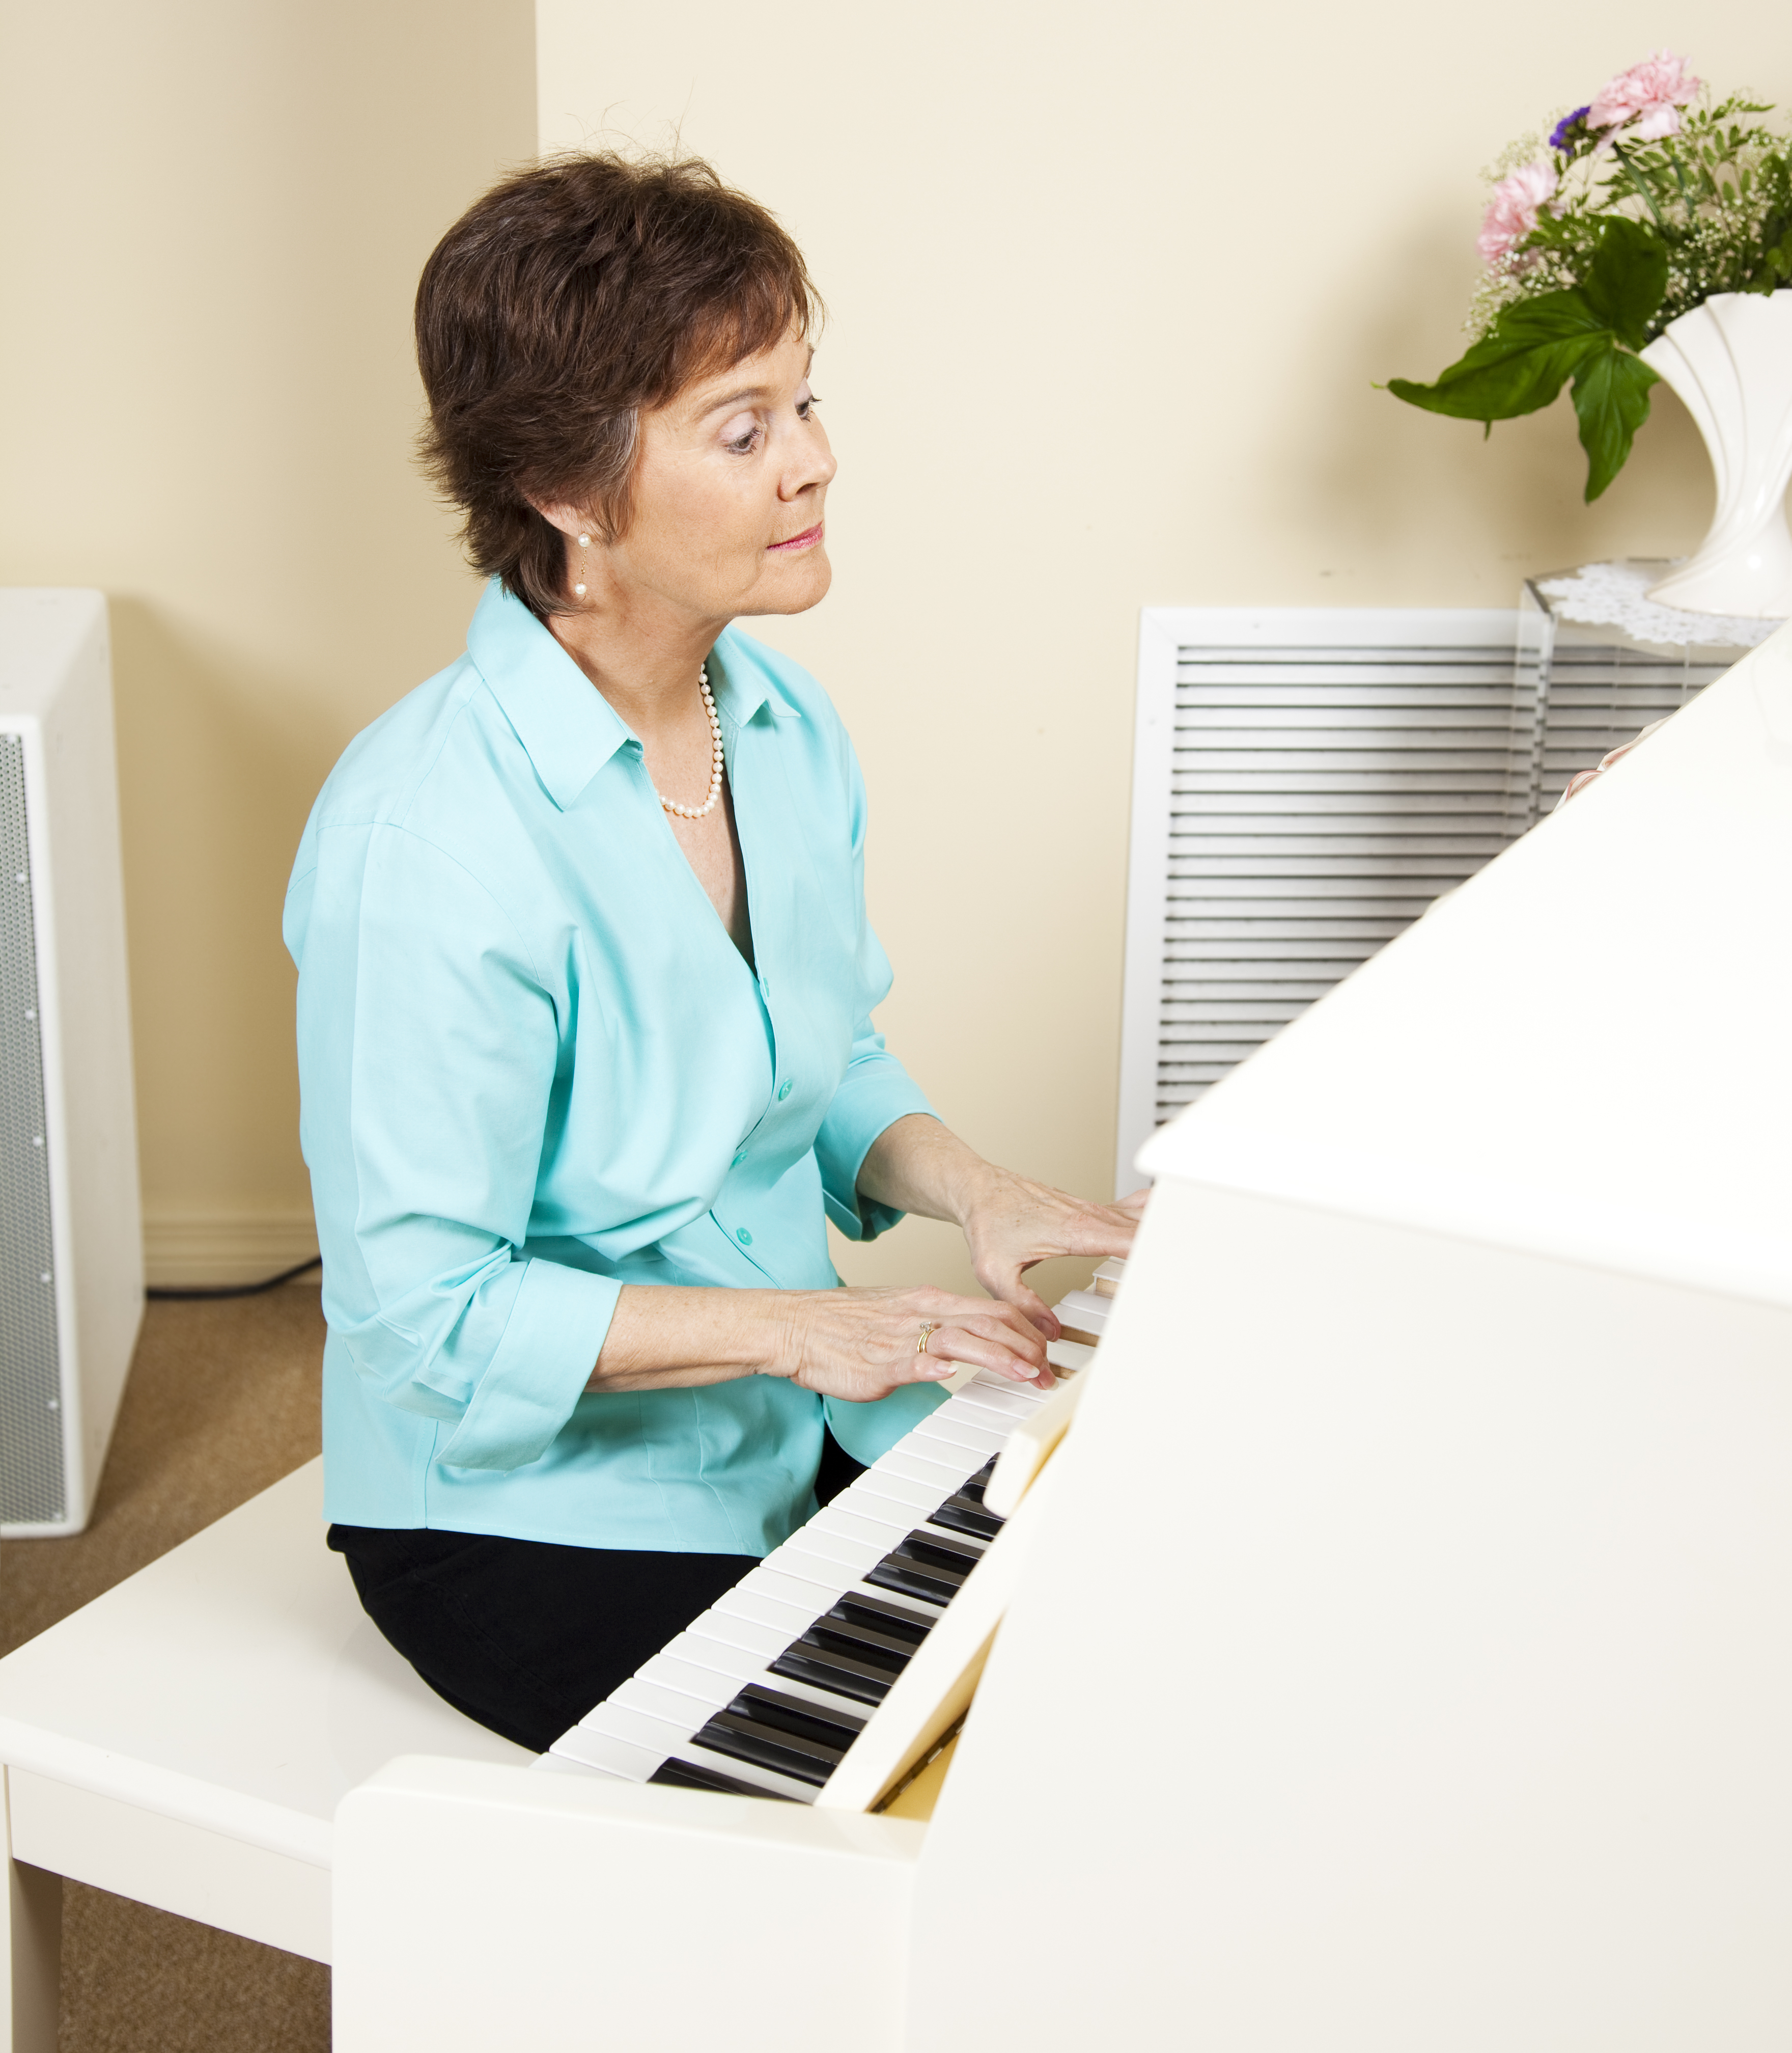
I Surrender My
Abilities

Slide 2
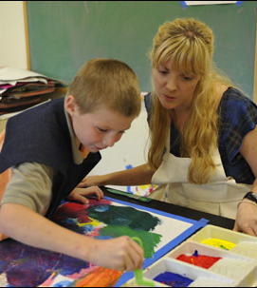
God gave you a very special gift!
No one can do a better job at being you than you.

Slide 3

Trust God to show you your spiritual gift(s) and allow Him to guide you in the best way to use that gift.

Slide 4
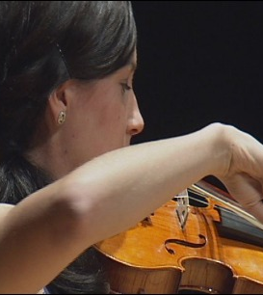
Date
Time
Place

Slide 5

In partnership
with….

