Slide 1
I
Surrender
My
Addictions

Slide 2
Addictions, when do they begin?

Slide 3
Does sin cause the addiction?
Or does the addiction cause the sin?

Slide 4
How do addiction and faith live together in the same person?

Slide 5
Addiction has been around as long as sin has been around.

Slide 6
Addictions have plagued the human race since the first sin caused Adam and Eve to be removed from the perfection of the Garden of Eden.

Slide 7
Anytime we let the desire or need to do one thing control us…we are on the verge of addiction.

Slide 8
Romans 8:1-8
Why are those of us who know Christ not condemned for our sin?
Does that mean we are free to sin?
How is the law of sin and death trumped by the law of the Spirit?

Slide 9
Sin desensitizes our hearts and minds.

Slide 10
Is there any hope?

Slide 11
Sin, and therefore the tendency toward addiction, is real, and we should put on the whole of God’s armor in order to avoid it.

Slide 12
Romans 8:1-17
We live in the power of the Holy Spirit and can be free from the power of sin in our lives.

Slide 13
James 5:16
The on-going prayers of the committed Christian will
produce results.

Slide 14
Christian 12-Step Programs
Celebrate Recovery
National Association for Christian Recover
Blazing Grace
Setting Captives Free

Slide 15
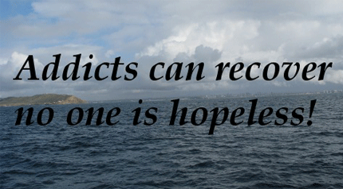
Be accountable to your friends.
Realize that addictions and the inclination to sin are bigger than you.

Slide 16
We have an amazing God who is real in our lives. Take Him at His word and begin the work of conquering instead of succumbing.

