Slide 1
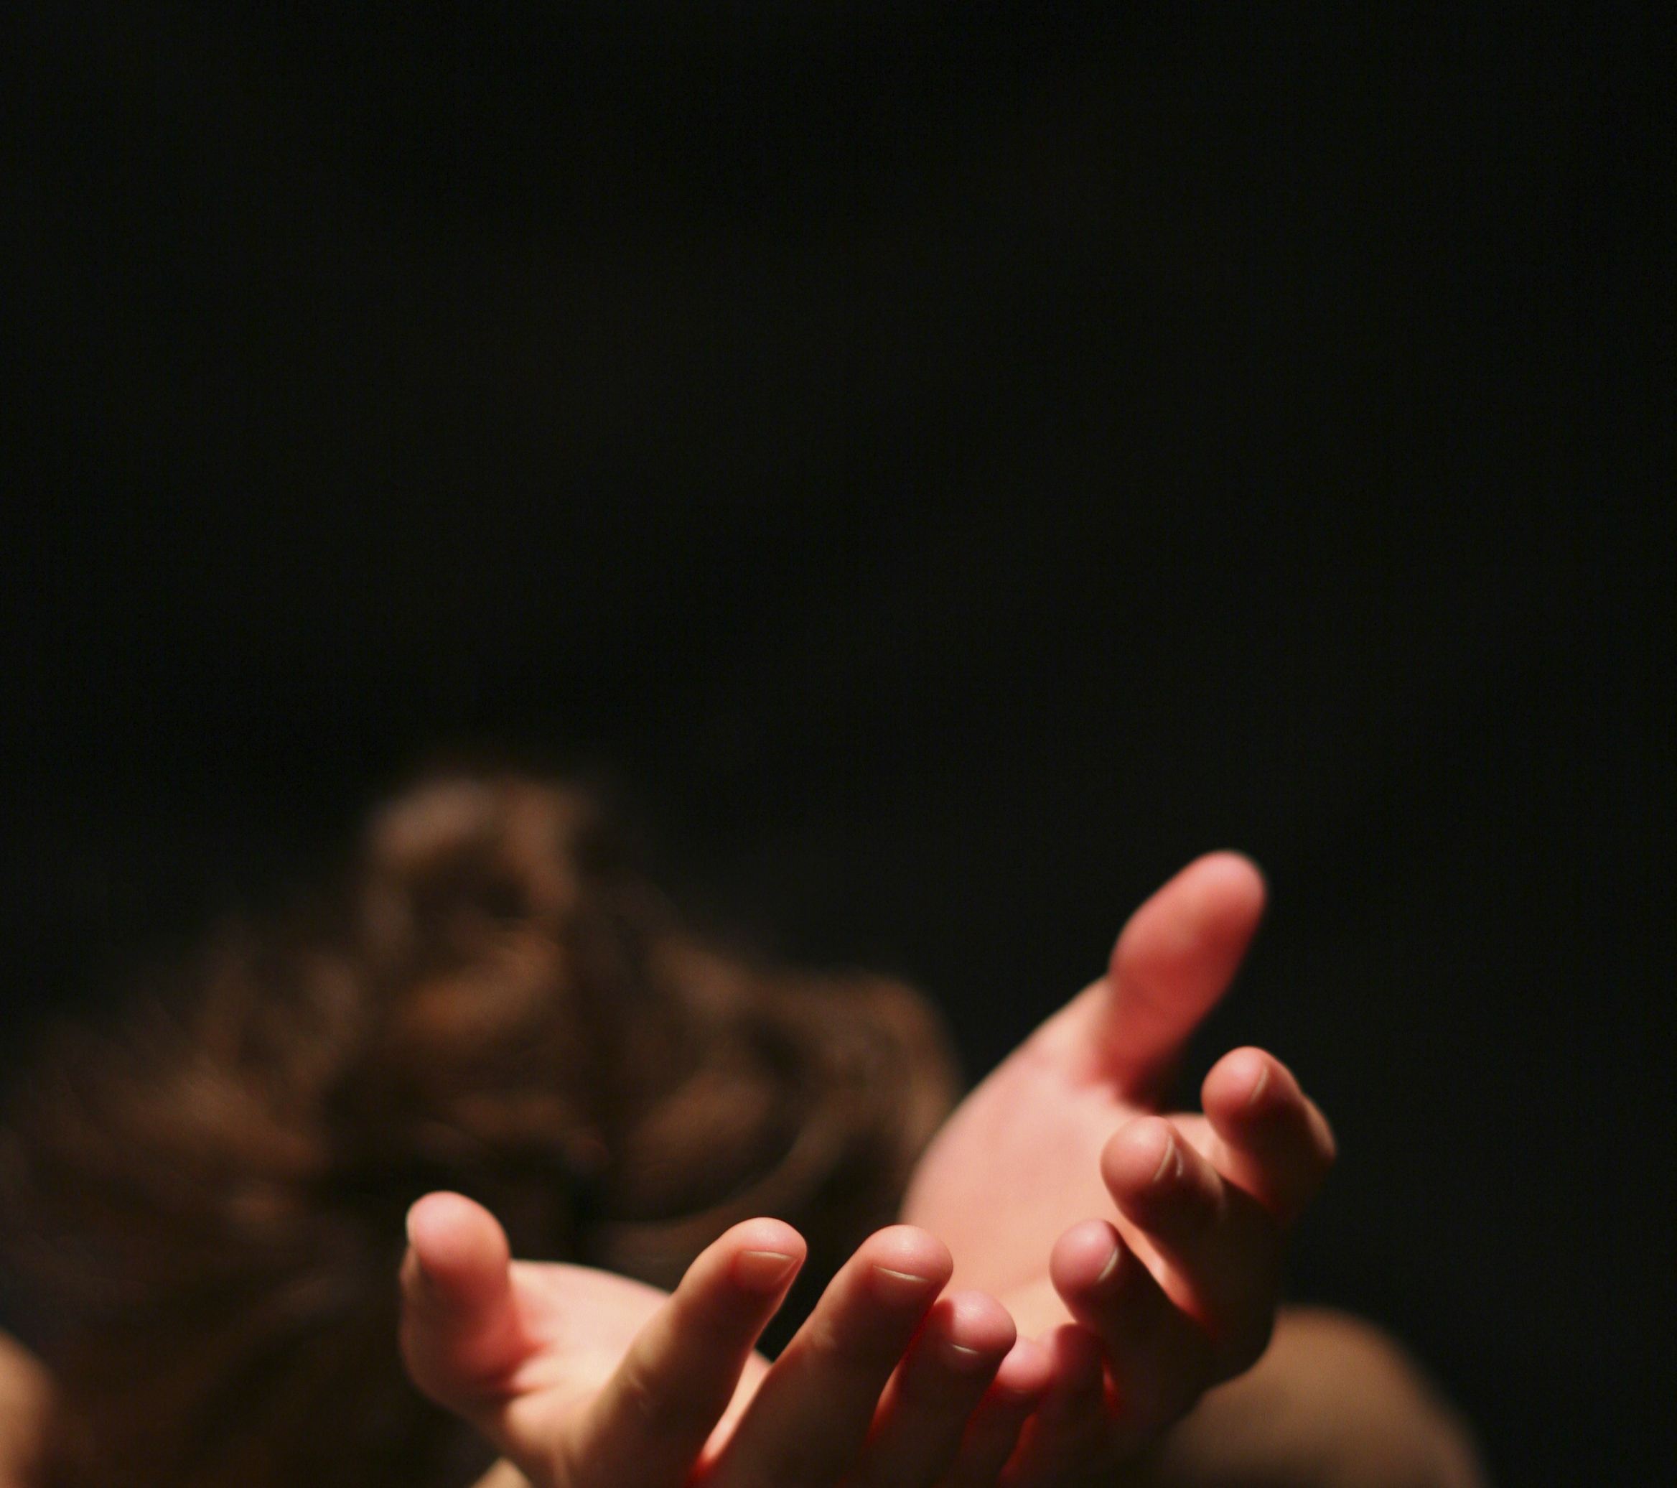
I Surrender My Addictions

Slide 2
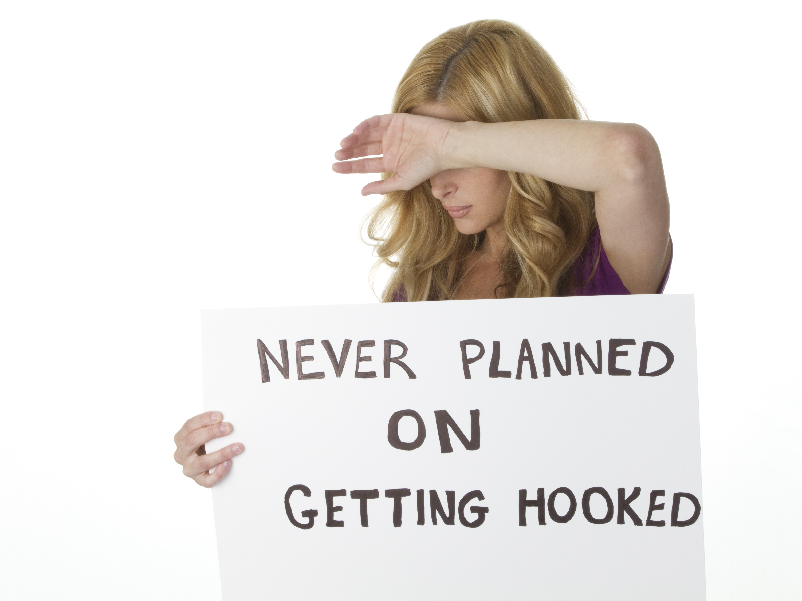
Addictions, when do they begin?

Slide 3
Does sin cause the addiction?
Or does the addiction cause the sin?

Slide 4
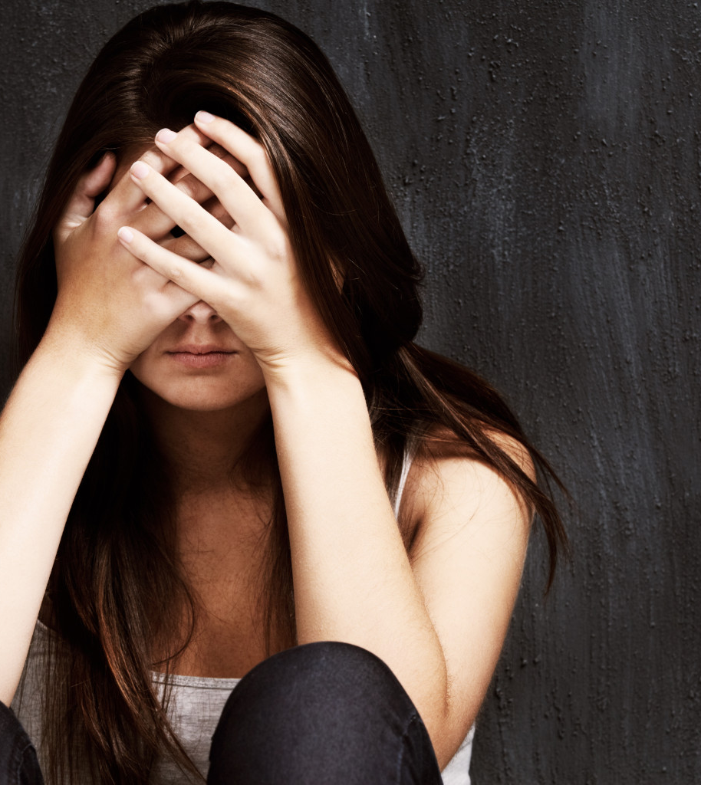
How do addictions and faith live together in the same person?

Slide 5
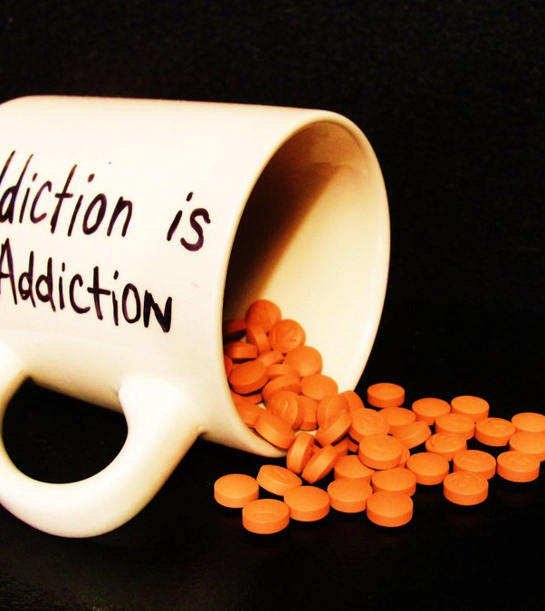
Date
Time
Place

Slide 6
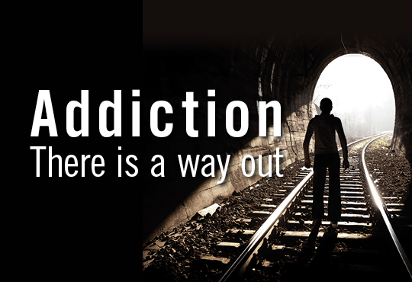

Slide 7

In partnership
with….

