Slide 1
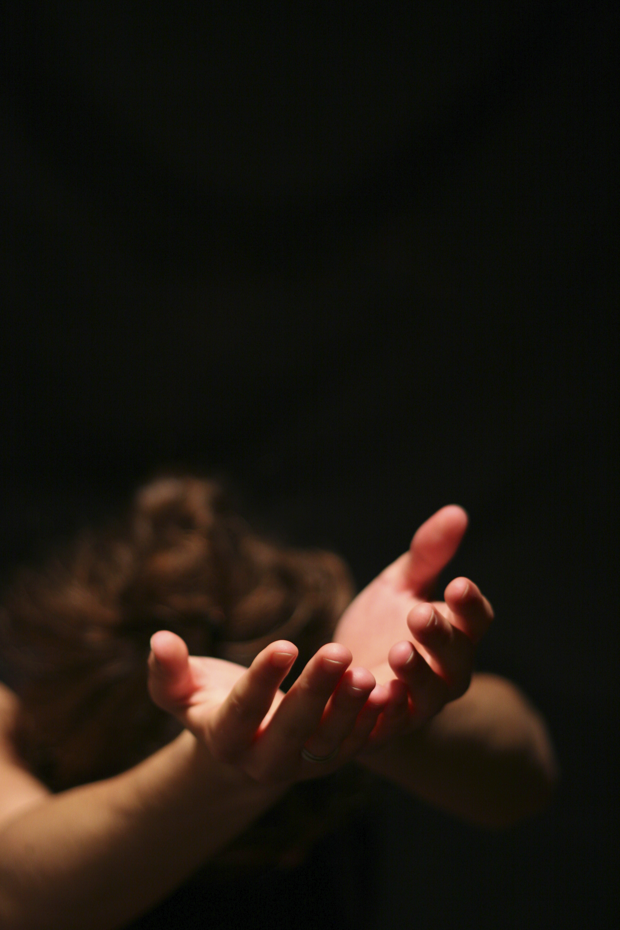
I Surrender Myself

Slide 2
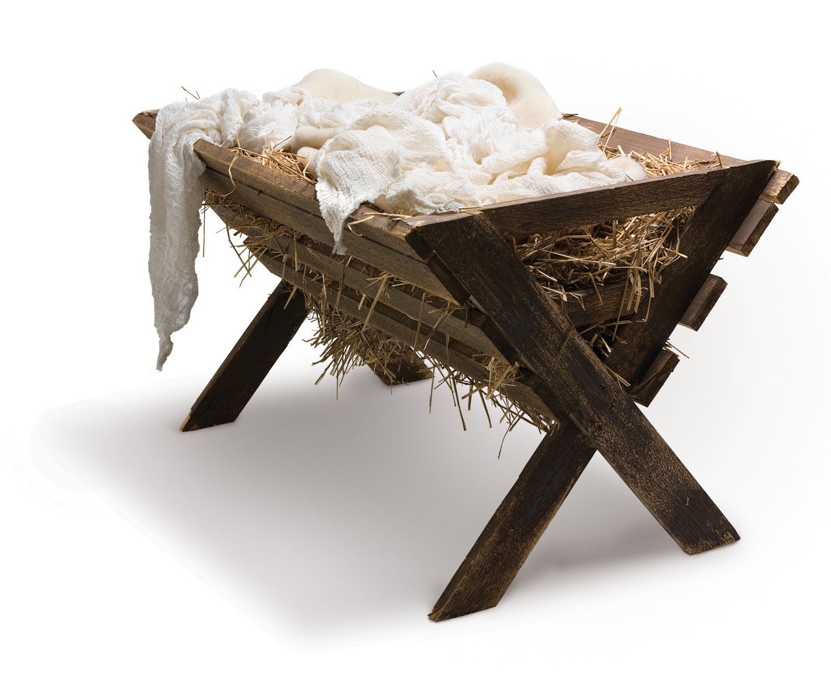
Christ set the example of surrender of self when He emptied Himself and became a man.

Slide 3
Surrendering self is an act of worship directed by the Holy Spirit’s renewing and our responding.

Slide 4
Date
Time
Place

Slide 5

In partnership
with….

