Slide 1

Speech
James 3:8

Slide 2
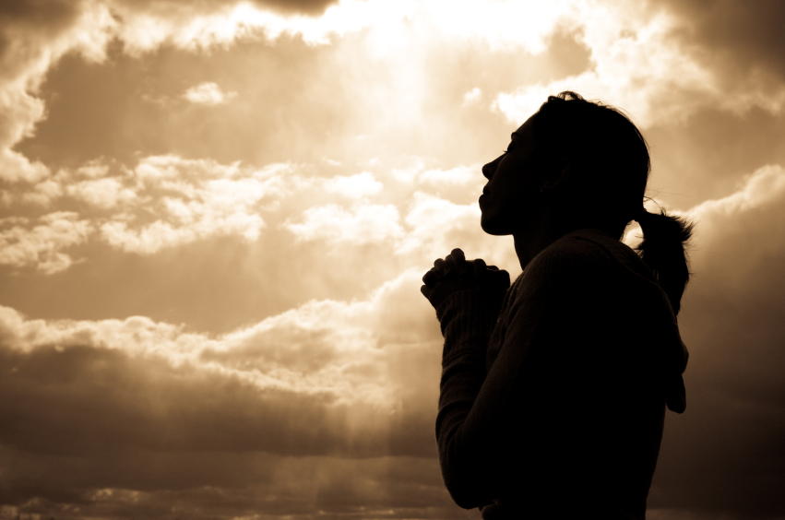
A healthy examination of our lives and motives is in order from
time to time.

Slide 3

The tongue’s ammunition is words.

Slide 4

God’s Word calls us to keep our tongues from evil.
Psalm 34:13

Slide 5
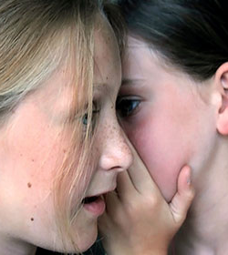
The tongue can be a…
…raging fire
…lethal weapon
…lifesaving tool for sharing the gospel.
Which is mine?

Slide 6

No man can tame the tongue
(James 3:8).
Yet a heart ruled by the Holy Spirit can bridle the tongue and use it to speak life, not death.

Slide 7
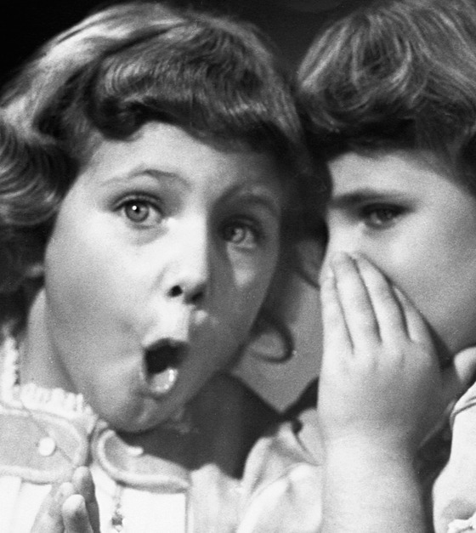
We are not called to be instigators;
we are called to be peacemakers.

Slide 8
People will remember
what you DO
more than what you SAY.

Slide 9
Living closer to God brings peace and contentment …. a place of refuge when our heart is hurting …
a way to keep our tongue under control.
(James 4:8)

Slide 10
It is hard to bicker
with someone
speaking gently and lovingly
to you
(Proverbs 15:1).

Slide 11

We must recognize there is a time to speak and a time to keep silent.
Ecclesiastes 3:7

Slide 12
Will I diligently seek to tame my tongue and thus bring glory to God?

