Slide 1
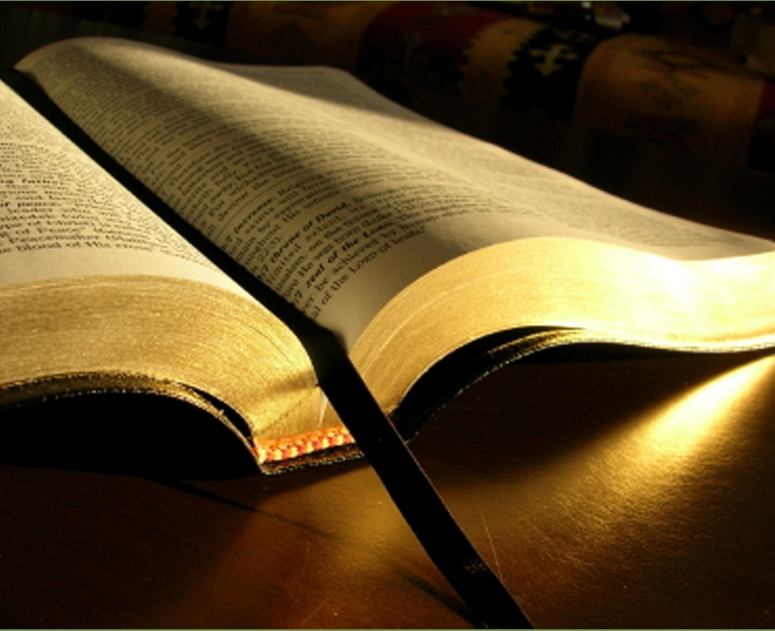
Biblical Edification
Ecclesiastes 3:1-3

Slide 2

Matthew 28:18-20
Spiritually speaking, edification involves promotion of spiritual growth in or building up of individual believers and the Church as a whole.

Slide 3
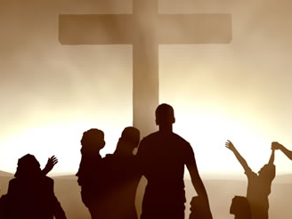
As each individual grows more and more into the likeness of Christ, the Church is strengthened and its influence in the world grows.

Slide 4

Galatians 4:19-20
Being formed into the likeness of Christ is a life-long process.

Slide 5
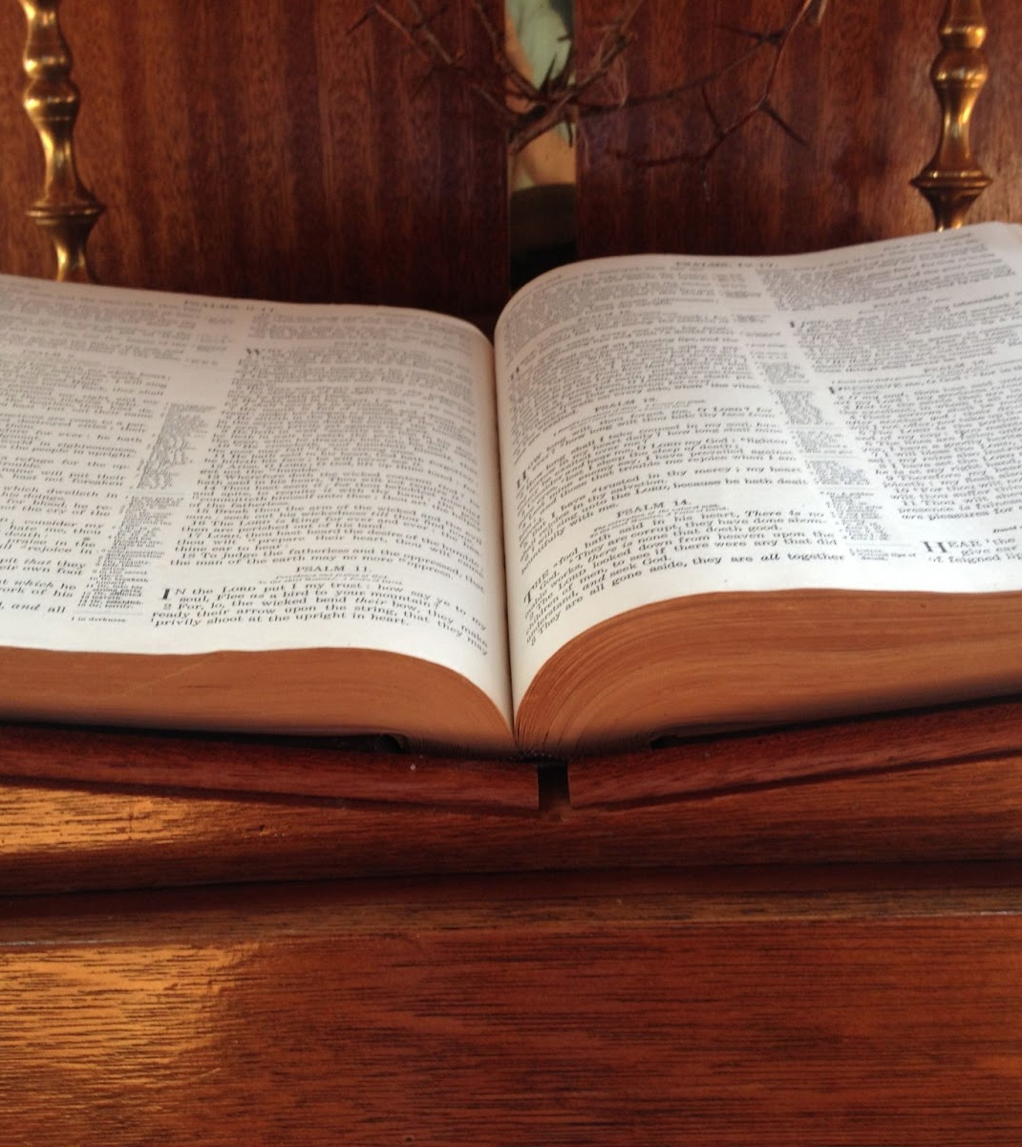
John 15:1-17 and Matthew 22:37-40
Spiritual growth is a Spirit-driven process of ongoing grace in the believer’s life.

Slide 6

I Corinthians 3:11
Christ Jesus is the foundation of our faith.

Slide 7
The ultimate purposes of observing spiritual discipline are for connecting more intentionally with our Lord and for positioning ourselves for the Holy Spirit’s work in us as He forms us into the likeness of Christ.

Slide 8
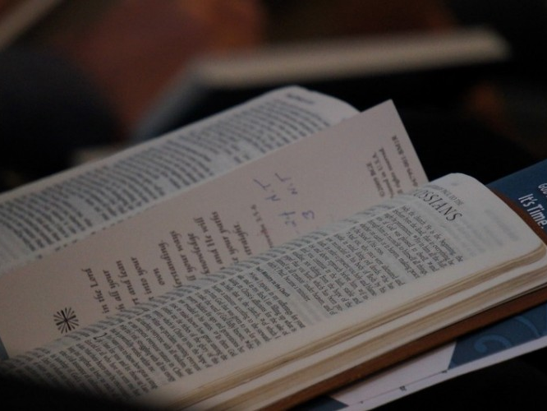
2 Timothy 3:16-17
How we hear from God depends on how we approach the reading and the hearing of His Word.

Slide 9

In this age of busy schedules and constant distractions, finding a time and place to have a conversation with God is almost impossible unless a person works at it.

Slide 10
Jesus was very busy and was sought after by multitudes, but He still managed to get away from the crowds, even away from those disciples who stayed with Him, so He could talk with His Father.
If this practice was necessary for Him, it must be necessary for each of His followers.

