Slide 1
Evangelism

Slide 2
Ecclesiastes 3:1-2

Slide 3
Sharing the message of salvation with others requires empowerment by the Holy Spirit and willingness to simply tell the story of God’s transformational work in our lives.

Slide 4
Evangelism is a time to plant, telling others about Christ. Then a time to reap relates to the actual experience of individuals coming into a relationship with Christ.

Slide 5
Matthew 28:18-20
Evangelism is not an option. Christ commanded all His followers to go and make disciples throughout the world.

Slide 6
A disciple is someone who believes in Jesus as Savior and obediently follows Him as Lord. Modern followers of Jesus are disciples, though that label is not typically used. Each disciple inherits the command to make disciples.

Slide 7
Evangelism…
…is simply telling the good news of Jesus Christ to other people. It is done with the goal of leading people to salvation through belief in Jesus.

Slide 8
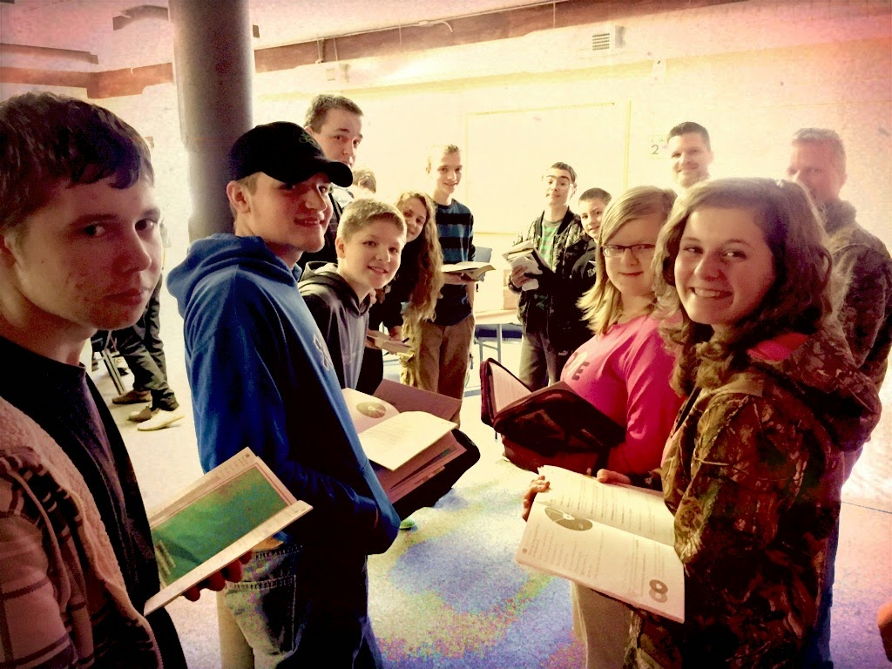
If every new generation of Christians obediently keeps His commandments, the disciple-making will continue until the end of time.

Slide 9
Romans 10:17
Faith cometh by hearing, and hearing by the word of God.

Slide 10
When a woman tells the story of her personal relationship to Christ, something about that story might pique the hearer’s curiosity.

Slide 11
Unless we embrace the population around us, develop friendships with people who need Christ, and share our best friend, Jesus, with them…
….we are missing opportunities to obey the Great Commission, in spite of our participation in sending missionaries to serve at home and abroad.

Slide 12
Pray for boldness, opportunities, and the words to say as you share the message of Jesus with others.

