Slide 1
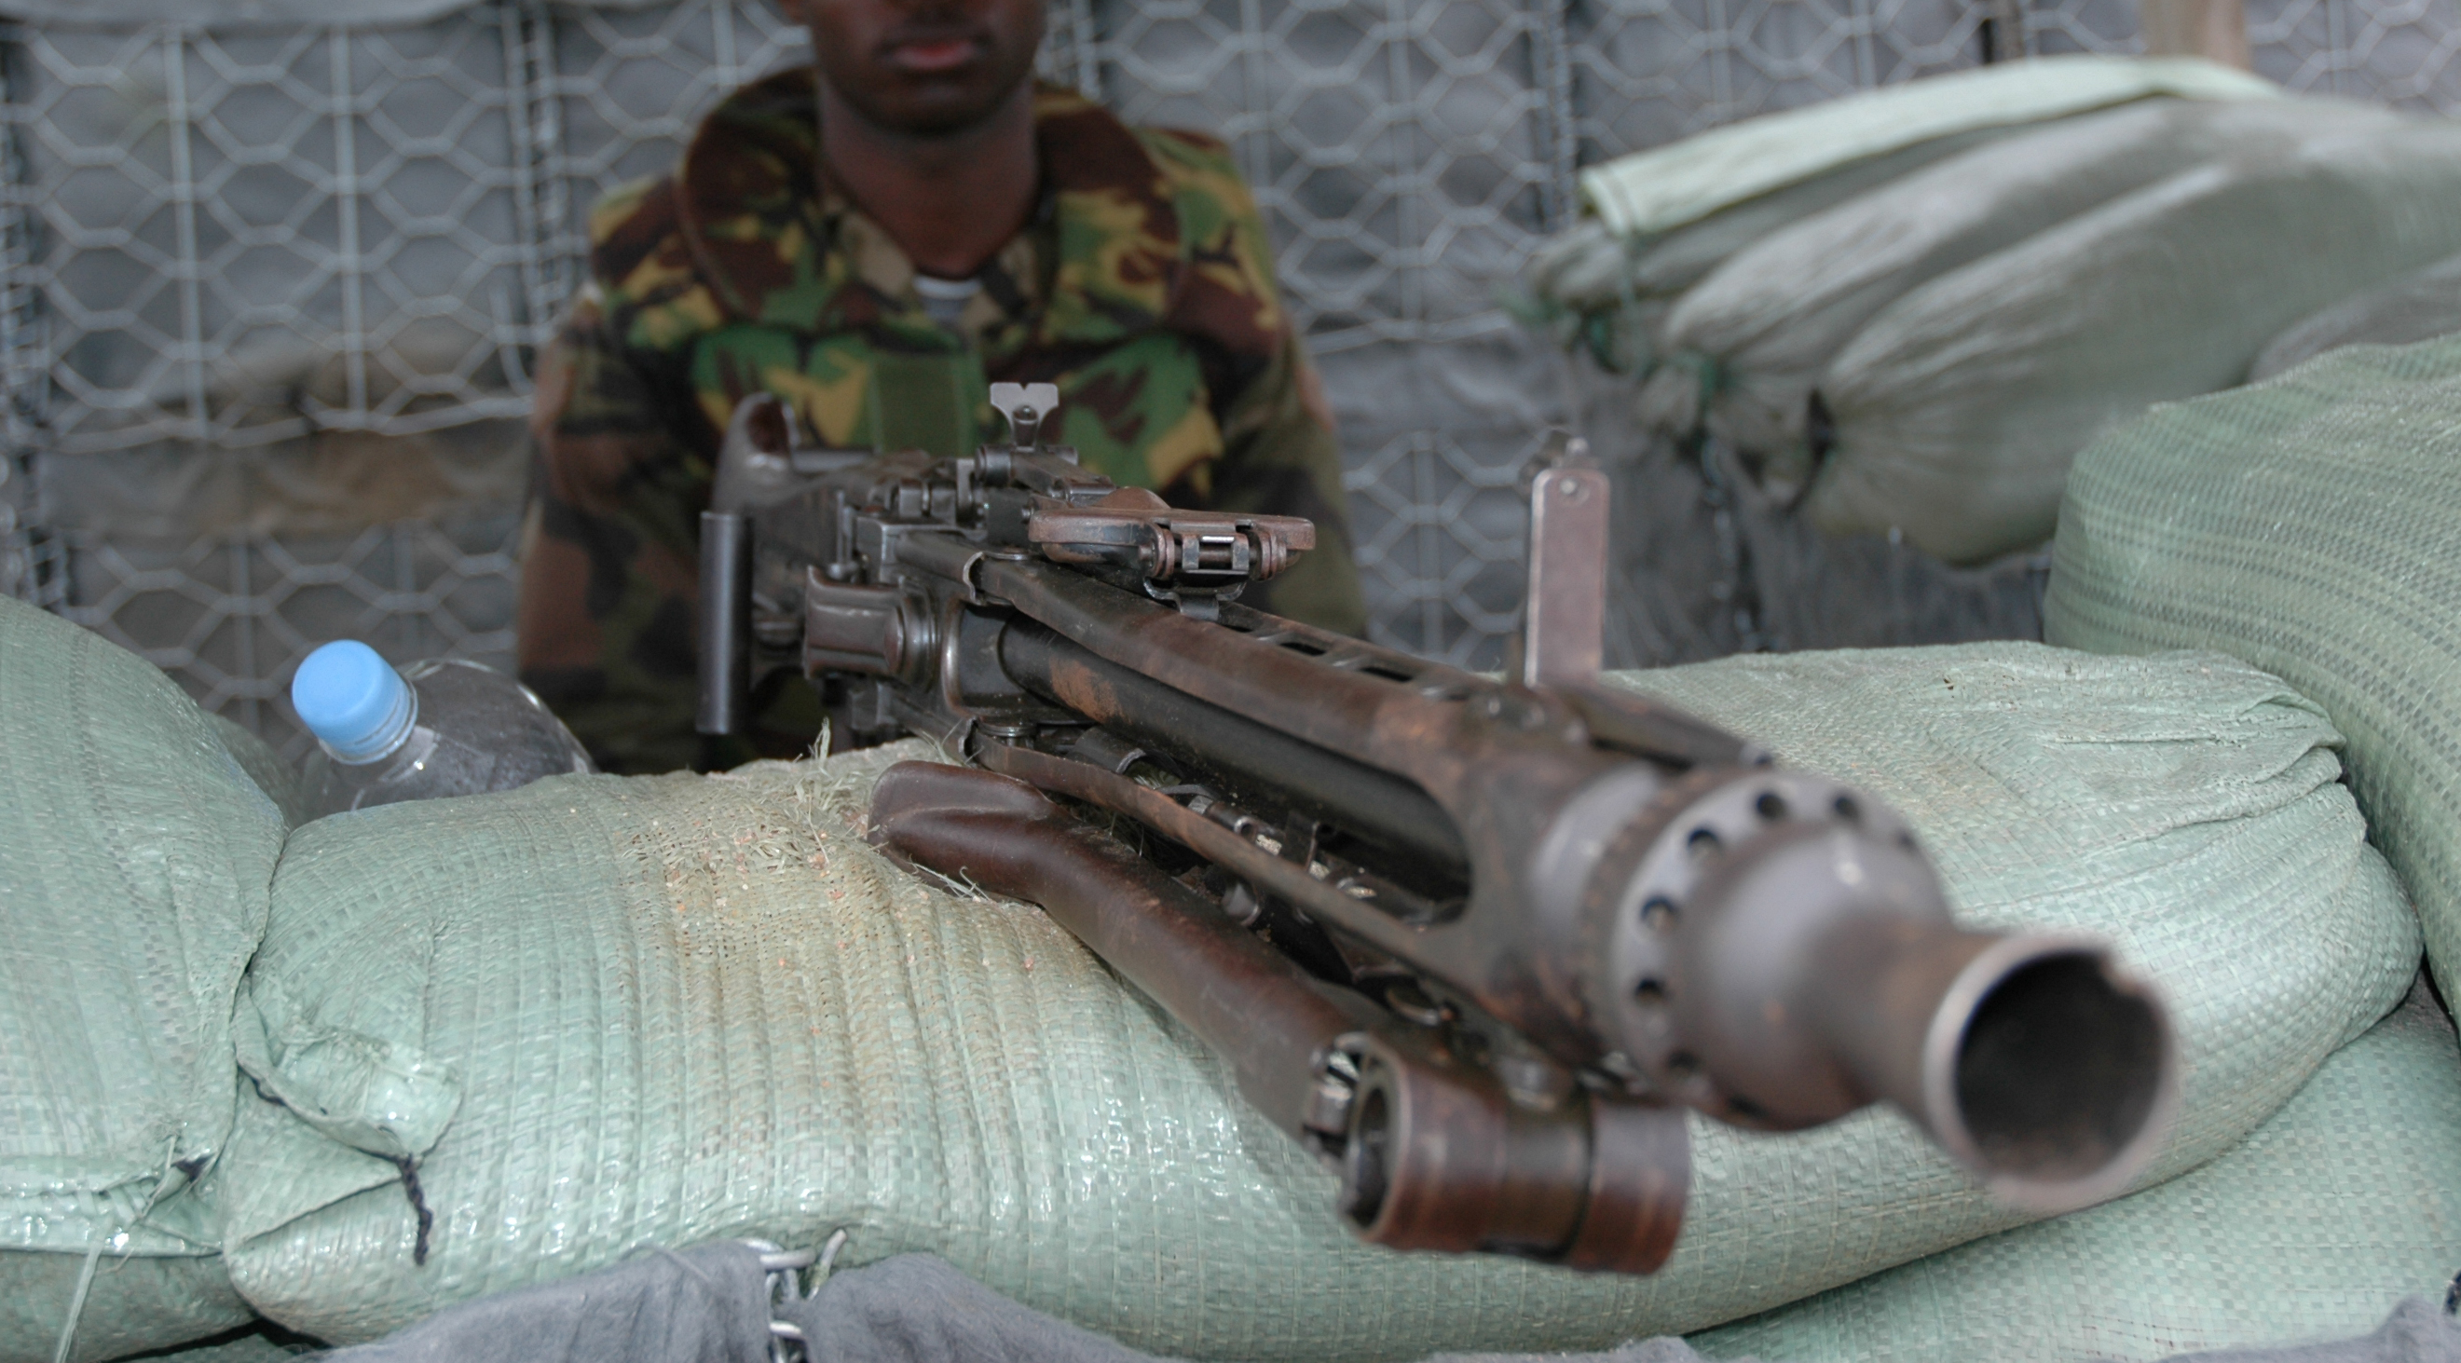
War and Justice

Slide 2
THE CHRISTIAN WOMAN and
War and Justice
Ecclesiastes 3:1-8
Genesis 6:1-8
Deuteronomy 25:17-19
Psalm 18:31-50
Revelation 19:11-21
Judges 6:14-16
Judges 7:18
Judges 4:4-14
Romans 12:14-21
I Peter 2:23-24
Romans 13:1-7
Luke 22:35-38

Slide 3
We can respond to and reconcile the difficult realities of war by remembering 3 principles:
God is both just and righteous;
War, though tragic and horrible, is sometimes both just and necessary;
Our response to evil, violence, and war should reflect both justice and mercy.

Slide 4
One thing that can help us accept the reality and necessity of war in our fallen world is to remind ourselves of the nature of God.

Slide 5
Noah found grace in the eyes of the Lord.
Genesis 6:1-8

Slide 6
Revelation 19:11-21
Who is seated on the white horse?
What two things does He do in righteousness?

Slide 7
Thomas Aquinas
In order for a war to be just, three things are necessary.
First, the authority of the Sovereign.
Secondly, a just cause.
Thirdly, a rightful intention.

Slide 8
Psalm 18:31-50
What military ability did David attribute to the Lord?

Slide 9
The Lord promised and provided victory in these just causes so His people could live in peace.
Moses: Numbers 31:1-12
Gideon: Judges 6:14-16
Deborah: Judges 4:4-14

Slide 10
There is a marked difference between a nation’s duty to uphold justice and defend her people …. and the response Jesus expects from us as individuals when we are wronged.

Slide 11
Romans 12 and Matthew 5
Tell us not to respond in kind---you murdered my son, I’ll murder yours.
They do not mean that we will never use government court systems or church discipline efforts to prevent further abuse or right wrongs.

Slide 12
Matthew 25:34-40
Ask the Lord to guide your actions, not from a sense of guilt but from a heart that loves justice and mercy.

