Slide 1
Abortion

Slide 2
THE CHRISTIAN WOMAN and Abortion
Ecclesiastes 3:1-2
Psalm 139:13-17

Slide 3
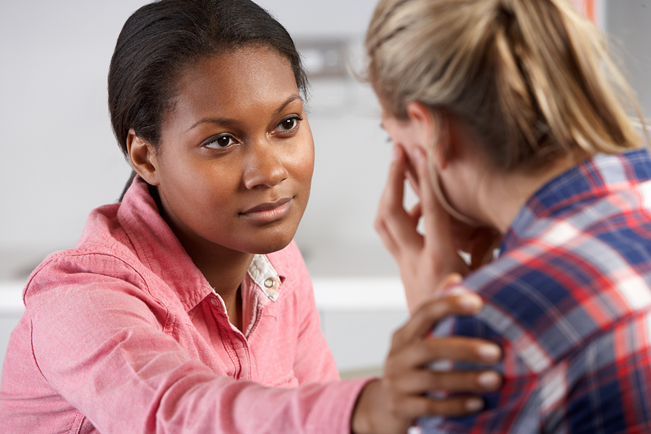
Life is precious and valuable to God—even the life of an unborn child. Yet, God offers grace, compassion, and healing to all who seek forgiveness for a past abortion.

Slide 4
Jeremiah 1:5
When does life begin?
At conception our DNA code is present. God says, “Before I formed thee in the belly I knew thee….”

Slide 5
Ecclesiastes 3:2
God has a
pre-determined
time for us to be born.

Slide 6
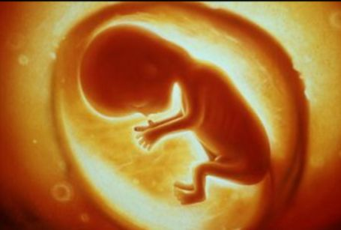
Jeremiah 1:5
God has a plan for the unborn child. God ordained for Jeremiah to be a prophet BEFORE he came forth from the womb.

Slide 7
An unborn child should not have to forfeit his life for the parents’ sin.

Slide 8
Why do women abort?
Fear
Extramarital relationship
Finances
Educational pursuits
Just don’t want the responsibility

Slide 9
We do not understand their reasoning because we are NOT in their situation.
It is overwhelming for them.
Fear is irrational.

Slide 10
Many women experience post-traumatic stress disorder (PTSD) almost immediately after having an abortion and it can continue to affect them years later.

Slide 11
How do we help?
We need to look at Jesus’ example with the woman caught in adultery.
“Neither do I condemn thee, go and sin no more”
(John 8:11).

Slide 12
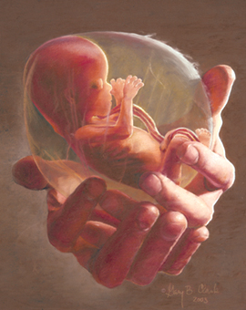
Where is the passion for the unborn child?
Is abortion something “too political” for us to become involved?
Is it not personal enough for me?

