Slide 1
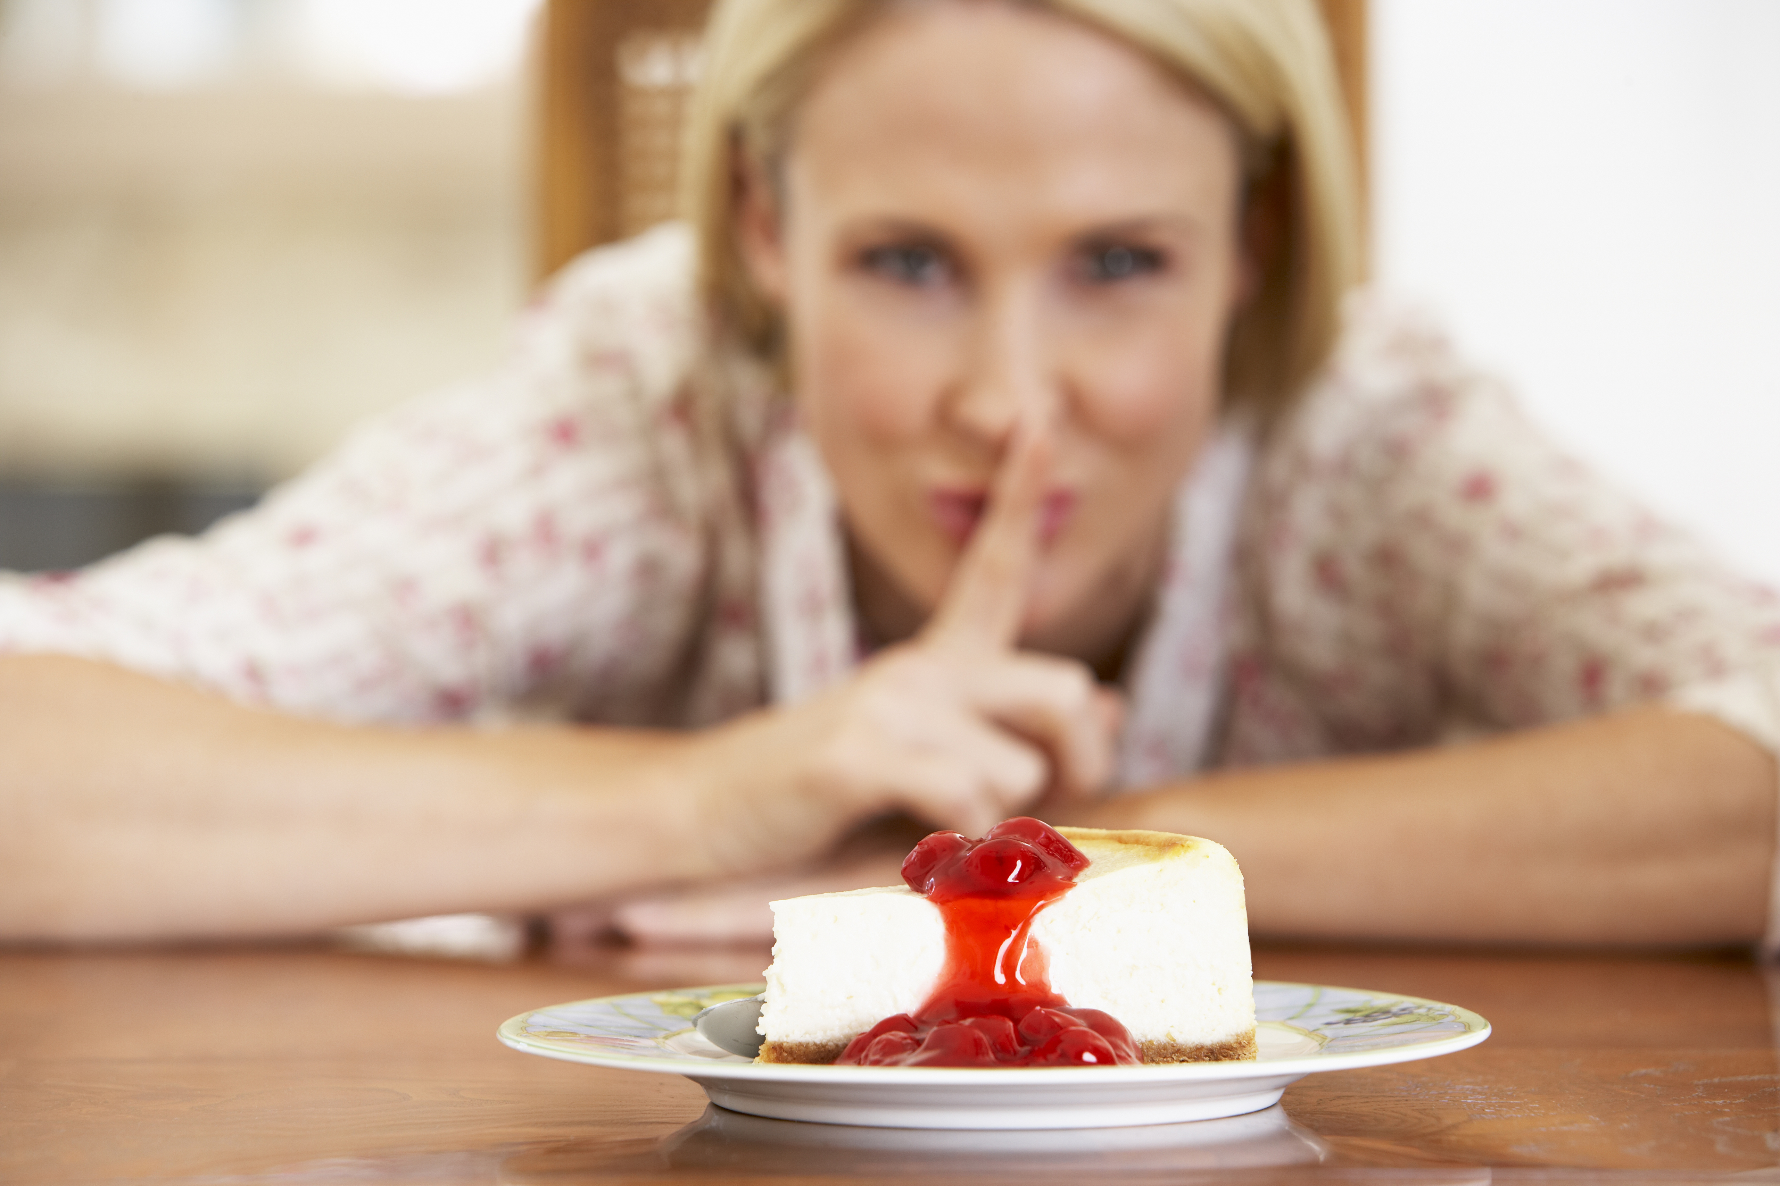
Self-Control

Slide 2
THE CHRISTIAN WOMAN and Self-Control
(Ecclesiastes 3:5)
Self-control is a gift we experience as we put on the whole armor of God, seek to build up His Kingdom, and embrace the cross.
Self-control involves surrendering ourselves to God’s will.

Slide 3
A time to cast away stones.
A time to embrace.

Slide 4
Date:
Time:
Location:

Slide 5
In partnership with…

