Slide 1
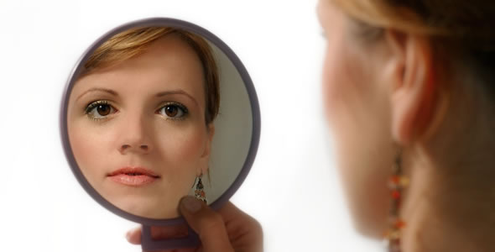
Beauty

Slide 2
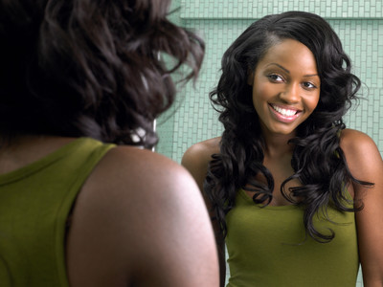
THE CHRISTIAN WOMAN and
Beauty
Ecclesiastes 3
Genesis 1
Psalm 139

Slide 3
Because God the Creator makes everything beautiful in His time, we can recognize His authority, respond in worship, realize our own worth and trust His timing in our lives.

Slide 4
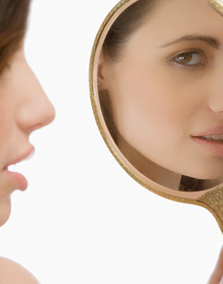
In our culture, beauty reflects Hollywood more than holiness.

Slide 5
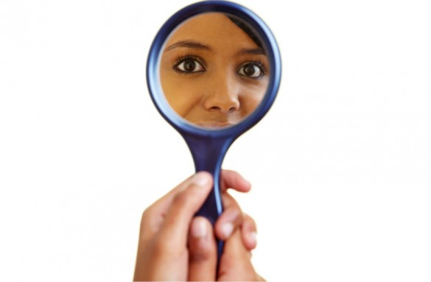
He Made Us
You are beautiful because a thoughtful, infallible Creator who has a very special purpose for your life designed you.

Slide 6
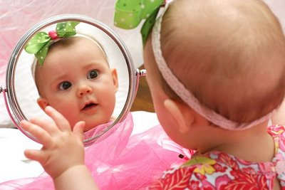
Everything
God has declared that there is beauty in everything He created, including you.

Slide 7
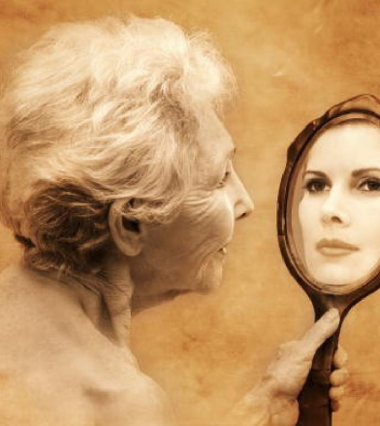
Beautiful
Beauty is not about temporal things.
It is an inward attitude.

Slide 8
Genuine beauty is evident in the woman who fears the Lord.

Slide 9
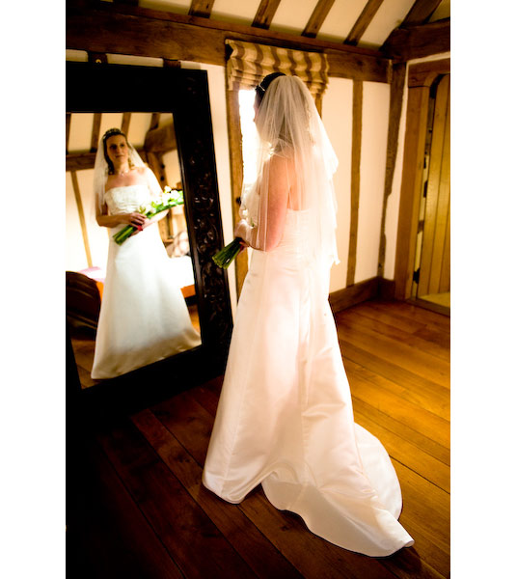
In Its Time
God put us in a world of order that counts time.

Slide 10
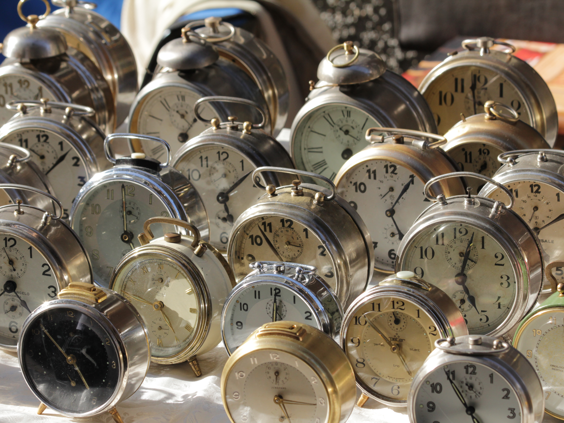
Our times are in His hands.
Psalm 31:15

Slide 11
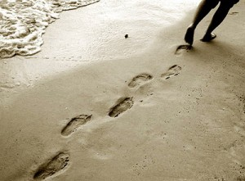
When we cannot see, we walk by faith confident in His promises.

