Slide 1
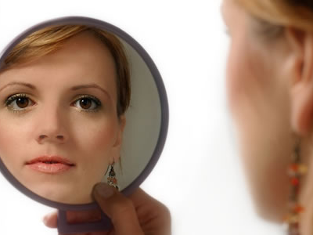
Beauty

Slide 2
THE CHRISTIAN WOMAN and Beauty
(Ecclesiastes 3; Genesis 1; Psalm 139))
Because God the Creator makes everything beautiful in His time, we can recognize His authority, respond in worship, realize our own worth and trust His timing in our lives.

Slide 3
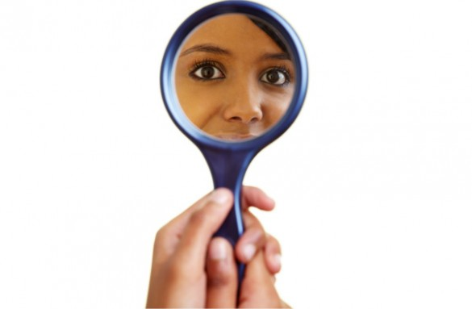
Date:
Time:
Location:

Slide 4
In partnership with…

