Slide 1
Women Jesus Challenged

Slide 2
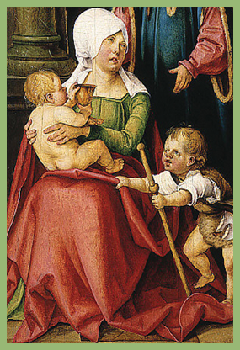
Matthew 20:20:
And he said unto her, What wilt thou? She saith unto him, Grant that these my two sons may sit, the one on thy right hand, and the other on the left, in thy kingdom.

Slide 3
Jesus challenged the mother of James and John in her outrageous request for her two sons.

Slide 4
Matthew 27:55-56:
And many women were there beholding afar off….among which was Mary Magdalene, and Mary the mother of James and Joses, and the mother of Zebedee’s children.

Slide 5
Jesus challenged the expectations of Salome and others as they watched Him suffer on the cross.

Slide 6
Titus 3:7
That being justified by his grace, we should be made heirs acccording to the hope of eternal life.

Slide 7
Jesus challenged Salome’s faith when His death seemingly destroyed all expections.

Slide 8
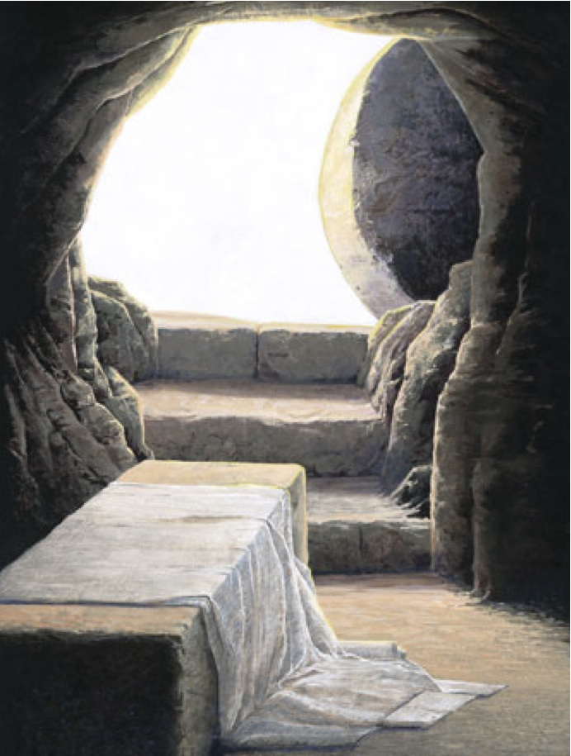
Ephesians 3:20
Now unto him that is able to do exceeding abundantly above all that we ask or think, according to the power that worketh in us.

Slide 9
Jesus challenged Salome at the tomb on Resurrection morning ---a day that exceeded all expectations.

Slide 10
Time:
Date:
Location:

Slide 11
In partnership
with….

