Slide 1
Women Jesus Challenged

Slide 2
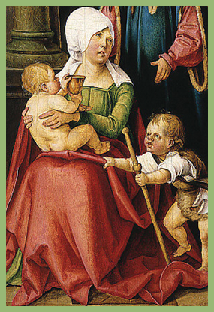
Matthew 20:20:
And he said unto her, What wilt thou? She saith unto him, Grant that these my two sons may sit, the one on thy right hand, and the other on the left, in thy kingdom.

Slide 3
Jesus challenged the mother of James and John in her outrageous request for her two sons.

Slide 4
^{Conduct a self-audit.}
Do your requests/ prayers/expectations to and of God go beyond what might be in His will?
Do all the things you expect God to do in and for you bring Him glory?

Slide 5
Matthew 27:55-56:
And many women were there beholding afar off….among which was Mary Magdalene, and Mary the mother of James and Joses, and the mother of Zebedee’s children.

Slide 6
Matthew 27:46:
What was Jesus’ question?

Slide 7
Jesus challenged the expectations of Salome and others as they watched Him suffer on the cross.

Slide 8
“Our life is full of brokenness—broken relationships, broken promises, broken expectations. How can we live with that brokenness without becoming bitter and resentful except by returning again and again to God’s faithful presence in our lives?”
–Henri Nouwen from Some Quotable Christian Quotes

Slide 9
Titus 3:7:
That being justified by his grace, we should be made heirs according to the hope of eternal life.

Slide 10
Jesus challenged Salome’s faith when His death seemingly destroyed all expectations.

Slide 11
Times of no expectations are perfect moments for our prowling Enemy to creep in for the attack—planting seeds of doubt, nursing our fears and causing us to question God’s love and forgiveness.
Jesus’ model prayer takes into account those very times. (Matthew 6:9-13)

Slide 12
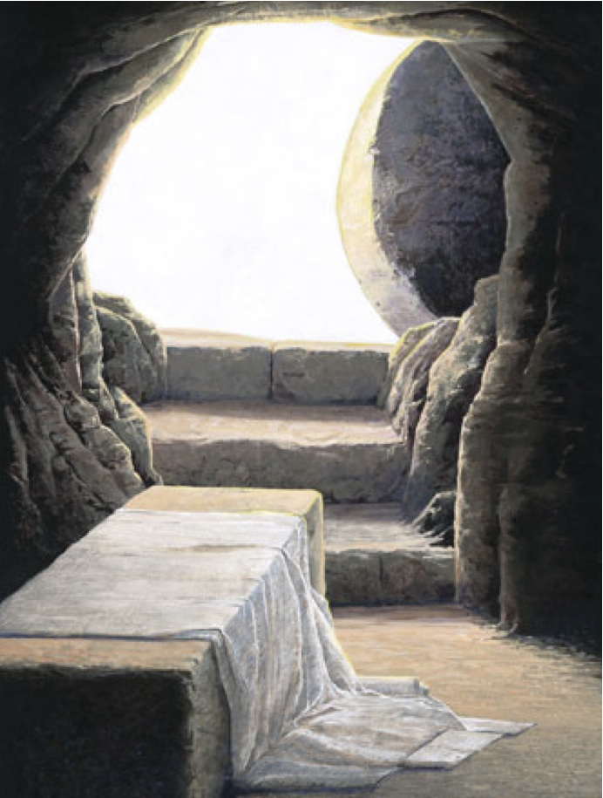
Ephesians 3:20:
Now unto him that is able to do exceedingly abundantly above all that we ask or think, according to the power that worketh in us.

Slide 13
Jesus challenged Salome at the tomb on Resurrection morning ---a day that exceeded all expectations.

Slide 14
Make time to just praise the Lord. Don’t ask Him for a thing. Just praise Him for always exceeding your expectations.

Slide 15
Time:
Date:
Location:

Slide 16
In partnership
with….

