Slide 1
Women Jesus Challenged

Slide 2
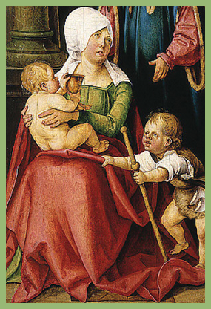
Jesus challenged the mother of James and John in her outrageous request for her two sons.

Slide 3
Jesus challenged the expectations of Salome and others as they watched Him suffer on the cross.

Slide 4
Jesus challenged Salome’s faith when His death seemingly destroyed all expectations.

Slide 5
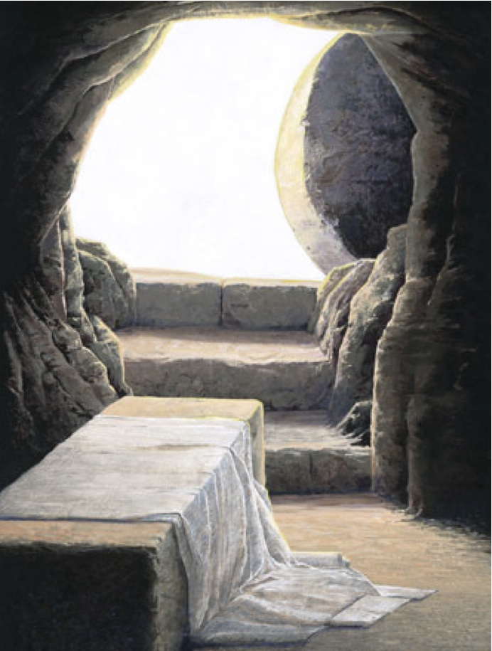
Jesus challenged Salome at the tomb on Resurrection morning ---a day that exceeded all expectations.

Slide 6
Time:
Date:
Location:

Slide 7
In partnership
with….

