Slide 1
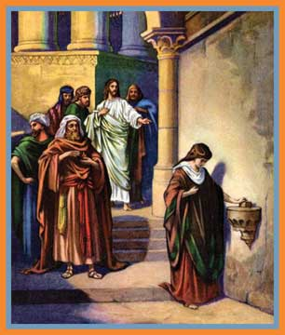
March Bible Study
“My Name is
Giver”
by Anita Scott

Slide 2
Leviticus 27:30: And all of the tithe of the land, whether of the seed of the land, or of the fruit of the tree, is the Lord’s: it is holy unto the Lord.

Slide 3
Giving financially acknowledges our gratitude to God, realizing all we possess comes as a gift from His hand.

Slide 4
Revelation 3:20:
Behold I stand at the door, and knock: if any man hear my voice, and open the door, I will come in to him, and will sup with him, and he with me.

Slide 5
True giving begins as we believe in our hearts that Jesus died and rose again for us, thus accepting His ultimate gift of salvation.

Slide 6
Luke 6:38:
Give, and it shall be given unto you; good measure, pressed down, and shaken together, and running over, shall men give into your bosom. For with the same measure that ye mete withal it shall be measured to you again.

Slide 7
Giving to others
is a natural
by-product of
our love and service to God.

Slide 8
2 Corinthians 8:5:
And this they did, not as we hoped, but first gave their own selves to the Lord, and unto us by the will of God.

Slide 9
In light of all God has given us, we should follow His example and willingly give of ourselves.

Slide 10
Make Me a Servant
humble and meek.
Lord, let me lift up those
who are weak.
And may the prayer of my
heart always be:
Make me a servant today.
--Kelly Willard

