Slide 1
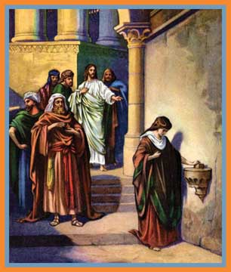
March Bible Study
“My Name is
Giver”
by Anita Scott

Slide 2
What is a giver?

Slide 3
What does it
mean to be a
giver?
….money?
….heart?
….soul?
….self?

Slide 4
Sacrificial gifts come from hearts wholly offered to
God.

Slide 5
Date:
Time:
Location:

Slide 6
In partnership with

