Slide 1
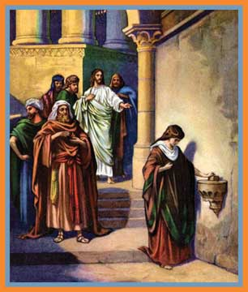
March Bible Study
“My Name is
Giver”
by Anita Scott

Slide 2
What is a
giver?

Slide 3
What does it
mean to be a
giver?
….money?
….heart?
….soul?
….self?

Slide 4
Sacrificial gifts come from hearts wholly offered to
God.

Slide 5
Jesus praised the widow in the temple who gave all her money (two mites) as an offering to God.

Slide 6
Leviticus 27:30
“And all the tithe of the land, whether of the seed of the land, or of the fruit of the tree, is the Lord’s: it is holy unto the Lord.”

Slide 7
Key Thought:
Giving financially acknowledges our gratitude to God, realizing all we possess comes as a gift from His hand.

Slide 8
Key Points:
God instituted the tithe.
He does not require…or even ask us to give all we have.

Slide 9
We should give
cheerfully.
(2 Corinthians 9:7)

Slide 10
Giving to God is a wonderful privilege and blessing.

Slide 11
By helping those in need, we help open a God-door within their hearts.

Slide 12
Exploration:
In what ways do you give of your money? self?

Slide 13
Interaction:
Is tithing outdated?
Why?
Why not?

Slide 14
Revelation 3:20
Behold I stand at the door and knock: if any man hear my voice, and open the door, I will come in to him, and will sup with him, and he with me.

Slide 15
Key Thought:
True giving begins as we believe in our hearts that Christ died and arose for us, and we accept Christ’s ultimate gift of salvation.

Slide 16
Key Points:
God hates lukewarmness.
God provides only one plan of salvation.

Slide 17
Sacrificial gifts come from hearts wholly surrendered to God.

Slide 18
Exploration:
How would you rate your “richness” in relation to your heart giving?

Slide 19
Interaction:
Do finances play into or determine the portion of your heart that is given to God?

Slide 20
Luke 6:38
Give, and it shall be given unto you; good measure, pressed down, and shaken together, and running over, shall men give into your bosom. For with the same measure that ye mete withal it shall be measured to you again.

Slide 21
Key Thought:
Giving to others
is a natural
by-product of
our love and service to God.

Slide 22
Key Points:
Are you “souled” out to God? His service?
We are called to do His work……feed His sheep.

Slide 23
Resist a judgmental spirit.
James 1:27
Put words into action.

Slide 24
2 Corinthians 8:5
And this they did, not as we hoped, but first gave their own selves to the Lord, and unto us by the will of God.

Slide 25
Key Thought:
In light of all God has given us, we should follow His example and willingly give of ourselves.

Slide 26
Key Points:
Do you ever get “tired” of giving?
God gives all the time. We are takers.

Slide 27
God fills us up so we can give to others.

Slide 28
Exploration:
Which biblical character(s) gave of himself or herself to others?

Slide 29
Interaction:
Each congregation or women’s group has a personality. How is your church or women’s group perceived?
Givers?
Takers?

Slide 30
Make Me a Servant
humble and meek.
Lord, let me lift up those
who are weak.
And may the prayer of my
heart always be:
Make me a servant today.
--Kelly Willard

