Slide 1
April Bible Study by Tammy Miller

Slide 2
Matthew 26:10:
When Jesus understood it, he said unto them, Why trouble ye the woman? For she hath wrought a good work upon me.

Slide 3
Jesus praised Mary of Bethany for her worshipful actions. Good work for God requires a deep love for the Savior.

Slide 4
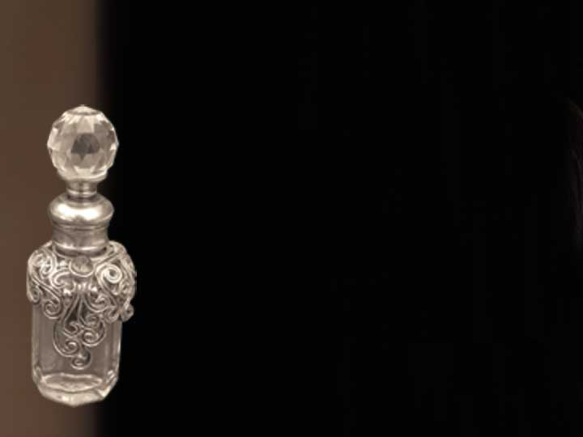
What work had she done?

Slide 5
The work that especially pleased the Lord and garnered His praise involved Mary’s love.

Slide 6
EExploration:
What was the good work Mary did for Jesus?

Slide 7
Interaction:
What types of “good work” might be misunderstood by Christ followers today?

Slide 8
Reflection:
Marvel in the thought that the Most High God desires our worship and love.

Slide 9
Mark 14:8:
She hath done what she could; she is come aforehand to anoint my body to the burying.

Slide 10
Jesus praised Mary for her worshipful attitude. Devotion to Christ should propel us to do all we can to give honor and service to God.

Slide 11
Mary’s devotion placed her often at the feet of Jesus.

Slide 12
Mary had a heart for God, a heart that loved. And a heart that loves, gives.

Slide 13
Mary’s exorbitant offering, bestowed in abundance, made her giving seem outrageous.

Slide 14
Exploration:
Would it have mattered to Jesus if she had given something that cost half as much?

Slide 15
Interaction:
What might such a gift look like in today’s world?

Slide 16
Reflection:
Worship your Lord with a fragrant offering of praise.

Slide 17
Matthew 26:12
For in that she hath poured this ointment on my body, she did it for my burial.

Slide 18
Jesus praised Mary for her worshipful intent. Our intent in worship should be to glorify God.

Slide 19
Mary recognized her Lord as Divine. She saw His kingship and sought to properly worship Him.

Slide 20
Mary anointed the King with costly oil because He was going to die.

Slide 21
When the ladies arrived at the tomb to anoint the body of Jesus, a glorious surprise awaited them. He had risen. Mary had already anointed His body for the burial.

Slide 22
Exploration:
Why was it necessary that Jesus be anointed for burial before He had even died?

Slide 23
Interaction:
What ministries or acts of worship today might be interpreted as wasteful or unnecessary?

Slide 24
Reflection:
Just as Mary wiped the feet of her Savior for burial, our Risen Lord will one day wipe away all tears as death will be no more.

Slide 25
Mark 14:9
Verily I say unto you, Wheresoever this gospel shall be preached in the whole world, this also that she hath done shall be spoken of for a memorial of her.

Slide 26
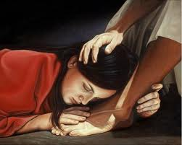
Jesus’ praise for Mary’s worshipful expression has endured for all time.

Slide 27
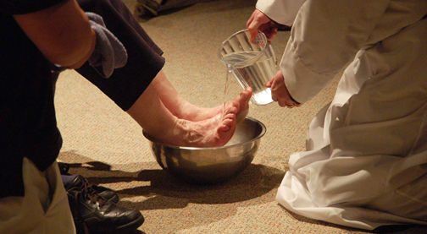
Valuable, memorable worship is motivated by one’s love for Christ.

Slide 28
Mary unintentionally made a name for herself that day. It came as a result of her unselfish attitude.

Slide 29
The Wise Men of the East came from afar bearing gifts fit for a King and fell down in worship.

Slide 30
Exploration:
When and why does Jesus want us to remember Mary?

Slide 31
Interaction:
Name women in your church who are known (or remembered) for their loving devotion and acts of worship.

Slide 32
Reflection:
Our finite minds can grasp Jesus’ words that Mary would always be remembered. Yet, God’s eternality goes far beyond our ability to comprehend.

Slide 33
No one but He could see the secret behind the tears she dried with her locks. For it was not in the oil, but in the love that flowed from that alabaster box.
--Tracey Brown

