Slide 1
April Bible Study by Tammy Miller

Slide 2
Matthew 26:10:
When Jesus understood it, he said unto them, Why trouble ye the woman? For she hath wrought a good work upon me.

Slide 3
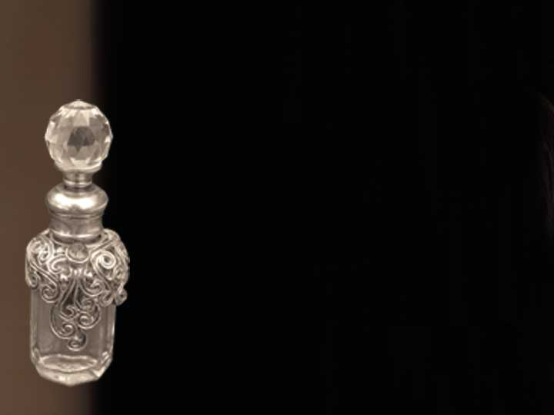
Jesus praised Mary of Bethany for her worshipful actions. Good work for God requires a deep love for the Savior.

Slide 4
Mark 14:8:
She hath done what she could; she is come aforehand to anoint my body to the burying.

Slide 5
Jesus praised Mary for her worshipful attitude.

Slide 6
Matthew 26:12
For in that she hath poured this ointment on my body, she did it for my burial.

Slide 7
Jesus praised Mary for her worshipful intent. Our intent in worship should be to glorify God.

Slide 8
Jesus’ praise for Mary’s worshipful expression would endure for all time.

Slide 9
Is our attitude worshipful? Does it honor Jesus?

