Slide 1
April Bible Study by Tammy Miller

Slide 2
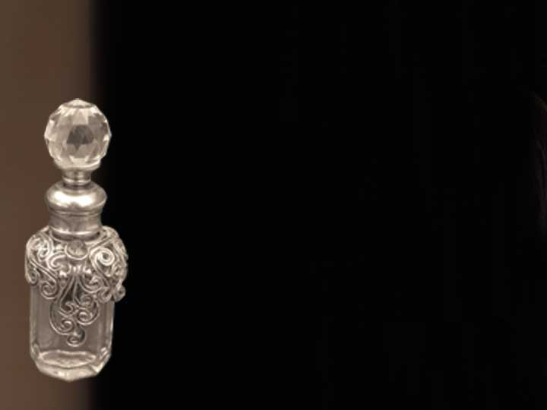
Jesus praised Mary of Bethany for her worshipful actions.

Slide 3
Jesus praised Mary for her worshipful attitude.

Slide 4
Jesus praised Mary for her worshipful intent.

Slide 5
Jesus’ praise for Mary’s worshipful expression would endure for all time.

Slide 6
Date:
Time:
Location:

Slide 7
In partnership
with….

