Slide 1
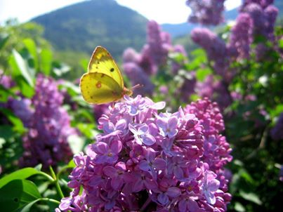
Treasure Fall Series Study
“Women Jesus Healed”

Slide 2
“My Name is Liberty”
By Carol Reid

Slide 3
Date: Place: Time:

