Slide 1
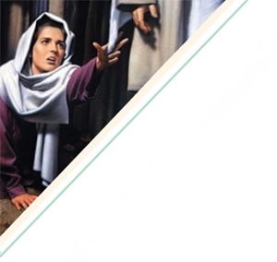
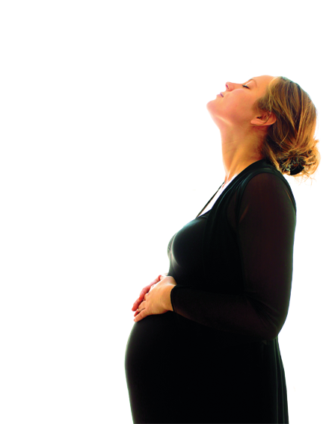
“My Name
Is Complete”
By Dana Copeland

Slide 2
“My Name is Complete”
“And a woman having an issue of blood twelve years, which had spent all her living upon physicians, neither could be healed of any, came behind him, and touched the border of his garment: and immediately her issue of blood stanched” (Luke 8: 43-44).

Slide 3
“My Name is Complete”
The Woman – Who was she?
A Daughter
A Mother
A Believer
Each

Slide 4
“My Name is Complete”
The Setting
Key Verse: “And it came to pass, that, when Jesus was returned, the people gladly received him: for they were all waiting for him” (Luke 8:40).
“Let us therefore come boldly unto the throne of grace, that we may obtain mercy, and find grace to help in time of need” (Hebrews 4:16).
Key Thought: Desperate situations demand desperate measures; Christ offers us wholeness and healing when we boldly approach Him with our needs.

Slide 5
“My Name is Complete”
The Setting
Jesus teaching
Demon-possessed man
Ruler of the synagogue
An unclean woman

Slide 6
“My Name is Complete”
Have you reached for the hem of His garment?
Are you willing to pray and even accept a current trial as God’s will? I’ve done this. No immediate answers came but a deep peace, a quieting in my spirit developed. After time, when the trials passed, I looked back and saw how my condition and life situation began to improve after I prayed and accepted this as His will for that season in my life.

Slide 7
He Knows My Name
Introduction: Read Job 3:24-26; Habakkuk 1:1-2; 2:1.
Exploration: Have you ever been desperate for an answer? Healing? Deliverance? Write at least one instance that comes to mind.

Slide 8
He Knows My Name
Whom did you seek for help with your problem? Doctors? Counselors? Friends?
Were you shunned during this time?
Did your family become frustrated with you as you sought answers?
Were you tempted to give up or did you struggle with despair?
God’s prophet Habbakuk faced similar moments. His desperation led him to cry out to God. In Habakkuk 1:2, what did he ask God?
Later in Habakkuk 2:1, what did he determine to do?

Slide 9
He Knows My Name
Job had many advisors during his time of trials. His wife even told him to curse God and die.
Even when healing and answers did not come immediately, he continued to trust his Redeemer.
Will you?

Slide 10
He Knows My Name
Interaction: The woman with the issue of blood was not welcomed into worship due to her uncleanness. What situations or conditions are treated similarly in the church today? How should we react when we see people shunned or excluded from worship in our churches?
Reflection: What two phrases does Jesus use to describe “Liberty” in Luke 13:16?
How does Luke describe her infirmity in Luke 13:11?

Slide 11
“My Name is Complete”
The Response
Key Verse: “But the woman fearing and trembling, knowing what was done in her, came and fell down before him, and told him all the truth” (Mark 5:33).
“Confess your faults one to another, and pray one for another, that ye may be healed. The effectual fervent prayer of a righteous man availeth much” (James 5:16).
Key Thought: Confession is a vital part of healing.

Slide 12
“My Name is Complete”
The Response
“Who touched me?”
Power was released
Confession
Response

Slide 13
“My Name is Complete”
Why do some receive instant healing while others do not?
Sin keeps many from reaching out to God for healing. Others reach out, but God delays healing in order to accomplish His purposes.

Slide 14
He Knows My Name
Introduction: Read Mark 5:25-34; 2 Corinthians 12:7-10; 1 Timothy 2:1.
Exploration: We know this woman followed the Jewish faith, because she was declared unclean by the Law. Do you think she came hoping for a cure from a miracle worker, or did she know and believe in Jesus as God?
Mark 5:34 records that Jesus told her to be made whole (be freed of her affliction). What made her free? Was it the garment? The compassion of Jesus? Or her faith?

Slide 15
He Knows My Name
Mark also says she “told Him all the truth.” One definition for confess is “to own or admit as true.” Look up these verses concerning confession. How might each be associated with healing?
James 5:16
Romans 10:9,10
Acts 19:17-19
Romans 14:10-12
Look again at these verses and circle any that mention fear.

Slide 16
He Knows My Name
How much of a role did fear play in this woman’s response? Did she fear the crowd? Was her fear toward Jesus a healthy fear?
Have you ever made a bold move toward God and then found yourself fearful? Did you find reassurance? How?

Slide 17
He Knows My Name
Interaction: Can the lost cry out for divine help during suffering? Will God divinely deliver or heal those outside the faith? Or is it the Body of Christ interceding that moves the hand of God?
Reflection: Praise El Emut (the God of Truth), found in Psalm 31:5.
Reflect upon ways God’s truth (and your confession of that truth) has brought healing in your life.

Slide 18
“My Name is Complete”
The Word
Key Verse: “And he said unto her, Daughter, be of good comfort: thy faith hath made thee whole; go in peace” (Luke 8:48).
Key Thought: Healing comes through faith in believing the Word of God.

Slide 19
“My Name is Complete”
The Word
Jesus’ words
Acceptance
Assurance
Are the same for us

Slide 20
“My Name is Complete”
Have you experienced healing
through the Word?
Soon after our ladies’ Sunday school class began a study entitled “Lord Change Me by Evelyn Christensen”, I wrote in my journal a deep cry for the Lord to change me. A few days later, He started me on a journey to remove the scab of many festering wounds.
Will you allow God’s Word to be the healing balm for your soul?

Slide 21
He Knows My Name
Introduction: Read Proverbs 3:1-12
Exploration: According to Proverbs 3, why is our understanding not dependable?
What does Proverbs 3:8 say will happen if we follow these verses?
How would you describe your daily time in the Word?

Slide 22
He Knows My Name
Look up these Bible passages that speak of healing by the Word. Write down any thoughts or insights.
Psalm 107:20
Matthew 8:16
Luke 7:7
2 Timothy 3:16-17 describes the value of the Word in our lives. In what ways is it profitable to us?
According to this verse, what is the Word’s ultimate purpose? (Perfect here means complete.)

Slide 23
He Knows My Name
Interaction: Why is it often so easy to believe everything else over the Scriptures? Is God’s Word an integral part of our worship services? Our family interactions? Our personal life?
Reflection: Celebrate these names for God: Logos, Eternal Word. Grab a hymnal or Google “Word of God song lyrics” and spend time singing praise to the Word for His written Word.

Slide 24
“My Name is Complete”
The Plan
Key Verse: “…Fear not: for I have redeemed thee, I have called thee by thy name; thou art mine. When thou passest through the waters, I will be with thee; and through the rivers, they shall not overflow thee: when thou walkest through the fire, thou shalt not be burned; neither shall the flame kindle upon thee” (Isaiah 43:1-2).
Key Thought: We can trust God’s sovereign plan for healing in our lives.

Slide 25
“My Name is Complete”
The Plan
A woman hurting became a woman healed.
Song writer
Woman in Jail
Godly woman with cancer
About the writer
A step toward the Savior

Slide 26
“My Name is Complete”
So what’s the plan? Recognize God is in control (Psalm 31:10).
Rest knowing healing comes in time (Psalm 31:10; 37:7).
Renounce fear (Psalm 34:4; 1 Timothy 1:7).
Believe in the Word. Don’t trust your emotions.
Seek godly counselors to hold you accountable.
Don’t harbor sin—confess. Pray; ask others to pray.
Share God’s work in your life.

Slide 27
He Knows My Name
Introduction: Read James 1:3-4; Job 1.
Exploration: According to James 1:3-4, why should we count it all joy when we fall into diverse temptations?
The Book of Job gives us a picture of ultimate suffering and a glimpse into the unseen battle in the Heavenlies.
Reading Chapter 1, do you think all suffering and times of testing come from Satan? Why or why not?

Slide 28
He Knows My Name
What encouragement do we find in Isaiah 43:1-2?
Read Isaiah 54:16-17. What did God create?
Do you know God well enough to trust Him?

Slide 29
He Knows My Name
Interaction: One way to better know God (and learn to trust Him) is to focus on His character and His attributes. List and/or share as many attributes or character qualities of God as you can name.
Reflection: Worship Immanuel (God with us). Rejoice that the same God who created us and redeemed us and called us by name promises to be with us throughout our journey to healing and wholeness.

