Slide 1
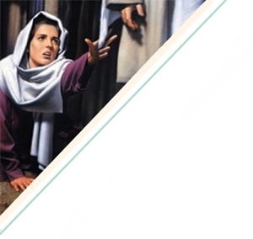
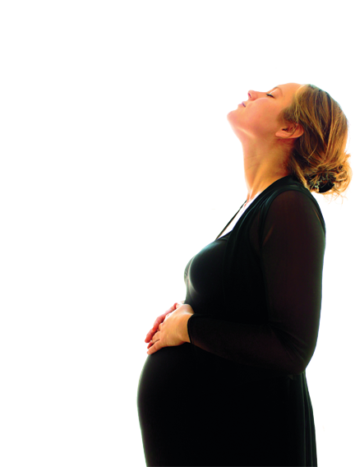
“My Name
Is Complete”
By Dana Copeland

Slide 2
“My Name is Complete”
“And a woman having an issue of blood twelve years, which had spent all her living upon physicians, neither could be healed of any, came behind him, and touched the border of his garment: and immediately her issue of blood stanched” (Luke 8: 43-44).

Slide 3
“My Name is Complete”
The Woman – Who was she?
A Daughter
A Mother
A Believer
Each

Slide 4
“My Name is Complete”
The Setting
Key Verse: “And it came to pass, that, when Jesus was returned, the people gladly received him: for they were all waiting for him” (Luke 8:40).
“Let us therefore come boldly unto the throne of grace, that we may obtain mercy, and find grace to help in time of need” (Hebrews 4:16).
Key Thought: Desperate situations demand desperate measures; Christ offers us wholeness and healing when we boldly approach Him with our needs.

Slide 5
“My Name is Complete”
Jesus teaching
Demon-possessed man
Ruler of the synagogue
An unclean woman

Slide 6
“My Name is Complete”
Have you reached for the hem of His garment?
Are you willing to pray and even accept a current trial as God’s will? I’ve done this. No immediate answers came but a deep peace, a quieting in my spirit developed. After time, when the trials passed, I looked back and saw how my condition and life situation began to improve after I prayed and accepted this as His will for that season in my life.

Slide 7
“My Name is Complete”
The Response
Key Verse: “But the woman fearing and trembling, knowing what was done in her, came and fell down before him, and told him all the truth” (Mark 5:33).
“Confess your faults one to another, and pray one for another, that ye may be healed. The effectual fervent prayer of a righteous man availeth much” (James 5:16).
Key Thought: Confession is a vital part of healing.

Slide 8
“My Name is Complete”
“Who touched me?”
Power was released
Confession
Response

Slide 9
“My Name is Complete”
Why do some receive instant healing while others do not?
Sin keeps many from reaching out to God for healing. Others reach out, but God delays healing in order to accomplish His purposes.

Slide 10
“My Name is Complete”
The Word
Key Verse: “And he said unto her, Daughter, be of good comfort: thy faith hath made thee whole; go in peace” (Luke 8:48).
Key Thought: Healing comes through faith in believing the Word of God.

Slide 11
“My Name is Complete”
Jesus’ words
Acceptance
Assurance
Are the same for us

Slide 12
“My Name is Complete”
Have you experienced healing
through the Word?
Soon after our ladies’ Sunday school class began a study entitled “Lord Change Me by Evelyn Christensen”, I wrote in my journal a deep cry for the Lord to change me. A few days later, He started me on a journey to remove the scab of many festering wounds.
Will you allow God’s Word to be the healing balm for your soul?

Slide 13
“My Name is Complete”
The Plan
Key Verse: “…Fear not: for I have redeemed thee, I have called thee by thy name; thou art mine. When thou passest through the waters, I will be with thee; and through the rivers, they shall not overflow thee: when thou walkest through the fire, thou shalt not be burned; neither shall the flame kindle upon thee” (Isaiah 43:1-2).
Key Thought: We can trust God’s sovereign plan for healing in our lives.

Slide 14
“My Name is Complete”
A woman hurting became a woman healed.
Song writer
Woman in Jail
Godly woman with cancer
About the writer
A step toward the Savior

Slide 15
“My Name is Complete”
So what’s the plan? Recognize God is in control (Psalm 31:10).
Rest knowing healing comes in time (Psalm 31:10; 37:7).
Renounce fear (Psalm 34:4; 1 Timothy 1:7).
Believe in the Word. Don’t trust your emotions.
Seek godly counselors to hold you accountable.
Don’t harbor sin—confess. Pray; ask others to pray.
Share God’s work in your life.

