Slide 1
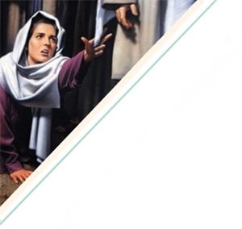
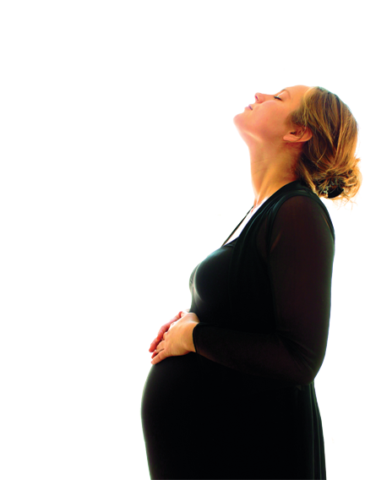
A woman hurting
becomes
A woman healed.

Slide 2
“My Name is Complete”
Women Active for Christ
Time:
Place:

