Slide 1
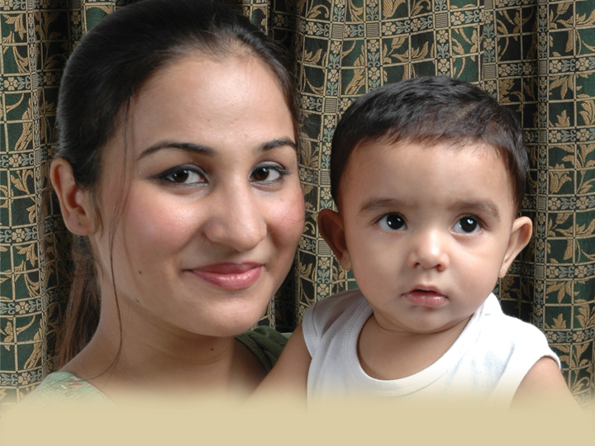
My Name is Favor by Emily Frady
December Study

Slide 2
My Name is Favor
A will to surrender
Key Verse: “ And Mary said, Behold the handmaid of the Lord; be it unto me according to thy word. And the angel departed from her” (Luke 1:38).
Key Thought: God entrusts us with His work as we surrender our wills and lives to His control.

Slide 3
My Name is Favor
A will to surrender
God showed Mary favor
Mary had to surrender herself
Mary’s decision left her open to imminent danger
God entrusted her with an extremely important task

Slide 4
My Name is Favor
A will to surrender
Introduction: Read Luke 1:38; James 4:7; James 4:10; Matthew 11:29; 1 Corinthians 6:19-20.
Exploration: According to James 4:7 and 4:10, what promises can we claim in submitting to God?

Slide 5
My Name is Favor
A will to surrender
We live in a culture that screams, “Do what you want! It’s your body.” What does 1 Corinthians 6:19-20 say about that mindset?
How can we practically surrender even our bodies to God?

Slide 6
My Name is Favor
A heart of humility
Key Verse: “And Mary said, My soul doth magnify the Lord, and my spirit hath rejoiced in God my Saviour. For he hath regarded the low estate of his handmaiden: for, behold, from henceforth all generations shall call me blessed” (Luke 1:46-48).

Slide 7
My Name is Favor
A heart of humility
Key Thought: As we humble our hearts before the Lord, He entrusts us with the display of His splendor and beauty to a watching world.

Slide 8
My Name is Favor
A heart of humility
Mary’s family tree
Mary’s song
Mary’s familiarity with the Word
Mary’s humility
Mary’s heart

Slide 9
My Name is Favor
the son as savior
Key Verse: “His mother saith unto the servants, Whatsoever he saith unto you, do it” (John 2:5).
Key Thought: As we, in faith, acknowledge the Son as our Savior, He entrusts us with eternal life and extends to us His favor.

Slide 10
My Name is Favor
the son as savior
Mary becoming a parent
Jesus the son
Jesus the Savior

Slide 11
My Name is Favor
Blessed through obedience
Key Verse: “ For whosoever shall do the will of my Father which is in heaven, the same is my brother, and sister, and mother” (Matthew 12:50).
Key Thought: As we follow Christ through obedience, He counts us as family and entrusts us with blessings.

Slide 12
My Name is Favor
Blessed through obedience
Mary was blessed
We are blessed
Mary had the privilege
We know the same privileges

