Slide 1
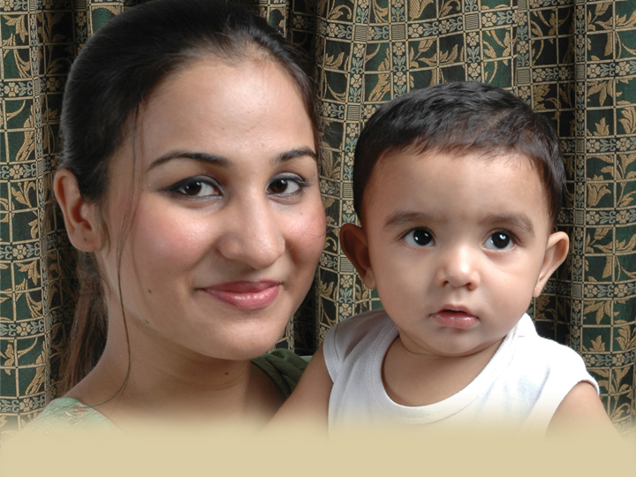
My Name is Favor by Emily Frady
December Study

Slide 2
Women Active for
Christ
(add your details here as needed)
Date:
Time:

