Slide 1
HUMILITY

Slide 2
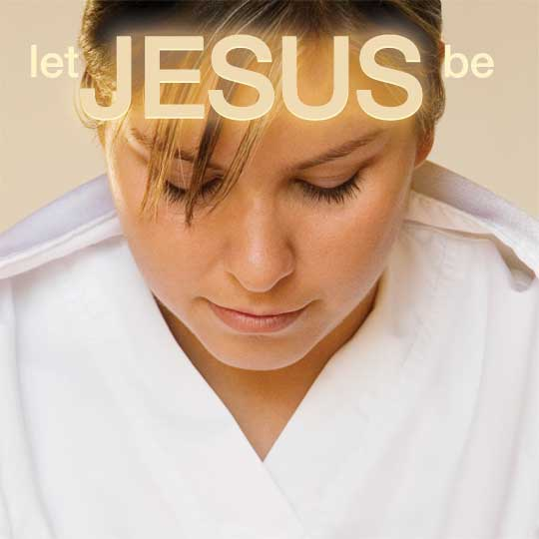
LORD
KING
WORSHIPED
SUPREME
HONORED
RULER
GLORIFIED
GREATEST
HIGHEST
ALL

Slide 3
(Insert your meeting information here)

Slide 4
