Slide 1
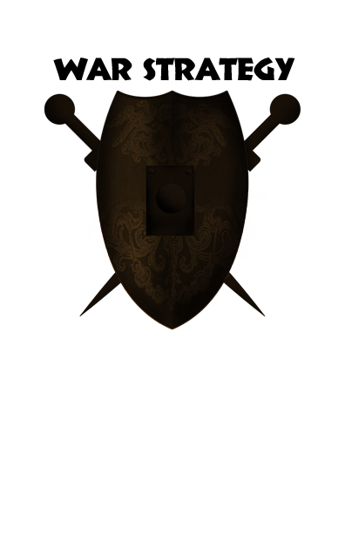
May Study
By Lynette Morgan

Slide 2
“Christians can become preoccupied with battling Satan…fighting battles that Christ has already won. If Satan can diverge you to wage a warfare that has already ended in surrender, he will have eliminated your effectiveness where God wants you.”

Slide 3
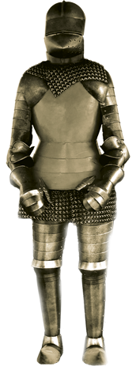
WAR STRATEGY
Our Armor
HANDPRINT: Understanding and utilizing each piece of the armor of God will help protect us from the Enemy’s attacks.
HANDWRITING ON THE HEART (to be memorized): “Therefore take up the whole armor of God, that you may be able to withstand in the evil day, and having done all, to stand” (Ephesians 6:13—and on through verse 17 if you’re willing to accept the challenge).

Slide 4
WAR STRATEGY Our Armor
God has provided all we need to protect ourselves and be victorious
Truth
Righteousness
Peace

Slide 5
WAR STRATEGY Our Armor
FROM HIS HAND: Read the following verses which describe the Christian’s armor. Then answer the next questions.
John 8:32 Revelation 3:7 Ephesians 4:24
Titus 3:5 Ephesians 2:14 John 14:27
TRACE HIS HAND: Which piece of armor does each of the above passages describe?

Slide 6
WAR STRATEGY Our Armor
Imagine yourself putting on these three pieces of armor. Beside each one, write a possible attack of the devil in which you would need this kind of protection.
Belt of Truth:
Breastplate of Righteousness:
Shoes of Peace:
How does Paul describe himself in 2 Corinthians 6:7? Can you say the same?
Has the Enemy ever tried to steal your peace? In what ways? Which verses can you claim?

Slide 7
WAR STRATEGY Our Armor
LEND A HAND:
—How do we go about daily “putting on” these pieces of armor?*
—Which one is hardest for you to keep on?
LIFT YOUR HANDS: Pray fervently and earnestly for God’s supernatural protection in the midst of this invisible war.
TOUCHPOINT: Starting the day without putting on God’s armor is like leaving the house undressed.

Slide 8
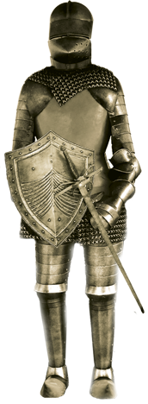
WAR STRATEGY
Our Armor
HANDPRINT: Understanding and utilizing each piece of the armor of God will help protect us from the Enemy’s attacks.
HANDWRITING ON THE HEART: “For though we walk in the flesh, we do not war according to the flesh. For the weapons of our warfare are not carnal, but mighty in God for pulling down strongholds, casting down arguments and every high thing that exalts itself against the knowledge of God, bringing every thought into captivity to the obedience of Christ” (2 Cor.10:3,4).

Slide 9
WAR STRATEGY Our Armor
We “put on” the first three pieces of armor and wear them at all times to protect our vital parts.
Faith
Salvation
God’s Word

Slide 10
WAR STRATEGY Our Armor
FROM HIS HAND: Read the following verses: Romans 13:11-14; 1 Corinthians 2:16; 2 Corinthians 11:3; Philippians 2:5; 2 Timothy 2:4.
TRACE HIS HAND: In 1 Corinthians 2:16, Paul makes a powerful statement that should challenge us to do a personal evaluation. What is the claim, and how is this possible?

Slide 11
WAR STRATEGY Our Armor
In Romans 13:11-14, what is the “armor of light” as opposed to the “works of darkness”? How do you think we as believers are “asleep”?
How can we apply verse 14? (If the sins listed in verse 13 are not temptations for you, replace them with struggles you face.) What correlation do these verses have with the plan of Satan?

Slide 12
WAR STRATEGY Our Armor
Write out your definition of faith. Why do you think Paul associates it with a shield rather than any other piece of armor?
What fiery dart does the Enemy use most often against your mind? Since the mind is the battlefield, how can we keep it from being corrupted? (See Philippians 2:5.)
What did Paul mean in 2 Corinthians 11:3? How can we protect against this happening?

Slide 13
WAR STRATEGY
Praying Always, Being Watchful
HANDPRINT: The powerful weapon of prayer is an absolute necessity in spiritual warfare.
HANDWRITING ON THE HEART: “…Praying always with all prayer and supplication in the Spirit, being watchful to this end with all perseverance and supplication for all saints….” (Ephesians 6:18).

Slide 14
WAR STRATEGY Our Armor
Pray…pray…pray
Prayer brings down the strongholds.
The Lord Himself, prayed for us
As we pray, we acknowledge our total weakness

Slide 15
WAR STRATEGY Our Armor
FROM HIS HAND: Read James 5:16b; John 14:13; Luke 18:1.
TRACE HIS HAND: Ephesians 6:18 says to pray for all the saints. Name the petitions we can make for the “saints” found in these passages:
• Ephesians 1:17
• Ephesians 3:17-19
• Ephesians 4:1
• Ephesians 4:18
• Ephesians 4:32
• Ephesians 5:10
• Ephesians 5:15,16
• Ephesians 6:11

Slide 16
WAR STRATEGY Our Armor
What kind of prayer does God require of us? (James 5:16-18; I Kings 18:41-45; Deuteronomy 4:29; 6:5.)
What promise do we find in John 14:13?
Christ Himself taught a lesson on prayer in a parable (Luke 18: 1-8). What is He telling us to do (18:1)? How does the parable emphasize this?

Slide 17
WAR STRATEGY Our Armor
LEND A HAND:
—Spending time in prayer is not easy. What tactics does the Enemy use to prevent you from praying?
LIFT YOUR HANDS: Decide how much time you think the Lord would have you devote daily in prayer. Then ask the Lord to help you spend this time in your prayer closet.
TOUCHPOINT: “Prayer is not a preparation for the battle; it is the battle!” —Leonard Ravenhill

Slide 18
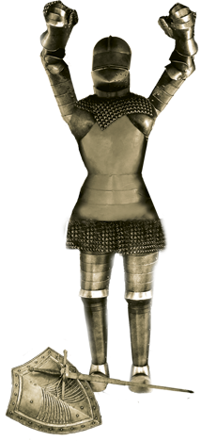
WAR STRATEGY
Our Victory
HANDPRINT: We can claim the victory Christ has promised.
HANDWRITING ON THE HEART: “For whatever is born of God overcometh the world; and this is the victory that overcometh the world, even our faith” (1 John 5:4,5).

Slide 19
WAR STRATEGY Our Armor
We must acknowledge our enemy and the battle
Our victory rests in what Christ offers us: His might.
Satan will not give up the fight
Final victory
Almighty God
Ours

Slide 20
WAR STRATEGY Our Armor
FROM HIS HAND: Read Ephesians 3:16; Zechariah 4:6b; Hebrews 2:14-18; 2 Chronicles 20:15; Ephesians 6:10; I Corinthians 1:8.
TRACE HIS HAND: Where are we to be strengthened for victory? (Ephesians 3:16) From where does this strength come?
Ultimately, who is the source of victory? (Zechariah 4:6b; 2 Chronicles 20:15).

Slide 21
WAR STRATEGY Our Armor
Read and study Hebrews 2:14-18. How is our Captain all-sufficient?
Ephesians 6:10 reads: “Be strong in the Lord and in the power of His might.” Let’s dissect the first part, noting what each phrase says to us:
Be strong (as opposed to what the devil tells us to be):
In (How can we be “in”?):
The Lord (of all His names, why this one?):

Slide 22
WAR STRATEGY Our Armor
What is the powerful promise given us in 1 Corinthians 1:8?
Describe the ultimate end to our life-long enemy prophesied in Revelation 19:17-21; 20:10. Then praise the Lord!

Slide 23
WAR STRATEGY Our Armor
LEND A HAND:
—Thinking about Heaven, what do you look forward to most?
—What truths has this study on spiritual warfare revealed or brought home to you? What will you do with these truths?
—What should the church be teaching about spiritual warfare? Is your church doing this?
LIFT YOUR HANDS: Father, we thank You that the battle is not ours, but Yours….that the victory is already assured. May we daily claim the victory and defeat Satan by Your power. Amen.
TOUCHPOINT: “Fearing Satan is fearing a prisoner of war. You have no need or calling to defeat Satan; you need only to apply Christ’s victory in every area of your life...” —Henry Blackaby

